Slide 1


Slide 2
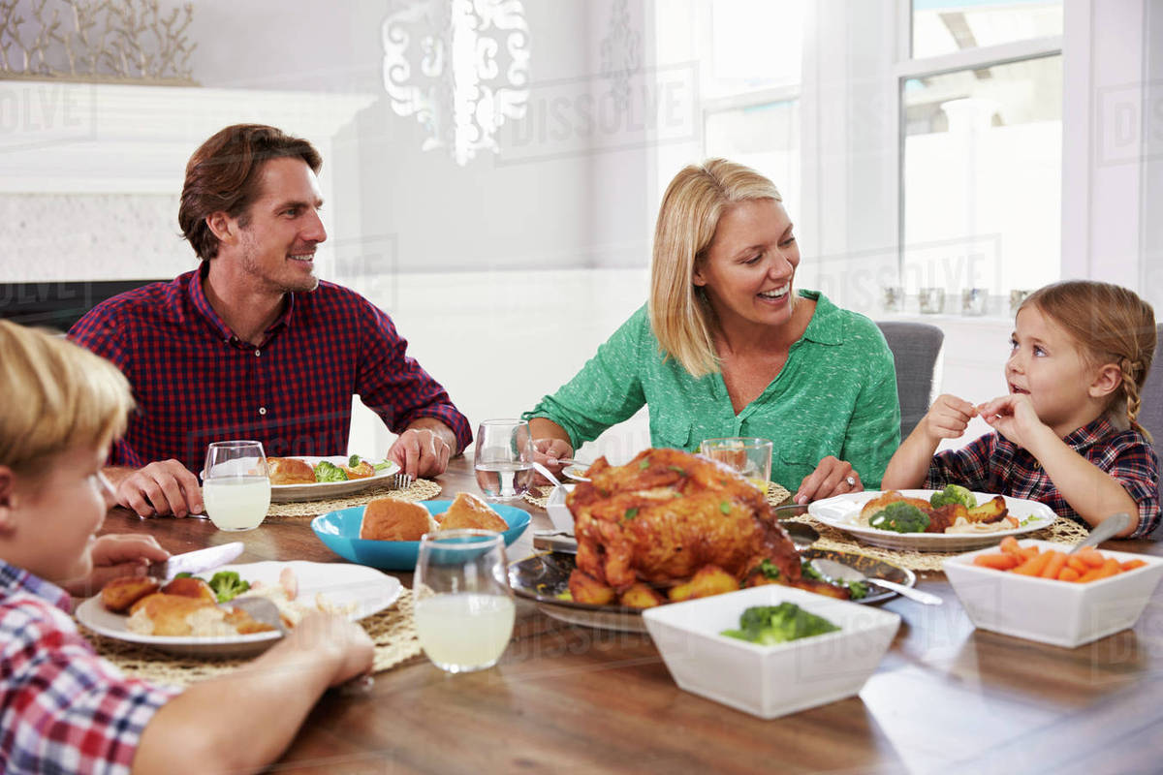

Slide 3
1 Corinthians 11:17
Now in giving these instructions I do not praise you, since you come together not for the better but for the worse.

Slide 4
1 Corinthians 11:18
For first of all, when you come together as a church, I hear that there are divisions among you, and in part I believe it.

Slide 5

The church body must not be DYSFUNCTIONAL.

Slide 6
1 Corinthians 11:19
For there must also be factions among you, that those who are approved may be recognized among you.

Slide 7
1 Corinthians 9:27
But I discipline my body and bring it into subjection, lest, when I have preached to others, I myself should become disqualified.

Slide 8
Luke 17:1
Then He said to the disciples, “It is impossible that no offenses should come, but woe to him through whom they do come!

Slide 9
1 Corinthians 11:20
Therefore when you come together in one place, it is not to eat the Lord’s Supper.

Slide 10
1 Corinthians 11:21
For in eating, each one takes his own supper ahead of others; and one is hungry and another is drunk.

Slide 11
We must be very careful not to be an OFFENSE to the church.

Slide 12
1 Corinthians 10:32
Give no offense, either to the Jews or to the Greeks or to the church of God,

Slide 13
1 Corinthians 11:22
What! Do you not have houses to eat and drink in? Or do you despise the church of God and shame those who have nothing? What shall I say to you? Shall I praise you in this? I do not praise you.

Slide 14
Communion is a MEMORIAL and proclaims a PROMISE.

Slide 15
1 Corinthians 11:23
For I received from the Lord that which I also delivered to you: that the Lord Jesus on the same night in which He was betrayed took bread;

Slide 16
1 Corinthians 11:24
and when He had given thanks, He broke it and said, “Take, eat; this is My body which is broken for you; do this in remembrance of Me.”

Slide 17
1 Corinthians 11:25
In the same manner He also took the cup after supper, saying, “This cup is the new covenant in My blood. This do, as often as you drink it, in remembrance of Me.”

Slide 18
1 Corinthians 11:26
For as often as you eat this bread and drink this cup, you proclaim the Lord’s death till
He comes.

Slide 19
Self evaluation is a MUST.

Slide 20
1 Corinthians 11:27
Therefore whoever eats this bread or drinks this cup of the Lord in an unworthy manner will be guilty of the body and blood of the Lord.

Slide 21
1 Corinthians 11:28
But let a man examine himself, and so let him eat of the bread and drink of the cup.

Slide 22
1 Corinthians 11:29
For he who eats and drinks in an unworthy manner eats and drinks judgment to himself, not discerning the Lord’s body.

Slide 23
1 Corinthians 11:30
For this reason many are weak and sick among you, and many sleep.

Slide 24
1 Corinthians 11:31
For if we would judge ourselves, we would not be judged.

Slide 25
The Lord CHASTENS those who take communion unworthily.

Slide 26
1 Corinthians 11:32
But when we are judged, we are chastened by the Lord, that we may not be condemned with the world.

Slide 27
Revelation 3:19
As many as I love, I rebuke and chasten. Therefore be zealous and repent.

Slide 28
Communion is observed
to EDIFY.

Slide 29
1 Corinthians 11:33
Therefore, my brethren, when you come together to eat, wait for one another.

Slide 30
1 Corinthians 11:34
But if anyone is hungry, let him eat at home, lest you come together for judgment. And the rest I will set in order when I come.

