Slide 1


Slide 2
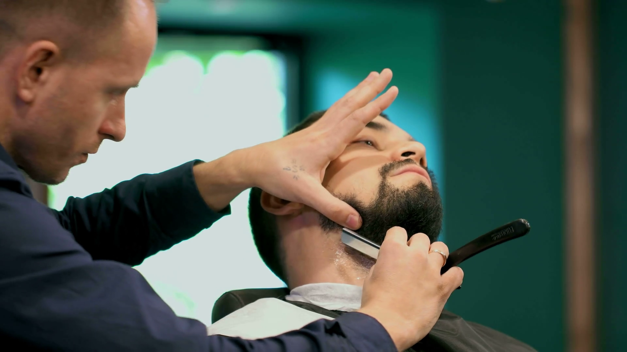

Slide 3

Real revival is the work of the HOLY SPIRIT.

Slide 4

Habakkuk 3:2
O Lord, I have heard Your speech and was afraid; O Lord, revive Your work in the midst of the years! In the midst of the years make it known; In wrath remember mercy.

Slide 5
Revival will only happen
when we recognize
our NEED.

Slide 6
Revival will never come if we are CONTENT.

Slide 7
We must admit our true spiritual CONDITION.

Slide 8
Psalm 139:23
Search me, O God, and know my heart; Try me, and know my anxieties;

Slide 9
Psalm 139:24
And see if there is any wicked way in me, And lead me in the way everlasting.

Slide 10
Revival will come when we have TRUE confession.

Slide 11
Psalm 51:10
Create in me a clean heart, O God, And renew a steadfast spirit within me.

Slide 12
Psalm 51:11
Do not cast me away from Your presence, And do not take Your Holy Spirit from me.

Slide 13
Psalm 51:12
Restore to me the joy of Your salvation, And uphold me by Your generous Spirit.

Slide 14
Psalm 51:13
Then I will teach transgressors Your ways, And sinners shall be converted to You.

Slide 15
Isaiah 57:15
For thus says the High and Lofty One Who inhabits eternity, whose name is Holy: “I dwell in the high and holy place, With him who has a contrite and humble spirit, To revive the spirit of the humble, And to revive the heart of the contrite ones.

Slide 16
2 Chronicles 7:14
if My people who are called by My name will humble themselves, and pray and seek My face, and turn from their wicked ways, then I will hear from heaven, and will forgive their sin and heal their land.

Slide 17
Jeremiah 29:11
For I know the thoughts that I think toward you, says the Lord, thoughts of peace and not of evil, to give you a future and a hope.

Slide 18
Jeremiah 29:12
Then you will call upon Me and go and pray to Me, and I will listen
to you.

Slide 19
Jeremiah 29:13
And you will seek Me and find Me, when you search for Me with all your heart.

Slide 20
Jeremiah 29:14
I will be found by you, says the Lord, and I will bring you back from your captivity; I will gather you from all the nations and from all the places where I have driven you, says the Lord, and I will bring you to the place from which I cause you to be carried away captive.

Slide 21
Jeremiah 33:3
‘Call to Me, and I will answer you, and show you great and mighty things, which you do not know.’

Slide 22
Revival comes when we are WHERE we need to be.

Slide 23
Hebrews 10:24
And let us consider one another
in order to stir up love and good works,

Slide 24
Hebrews 10:25
not forsaking the assembling of ourselves together, as is the manner of some, but exhorting one another, and so much the more as you see the Day approaching.

