Slide 1
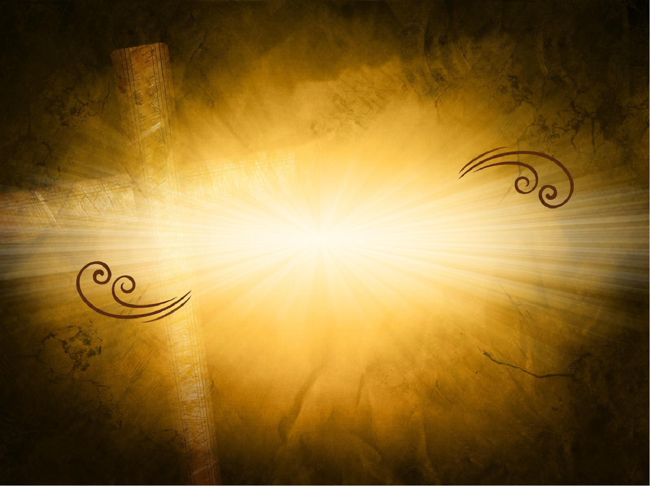
New
Covenant
in the
Church

Slide 2
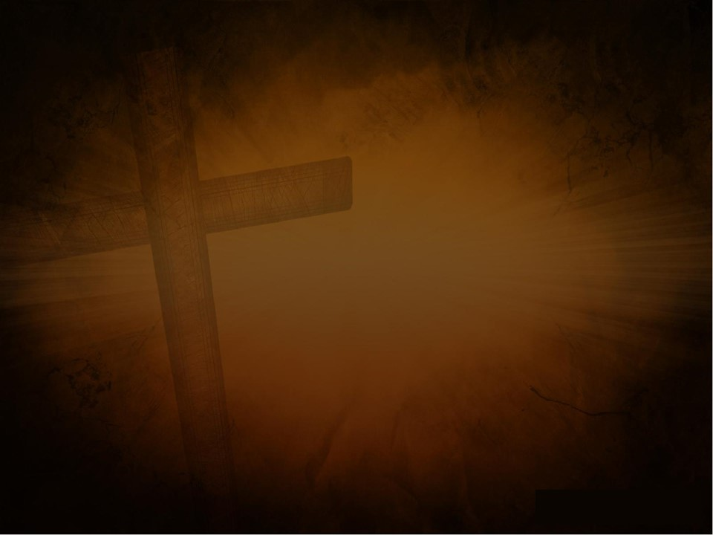
Old Covenant v. New Covenant
Old Covenant:
The law was on stone.
New Covenant:
The law is on our hearts.

Slide 3
Old Covenant v. New Covenant
Old Covenant:
brought conviction
New Covenant:
brings cleansing

Slide 4
Old Covenant v. New Covenant
Old Covenant:
corrupt heart that resists God
New Covenant:
new heart; responsive to God

Slide 5
Old Covenant v. New Covenant
Old Covenant:
gave laws with no power to follow
New Covenant:
gives Holy Spirit Who empowers

Slide 6
In the New Covenant
we have PROMISES
to enjoy.

Slide 7
2 Peter 1:3
as His divine power has given to us all things that pertain to life and godliness, through the knowledge of Him who called us by glory and virtue,

Slide 8
2 Peter 1:4
by which have been given to us exceedingly great and precious promises, that through these you may be partakers of the divine nature, having escaped the corruption that is in the world
through lust.

Slide 9
1 Corinthians 6:14
And God both raised up the Lord and will also raise us up by His power.

Slide 10
1 Corinthians 6:15
Do you not know that your bodies are members of Christ? Shall I then take the members of Christ and make them members of a harlot?
Certainly not!

Slide 11
1 Corinthians 6:16
Or do you not know that he who is joined to a harlot is one body with her? For “the two,” He says, “shall become one flesh.”

Slide 12
1 Corinthians 6:17
But he who is joined to the Lord is one spirit with Him.

Slide 13
In New Covenant relationship with God brings CERTAINTY.

Slide 14
James 1:6
But let him ask in faith, with no doubting, for he who doubts is like a wave of the sea driven and tossed by the wind.

Slide 15
James 1:7
For let not that man suppose that he will receive anything from the Lord;

Slide 16
James 1:8
he is a double-minded man,
unstable in all his ways.

Slide 17
In New Covenant relationship with God we affect EACH OTHER.

Slide 18
1 Peter 2:9
But you are a chosen generation, a royal priesthood, a holy nation, His own special people, that you may proclaim the praises of Him who called you out of darkness into His marvelous light;

Slide 19
1 Peter 2:10
who once were not a people but are now the people of God, who had not obtained mercy but now have obtained mercy.

Slide 20
Acts 2:47
praising God and having favor with all the people. And the Lord added to the church daily those who were being saved.

Slide 21
1 Corinthians 1:18
For the message of the cross is foolishness to those who are perishing, but to us who are being saved it is the power of God.

Slide 22
In New Covenant
we practice two ORDINANCES.

Slide 23
BAPTISM
by immersion

Slide 24
COMMUNION
or the Lord’s supper

Slide 25
1 Corinthians 11:23
For I received from the Lord that which I also delivered to you: that the Lord Jesus on the same night in which He was betrayed took bread;

Slide 26
1 Corinthians 11:24
and when He had given thanks, He broke it and said, “Take, eat; this is My body which is broken for you; do this in remembrance of Me.”

Slide 27
1 Corinthians 11:25
In the same manner He also took the cup after supper, saying, “This cup is the new covenant in My blood.
This do, as often as you drink it, in remembrance of Me.”

Slide 28
1 Corinthians 11:26
For as often as you eat this bread and drink this cup, you proclaim the Lord’s death till He comes.

Slide 29
1 Corinthians 11:27
Therefore whoever eats this bread or drinks this cup of the Lord in an unworthy manner will be guilty of the body and blood of the Lord.

Slide 30
1 Corinthians 11:28
But let a man examine himself, and so let him eat of the bread and drink of the cup.

Slide 31
1 Corinthians 11:29
For he who eats and drinks in an unworthy manner eats and drinks judgment to himself, not discerning the Lord’s body.

Slide 32
1 Corinthians 11:30
For this reason many are weak and sick among you, and many sleep.

Slide 33
1 Corinthians 11:31
For if we would judge ourselves,
we would not be judged.

Slide 34
1 Corinthians 11:32
But when we are judged, we are chastened by the Lord, that we may not be condemned with the world.

Slide 35
1 Corinthians 11:33
Therefore, my brethren, when you come together to eat, wait for one another.

Slide 36
1 Corinthians 11:34
But if anyone is hungry, let him eat at home, lest you come together for judgment. And the rest I will set in order when I come.

Slide 37
Galatians 6:1
Brethren, if a man is overtaken in any trespass, you who are spiritual restore such a one in a spirit of gentleness, considering yourself lest you also be tempted.

Slide 38
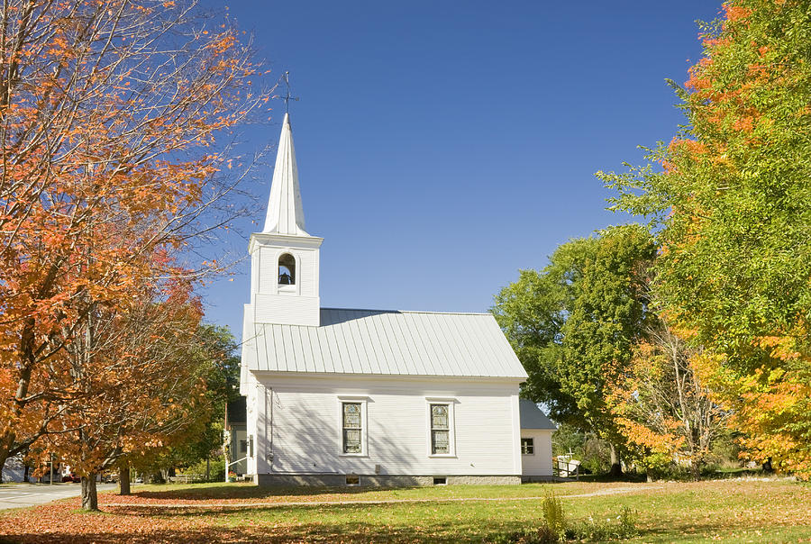

Slide 39
New
Covenant
in the
Church

