Slide 1

Covenant
Relationship
with
God

Slide 2

Isaiah 54:10
For the mountains shall depart and the hills be removed, but My kindness shall not depart from you, nor shall My covenant of peace be removed,” says the Lord, who has mercy on you.

Slide 3
Exodus 19:5
Now therefore, if you will indeed obey My voice and keep My covenant, then you shall be a special treasure to Me above all people; for all the earth is Mine.

Slide 4
Jeremiah 7:23
But this is what I commanded them, saying, ‘Obey My voice, and I will be your God, and you shall be My people. And walk in all the ways that I have commanded you, that it may be well with you.’

Slide 5
Old Covenant v. New Covenant
Old Covenant:
The law was on stone.
New Covenant:
The law is on our hearts.

Slide 6
Old Covenant v. New Covenant
Old Covenant:
brought conviction
New Covenant:
brings cleansing

Slide 7
Old Covenant v. New Covenant
Old Covenant:
corrupt heart that resists God
New Covenant:
new heart; responsive to God

Slide 8
Old Covenant v. New Covenant
Old Covenant:
gave laws with no power to follow
New Covenant:
gives Holy Spirit Who empowers

Slide 9
Ezekiel 36:26
I will give you a new heart and put a new spirit within you; I will take the heart of stone out of your flesh and give you a heart of flesh.

Slide 10
Ezekiel 36:27
I will put My Spirit within you and cause you to walk in My statutes, and you will keep My judgments and do them.

Slide 11
Romans 8:1
There is therefore now no condemnation to those who are in Christ Jesus, who do not walk according to the flesh, but according to the Spirit.

Slide 12
Romans 8:2
For the law of the Spirit of life in Christ Jesus has made me free from the law of sin and death.

Slide 13
Romans 8:3
For what the law could not do in that it was weak through the flesh, God did by sending His own Son in the likeness of sinful flesh, on account of sin: He condemned sin in the flesh,

Slide 14
Romans 8:4
that the righteous requirement of the law might be fulfilled in us who do not walk according to the flesh but according to the Spirit.

Slide 15
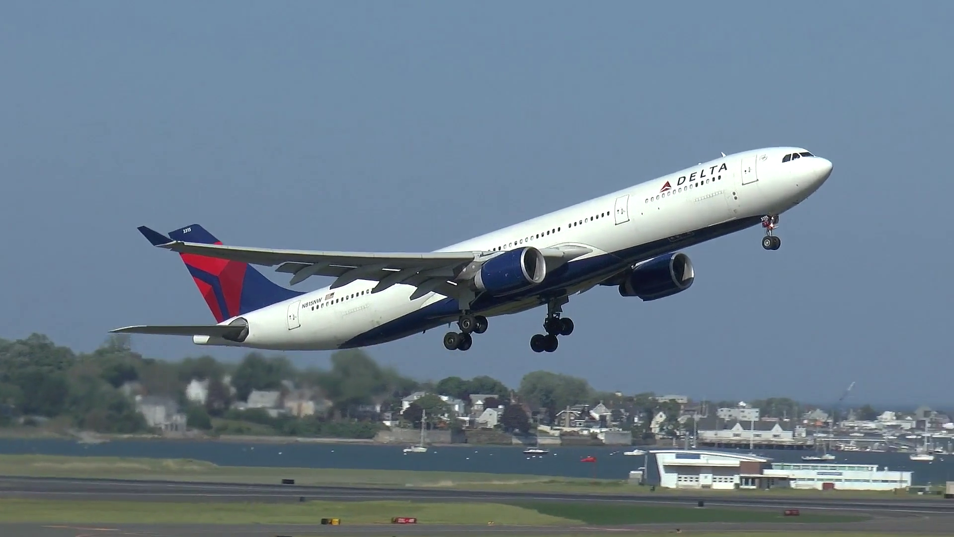

Slide 16


Slide 17
Covenant
Relationship
with
God

