Slide 2
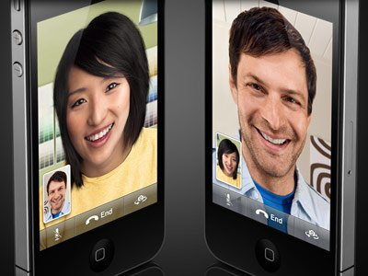

Slide 3
John 1:35
Again, the next day, John stood with two of his disciples.

Slide 4
John 1:36
And looking at Jesus as He walked, he said, “Behold the Lamb of God!”

Slide 5
John 1:37
The two disciples heard him speak, and they followed Jesus.

Slide 6
John 1:38
Then Jesus turned, and seeing them following, said to them, “What do you seek?” They said to Him, “Rabbi” (which is to say, when translated, Teacher), “where are You staying?”

Slide 7
John 1:39
He said to them, “Come and see.” They came and saw where He was staying, and remained with Him that day (now it was about the tenth hour).

Slide 8
John 1:40
One of the two who heard John speak, and followed Him, was Andrew, Simon Peter’s brother.

Slide 9
John 1:41
He first found his own brother Simon, and said to him, “We have found the Messiah” (which is translated, the Christ).

Slide 10
John 1:42
And he brought him to Jesus. Now when Jesus looked at him, He said, “You are Simon the son of Jonah. You shall be called Cephas” (which is translated, A Stone).

Slide 11
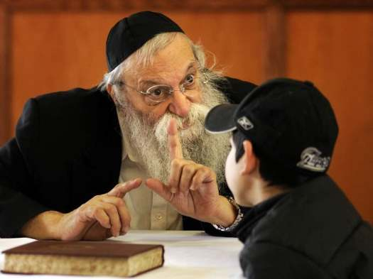

Slide 12
Being a student requires a PASSION for learning from The Rabbi.

Slide 13
To be a follower
required 100% COMMITMENT.

Slide 14
The focus of a follower is to be LIKE the rabbi.

Slide 15
Romans 8:29
For whom He foreknew, He also predestined to be conformed to the image of His Son, that He might be the firstborn among many brethren.

Slide 16
A student TRUSTS the rabbi that he will take them to the best place to learn.

Slide 17
Students must
be IN the
rabbi’s world.

Slide 18
1 Corinthians 11:1
Imitate me, just as I also imitate Christ.

Slide 19
Matthew 28:18
And Jesus came and spoke to them, saying, “All authority has been given to Me in heaven and on earth.

Slide 20
Matthew 28:19
Go therefore and make disciples of all the nations, baptizing them in the name of the Father and of the Son and of the Holy Spirit,

Slide 21
Matthew 28:20
teaching them to observe all things that I have commanded you; and lo, I am with you always, even to the end of the age.” Amen.

