Slide 1


Slide 2

John 5:1
After this there was a feast of the
Jews, and Jesus went up to
Jerusalem.

Slide 3
John 5:2
Now there is in Jerusalem by the
Sheep Gate a pool, which is called
in Hebrew, Bethesda, having
five porches.

Slide 4
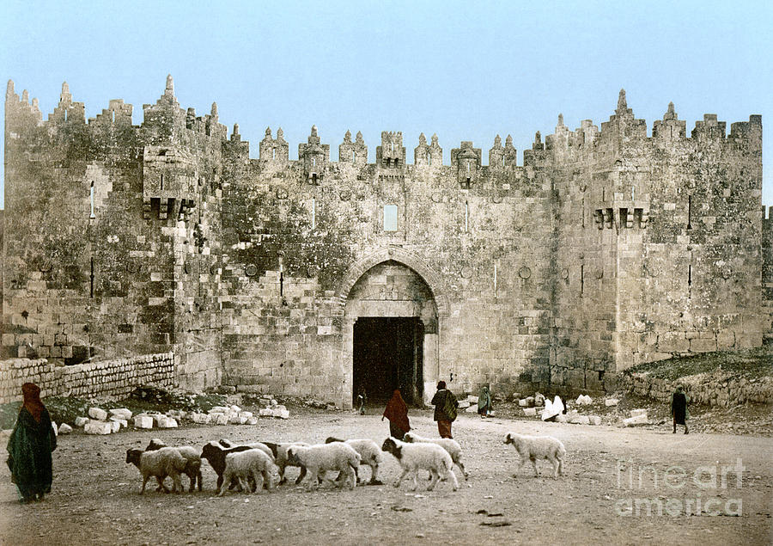

Slide 5
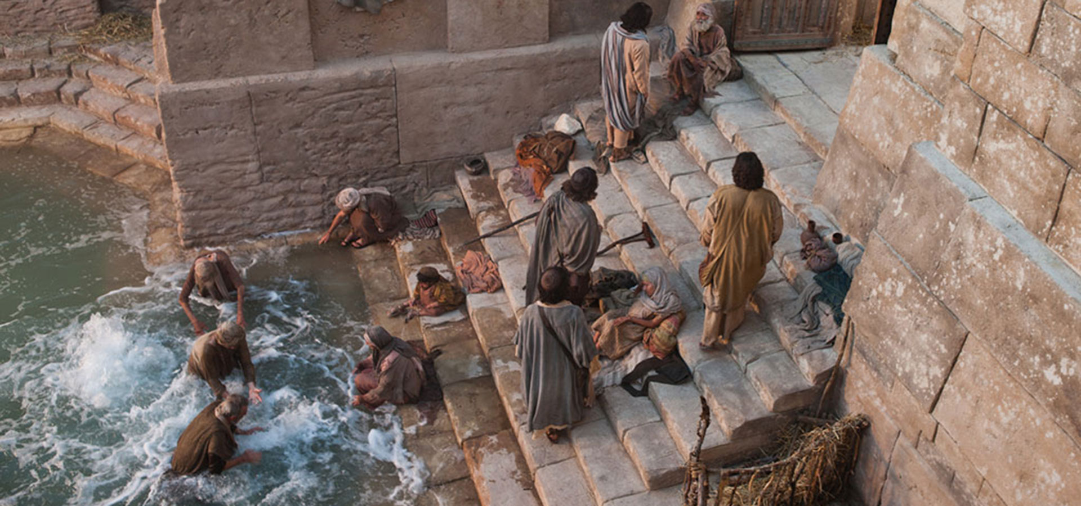

Slide 6
John 5:3
In these lay a great multitude of sick people, blind, lame, paralyzed, waiting for the moving of the water.

Slide 7
John 5:4
For an angel went down at a certain time into the pool and stirred up the water; then whoever stepped in first, after the stirring of the water, was made well of whatever disease he had.

Slide 8
John 5:5
Now a certain man was there who had an infirmity thirty-eight years.

Slide 9
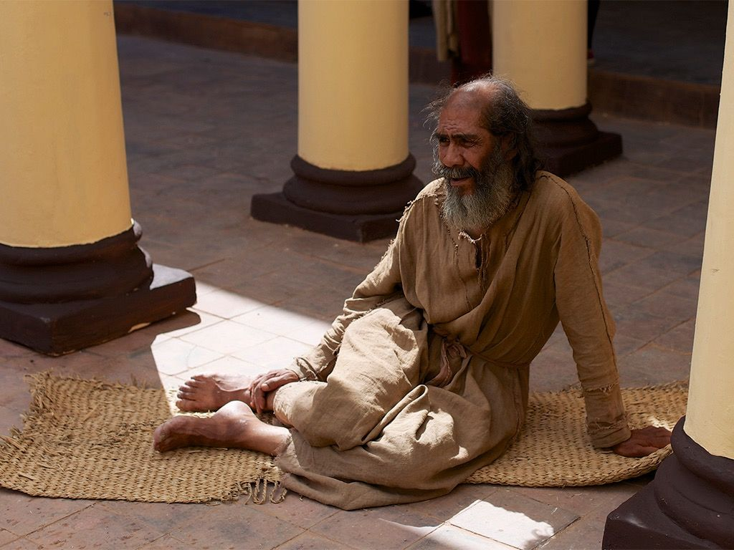

Slide 10
John 5:6
When Jesus saw him lying there, and knew that he already had been in that condition a long time, He said to him, “Do you want to be made well?”

Slide 11
John 5:7
The sick man answered Him, “Sir, I have no man to put me into the pool when the water is stirred up; but while I am coming, another steps down
before me.”

Slide 12
John 5:8
Jesus said to him, “Rise, take up your bed and walk.”

Slide 13
John 5:9
And immediately the man was made well, took up his bed, and walked. And that day was the Sabbath.

Slide 14
John 5:10
The Jews therefore said to him who was cured, “It is the Sabbath; it is not lawful for you to carry your bed.”

Slide 15
John 5:11
He answered them, “He who made me well said to me, ‘Take up your bed
and walk.’ ”

Slide 16
John 5:12
Then they asked him, “Who is the Man who said to you, ‘Take up your bed
and walk’?”

Slide 17
John 5:13
But the one who was healed did not know who it was, for Jesus had withdrawn, a multitude being in
that place.

Slide 18
John 5:14
Afterward Jesus found him in the temple, and said to him, “See, you have been made well. Sin no more, lest a worse thing come upon you.”

Slide 19
John 5:15
The man departed and told the Jews that it was Jesus who had made
him well.

Slide 20
John 5:16
For this reason the Jews persecuted Jesus, and sought to kill Him, because He had done these things on the Sabbath.

Slide 21
John 5:17
But Jesus answered them, “My Father has been working until now, and I have been working.”

Slide 22
John 5:18
Therefore the Jews sought all the more to kill Him, because He not only broke the Sabbath, but also said that God was His Father, making Himself equal with God.

