Slide 1


Slide 2

Romans 12:1
I beseech you therefore,
brethren, by the mercies of God,
that you present your bodies a living sacrifice, holy, acceptable to God, which is your reasonable service.

Slide 3
Romans 12:2
And do not be conformed to
this world, but be transformed by the renewing of your mind, that you may prove what is that good and acceptable and perfect will of God.

Slide 4
Romans 12:3
For I say, through the grace given
to me, to everyone who is among you, not to think of himself more highly than he ought to think, but to think soberly, as God has dealt to each one a measure of faith.

Slide 5
Romans 12:4
For as we have many
members in one body, but all the members do not have the same function,

Slide 6
Romans 12:5
so we, being many, are one
body in Christ, and individually
members of one another.

Slide 7
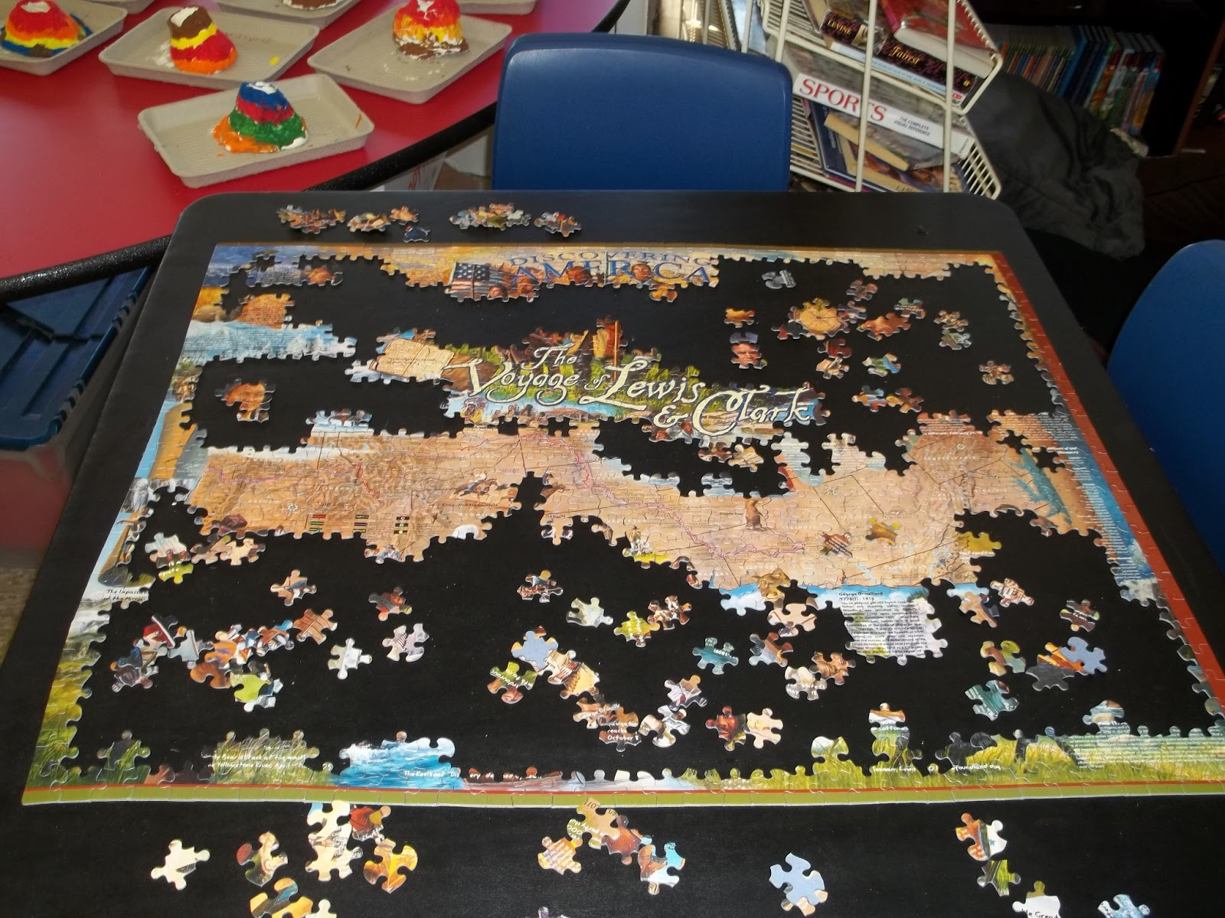

Slide 8


Slide 9

We are Christ’s body and must work TOGETHER.

Slide 10
We are to
USE our gifts GENEROUSLY.

Slide 11
Romans 12:6
Having then gifts differing
according to the grace that is given
to us, let us use them: if prophecy, let us prophesy in proportion to our faith;

Slide 12
Romans 12:7
or ministry, let us use it in our ministering; he who teaches, in teaching;

Slide 13
Romans 12:8
he who exhorts, in exhortation;
he who gives, with liberality;
he who leads, with diligence;
he who shows mercy, with cheerfulness.

Slide 14
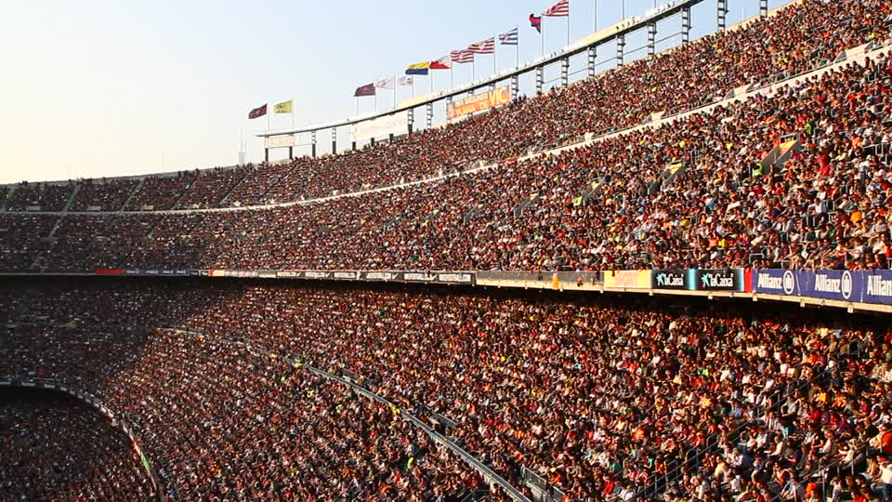

Slide 15
We are to live DIFFERENTLY
than the world.

Slide 16
Romans 12:9
Let love be without hypocrisy.
Abhor what is evil.
Cling to what is good.

Slide 17
Romans 12:10
Be kindly affectionate to one
another with brotherly love,
in honor giving preference to
one another;

Slide 18
Romans 12:11
not lagging in diligence,
fervent in spirit, serving the Lord;

Slide 19
Romans 12:12
rejoicing in hope, patient in
tribulation, continuing steadfastly
in prayer;

Slide 20
Romans 12:13
distributing to the needs
of the saints, given to hospitality.

Slide 21
Romans 12:14
Bless those who persecute
you; bless and do not curse.

Slide 22
Romans 12:15
Rejoice with those who rejoice,
and weep with those who weep.

Slide 23
Romans 12:16
Be of the same mind toward
one another. Do not set your mind
on high things, but associate with the humble. Do not be wise in your own opinion.

Slide 24
Romans 12:17
Repay no one evil for evil.
Have regard for good things in
the sight of all men.

Slide 25
Romans 12:18
If it is possible, as much as
depends on you, live peaceably
with all men.

Slide 26
Romans 12:19
Beloved, do not avenge
yourselves, but rather give place to wrath; for it is written, “Vengeance is Mine, I will repay,” says the Lord.

Slide 27
Romans 12:20
Therefore “If your enemy is
hungry, feed him; if he is thirsty,
give him a drink; for in so doing you
will heap coals of fire on his head.”

Slide 28
Romans 12:21
Do not be overcome by evil,
but overcome evil with good.

Slide 29
GOOD
EVIL

