Slide 3
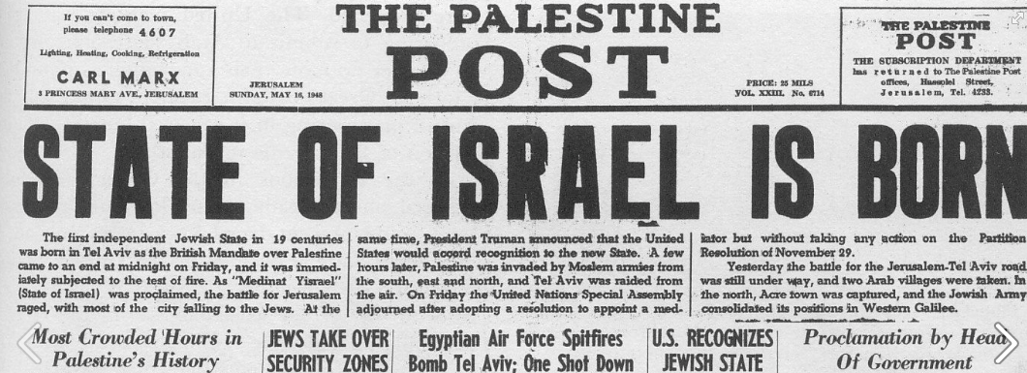

Slide 9
Ezekiel 38:1
Now the word of the Lord came to me, saying,

Slide 10
Ezekiel 38:2
“Son of man, set your face against Gog, of the land of Magog, the prince of Rosh, Meshech, and Tubal, and prophesy against him,

Slide 11
Ezekiel 38:3
and say, ‘Thus says the Lord God: “Behold, I am against you, O Gog, the prince of Rosh, Meshech, and Tubal.

Slide 12
Ezekiel 38:4
I will turn you around, put hooks into your jaws, and lead you out, with all your army, horses, and horsemen, all splendidly clothed, a great company with bucklers and shields, all of them handling swords.

Slide 13
Ezekiel 38:5
Persia, Ethiopia, and Libya are with them, all of them with shield and helmet;

Slide 14
Ezekiel 38:6
Gomer and all its troops; the house of Togarmah from the far north and all its troops—many people are with you.

Slide 15
Ezekiel 38:7
“Prepare yourself and be ready, you and all your companies that are gathered about you; and be a guard for them.

Slide 16
Ezekiel 38:8
After many days you will be visited. In the latter years you will come into the land of those brought back from the sword and gathered from many people on the mountains of Israel,

Slide 17
Ezekiel 38:8
which had long been desolate; they were brought out of the nations, and now all of them dwell safely.

Slide 18
Ezekiel 38:9
You will ascend, coming like a storm, covering the land like a cloud, you and all your troops and many peoples with you.”

Slide 19
Ezekiel 38:10
‘Thus says the Lord God: “On that day it shall come to pass that thoughts will arise in your mind, and you will make an
evil plan:

Slide 20
Ezekiel 38:11
You will say, ‘I will go up against a land of unwalled villages; I will go to a peaceful people, who dwell safely, all of them dwelling without walls, and having neither bars nor gates’—

Slide 21
Ezekiel 38:12
to take plunder and to take booty, to stretch out your hand against the waste places that are again inhabited, and against a people gathered from the nations, who have acquired livestock and goods, who dwell in the midst of the land.

Slide 22
Ezekiel 38:13
Sheba, Dedan, the merchants of Tarshish, and all their young lions will say to you, ‘Have you come to take plunder? Have you gathered your army to take booty, to carry away silver and gold, to take away livestock and goods, to take great plunder?’ ” ’

Slide 23
Ezekiel 38:14
“Therefore, son of man, prophesy and say to Gog, ‘Thus says the Lord God: “On that day when My people Israel dwell safely, will you not know it?

Slide 24
Ezekiel 38:15
Then you will come from your place out of the far north, you and many peoples with you, all of them riding on horses, a great company and a mighty army.

Slide 25
Ezekiel 38:16
You will come up against My people Israel like a cloud, to cover the land. It will be in the latter days that I will bring you against My land, so that the nations may know Me, when I am hallowed in you, O Gog, before their eyes.”

Slide 26
Ezekiel 38:17
Thus says the Lord God: “Are you he of whom I have spoken in former days by My servants the prophets of Israel, who prophesied for years in those days that I would bring you against them?

Slide 27
Ezekiel 38:18
“And it will come to pass at the same time, when Gog comes against the land of Israel,” says the Lord God, “that My fury will show in My face.

Slide 28
Ezekiel 38:19
For in My jealousy and in the fire of My wrath I have spoken: ‘Surely in that day there shall be a great earthquake in the land of Israel,

Slide 29
Ezekiel 38:20
so that the fish of the sea, the birds of the heavens, the beasts of the field, all creeping things that creep on the earth, and all men who are on the face of the earth shall shake at My presence. The mountains shall be thrown down,

Slide 30
Ezekiel 38:20
the steep places shall fall, and every wall shall fall to the ground.’

Slide 31
Ezekiel 38:21
I will call for a sword against Gog throughout all My mountains,” says the Lord God. “Every man’s sword will be against his brother.

Slide 32
Ezekiel 38:22
And I will bring him to judgment with pestilence and bloodshed; I will rain down on him, on his troops, and on the many peoples who are with him, flooding rain, great hailstones, fire, and brimstone.

Slide 33
Ezekiel 38:23
Thus I will magnify Myself and sanctify Myself, and I will be known in the eyes of many nations. Then they shall know that I am the Lord.” ’

Slide 34
Ezekiel 39:1
“And you, son of man, prophesy against Gog, and say, ‘Thus says the Lord God: “Behold, I am against you, O Gog, the prince of Rosh, Meshech, and Tubal;

Slide 35
Ezekiel 39:2
and I will turn you around and lead you on, bringing you up from the far north, and bring you against the mountains of Israel.

Slide 36
Ezekiel 39:3
Then I will knock the bow out of your left hand, and cause the arrows to fall out of your right hand.

Slide 37
Ezekiel 39:4
You shall fall upon the mountains of Israel, you and all your troops and the peoples who are with you; I will give you to birds of prey of every sort and to the beasts of the field to be devoured.

Slide 38
Ezekiel 39:5
You shall fall on the open field; for I have spoken,” says the Lord God.

Slide 39
Ezekiel 39:6
“And I will send fire on Magog and on those who live in security in the coastlands. Then they shall know that I am the Lord.

Slide 40
Ezekiel 39:7
So I will make My holy name known in the midst of My people Israel, and I will not let them profane My holy name anymore. Then the nations shall know that I am the Lord, the Holy One in Israel.

Slide 41
Ezekiel 39:8
Surely it is coming, and it shall be done,” says the Lord God. “This is the day of which I have spoken.

Slide 42
Ezekiel 39:9
“Then those who dwell in the cities of Israel will go out and set on fire and burn the weapons, both the shields and bucklers, the bows and arrows, the javelins and spears; and they will make fires with them for seven years.

Slide 43
Ezekiel 39:10
They will not take wood from the field nor cut down any from the forests, because they will make fires with the weapons; and they will plunder those who plundered them, and pillage those who pillaged them,” says the Lord God.

Slide 44
Ezekiel 39:11
“It will come to pass in that day that I will give Gog a burial place there in Israel, the valley of those who pass by east of the sea; and it will obstruct travelers, because there they will bury Gog and all his multitude. Therefore they will call it the Valley of Hamon Gog.

Slide 45
Ezekiel 39:12
For seven months the house of Israel will be burying them, in order to cleanse the land.

Slide 46
Ezekiel 39:13
Indeed all the people of the land will be burying, and they will gain renown for it on the day that I am glorified,” says the Lord God.

Slide 47
Ezekiel 39:14
“They will set apart men regularly employed, with the help of a search party, to pass through the land and bury those bodies remaining on the ground, in order to cleanse it. At the end of seven months they will make a search.

Slide 48
Ezekiel 39:15
The search party will pass through the land; and when anyone sees a man’s bone, he shall set up a marker by it, till the buriers have buried it in the Valley of Hamon Gog.

Slide 49
Ezekiel 39:16
The name of the city will also be Hamonah. Thus they shall cleanse the land.” ’

Slide 50
Ezekiel 39:17
“And as for you, son of man, thus says the Lord God, ‘Speak to every sort of bird and to every beast of the field: “Assemble yourselves and come; Gather together from all sides to My

Slide 51
Ezekiel 39:17
sacrificial meal which I am sacrificing for you, a great sacrificial meal on the mountains of Israel, that you may eat flesh and drink blood.

Slide 52
Ezekiel 39:18
You shall eat the flesh of the mighty, drink the blood of the princes of the earth, of rams and lambs, of goats and bulls, all of them fatlings of Bashan.

Slide 53
Ezekiel 39:19
You shall eat fat till you are full, and drink blood till you are drunk, at My sacrificial meal which I am sacrificing for you.

Slide 54
Ezekiel 39:20
You shall be filled at My table with horses and riders, with mighty men and with all the men of war,” says the Lord God.

Slide 55
Ezekiel 39:21
“I will set My glory among the nations; all the nations shall see My judgment which I have executed, and My hand which I have laid on them.

Slide 56
Ezekiel 39:22
So the house of Israel shall know that I am the Lord their God from that day forward.

Slide 57
Ezekiel 39:23
The Gentiles shall know that the house of Israel went into captivity for their iniquity; because they were unfaithful to Me, therefore I hid My face from them. I gave them into the hand of their enemies, and they all fell by the sword.

Slide 58
Ezekiel 39:24
According to their uncleanness and according to their transgressions I have dealt with them, and hidden My face from them.” ’

Slide 59
Ezekiel 39:25
“Therefore thus says the Lord God: ‘Now I will bring back the captives of Jacob, and have mercy on the whole house of Israel; and I will be jealous for My holy name—

Slide 60
Ezekiel 39:26
after they have borne their shame, and all their unfaithfulness in which they were unfaithful to Me, when they dwelt safely in their own land and no one made them afraid.

Slide 61
Ezekiel 39:27
When I have brought them back from the peoples and gathered them out of their enemies’ lands, and I am hallowed in them in the sight of many nations,

Slide 62
Ezekiel 39:28
then they shall know that I am the Lord their God, who sent them into captivity among the nations, but also brought them back to their land, and left none of them captive any longer.

Slide 63
Ezekiel 39:29
And I will not hide My face from them anymore; for I shall have poured out My Spirit on the house of Israel,’ says the Lord God.”

