Slide 1


Slide 2


Slide 3
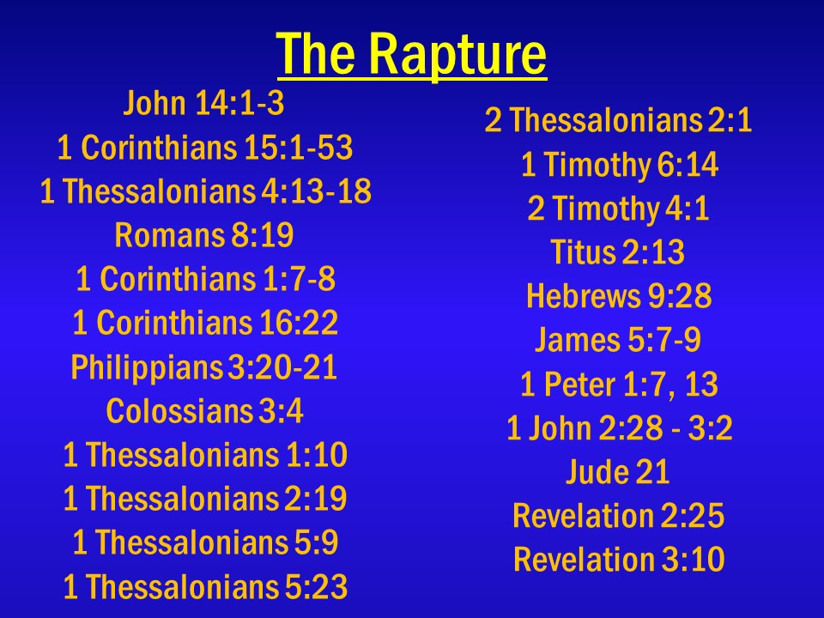

Slide 4
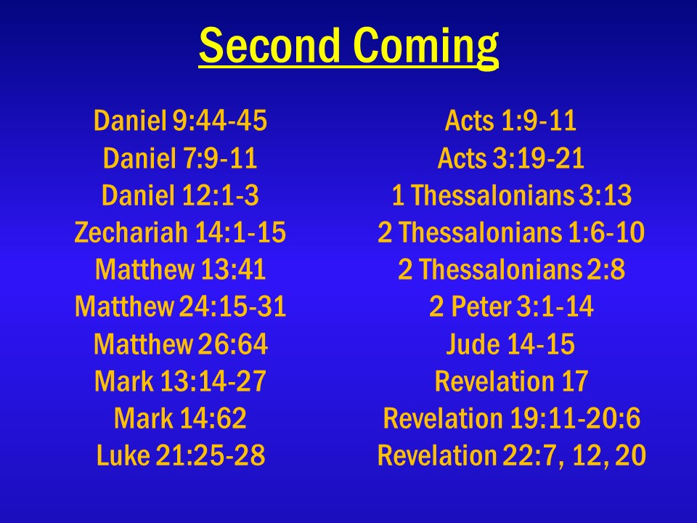

Slide 5
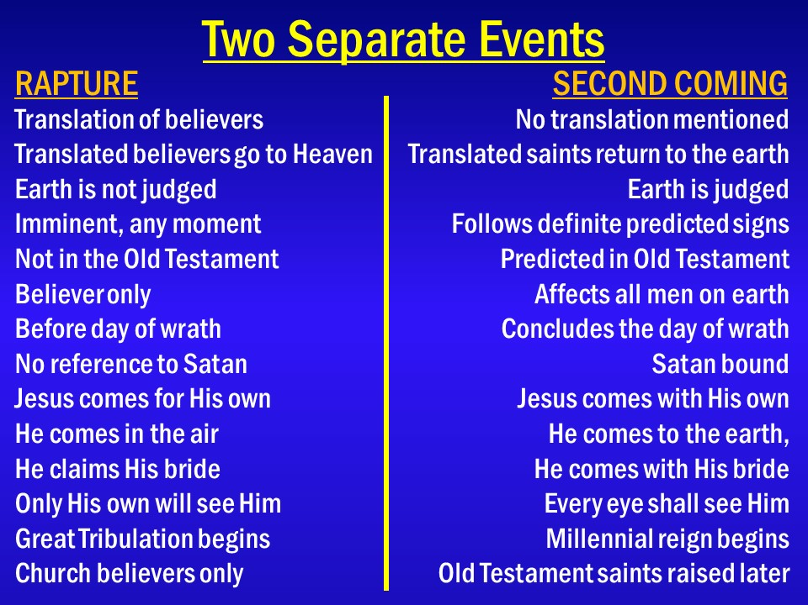

Slide 6

“The Great Tribulation”

Slide 7

Matthew 24:21
For then there will be great tribulation, such as has not been since the beginning of the world until this time, no, nor ever
shall be.

Slide 8
Matthew 24:22
And unless those days were shortened, no flesh would be saved; but for the elect’s sake those days will be shortened.

Slide 9
Daniel 12:1
“At that time Michael shall stand up, the great prince who stands watch over the sons of your people; and there shall be a time of trouble, such as never was since there was a nation, even to that time. And at that time your people shall be delivered, every one who is found written in the book.

Slide 10
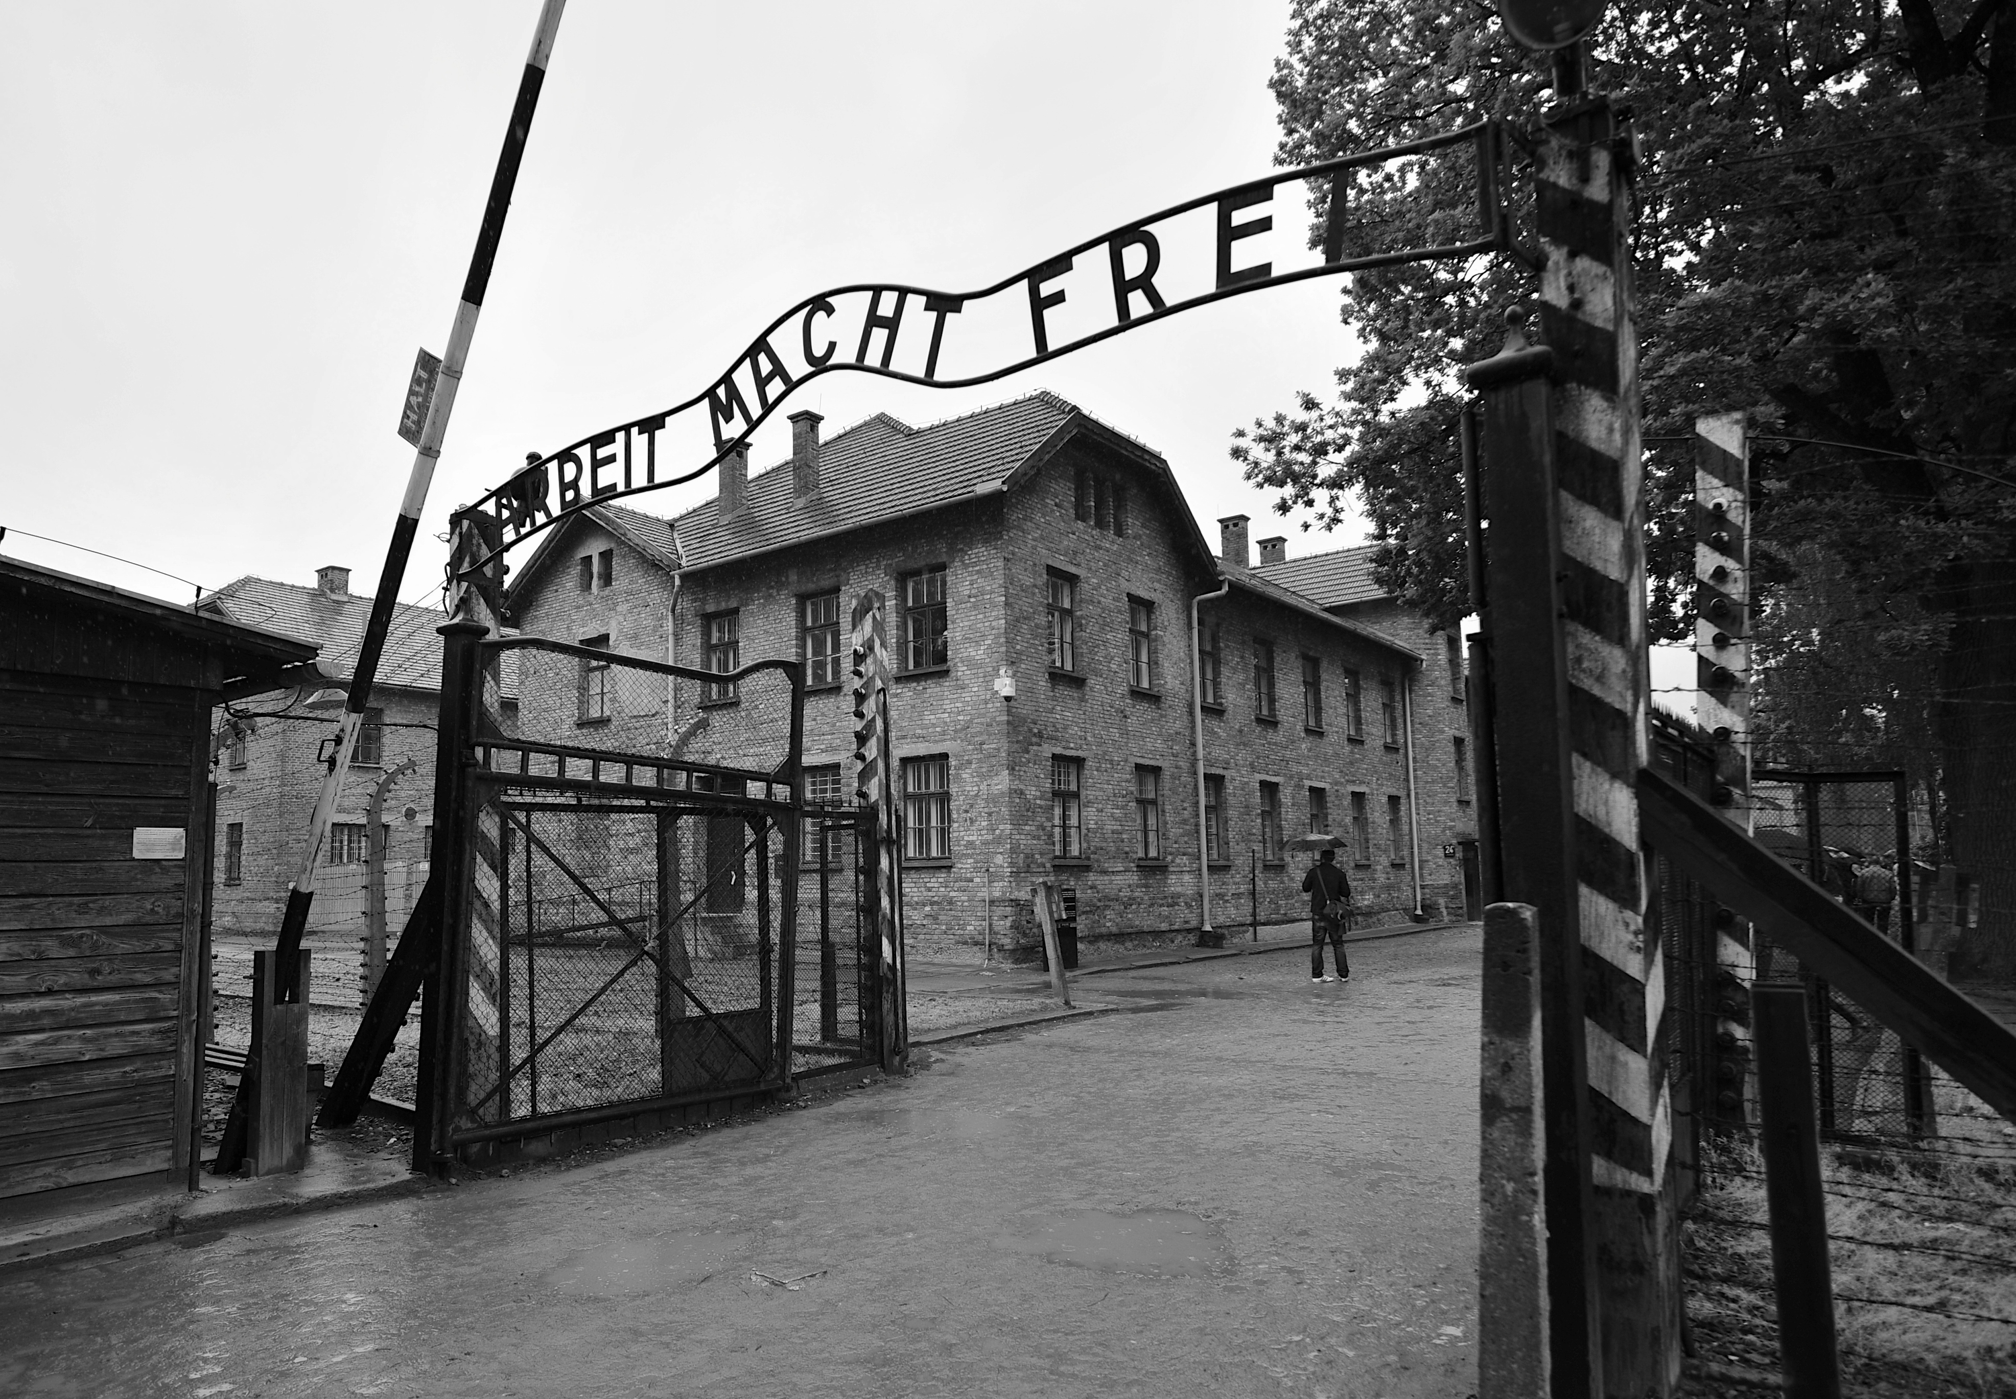

Slide 11
Zechariah 13:8
And it shall come to pass in all the land,” says the Lord, “that two-thirds in it shall be cut off and die, but one-third shall be left in it:

Slide 12
Zechariah 13:9
I will bring the one-third through the fire, will refine them as silver is refined, and test them as gold is tested. They will call on My name, and I will answer them. I will say, ‘This is My people’; and each one will say, ‘The Lord is my God.’ ”

Slide 13
Jeremiah 30:7
Alas! For that day is great, so that none is like it; and it is the time of Jacob’s trouble, but he shall be saved out of it.

Slide 14
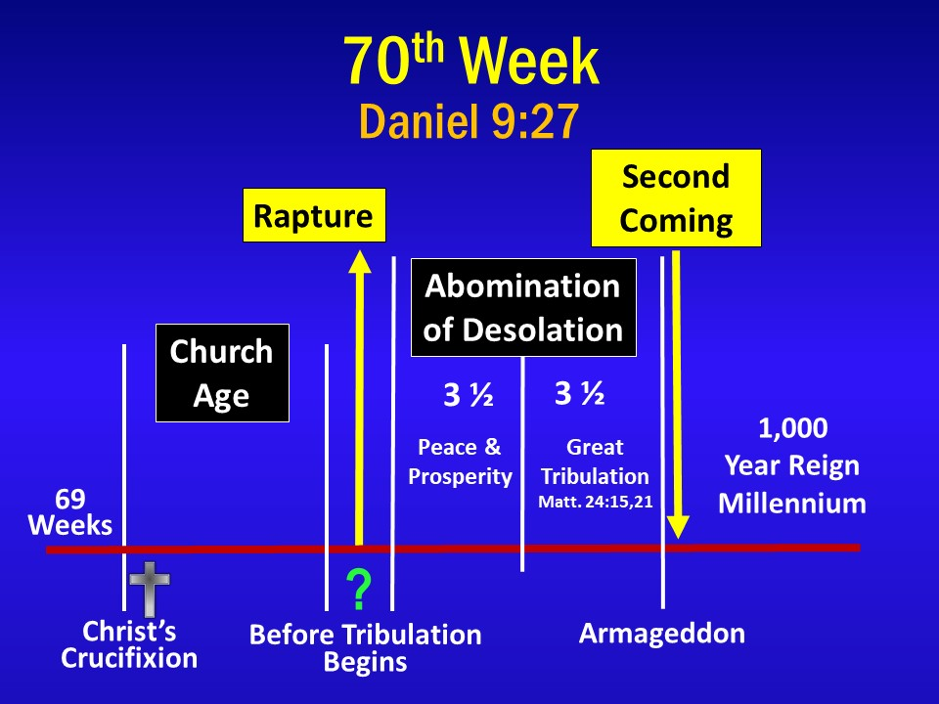

Slide 15
Daniel 9:27
Then he shall confirm a covenant with many for one week; but in the middle of the week He shall bring an end to sacrifice and offering. And on the wing of abominations shall be one who makes desolate, even until the consummation, which is determined, is poured out on the desolate.”

Slide 16
Matthew 24:15
“Therefore when you see the ‘abomination of desolation,’ spoken of by Daniel the prophet, standing in the holy place” (whoever reads, let him understand),

Slide 17
Matthew 24:21
“For then there will be great tribulation, such as has not been since the beginning of the world until this time, no, nor ever
shall be.

Slide 18
2 Thessalonians 2:6
And now you know what is restraining, that he may be revealed in his own time.

Slide 19
2 Thessalonians 2:7
For the mystery of lawlessness is already at work; only He who now restrains will do so until He is taken out of the way.

Slide 20
2 Thessalonians 2:8
And then the lawless one will be revealed, whom the Lord will consume with the breath of His mouth and destroy with the brightness of His coming.

Slide 21
2 Thessalonians 2:9
The coming of the lawless one is according to the working of Satan, with all power, signs, and lying wonders,

Slide 22
Matthew 24:36
“But of that day and hour no one knows, not even the angels of heaven, but My Father only.

Slide 23
Matthew 24:42
Watch therefore, for you do not know what hour your Lord is coming.

Slide 24
Matthew 24:44
Therefore you also be ready, for the Son of Man is coming at an hour you do not expect.

Slide 25
Matthew 25:13
“Watch therefore, for you know neither the day nor the hour in which the Son of Man is coming.

Slide 26
1 Thessalonians 4:13
But I do not want you to be ignorant, brethren, concerning those who have fallen asleep, lest you sorrow as others who have
no hope.

Slide 27
1 Thessalonians 4:14
For if we believe that Jesus died and rose again, even so God will bring with Him those who sleep
in Jesus.

Slide 28
1 Thessalonians 4:15
For this we say to you by the word of the Lord, that we who are alive and remain until the coming of the Lord will by no means precede those who are asleep.

Slide 29
1 Thessalonians 4:16
For the Lord Himself will descend from heaven with a shout, with the voice of an archangel, and with the trumpet of God. And the dead in Christ will rise first.

Slide 30
1 Thessalonians 4:17
Then we who are alive and remain shall be caught up together with them in the clouds to meet the Lord in the air. And thus we shall always be with the Lord.

Slide 31
1 Thessalonians 4:18
Therefore comfort one another with these words.

Slide 32
1 Thessalonians 5:1
But concerning the times and the seasons, brethren, you have no need that I should write to you.

Slide 33
1 Thessalonians 5:2
For you yourselves know perfectly that the day of the Lord so comes as a thief in the night.

Slide 34
1 Thessalonians 5:3
For when they say, “Peace and safety!” then sudden destruction comes upon them, as labor pains upon a pregnant woman. And they shall not escape.

Slide 35
1 Thessalonians 5:4
But you, brethren, are not in darkness, so that this Day should overtake you as a thief.

Slide 36
1 Thessalonians 5:5
You are all sons of light and sons of the day. We are not of the night nor of darkness.

Slide 37
1 Thessalonians 5:6
Therefore let us not sleep, as others do, but let us watch and
be sober.

Slide 38
1 Thessalonians 5:7
For those who sleep, sleep at night, and those who get drunk
are drunk at night.

Slide 39
1 Thessalonians 5:8
But let us who are of the day be sober, putting on the breastplate of faith and love, and as a helmet the hope of salvation.

Slide 40
1 Thessalonians 5:9
For God did not appoint us to wrath, but to obtain salvation through our Lord Jesus Christ,

Slide 41
1 Thessalonians 5:10
who died for us, that whether we wake or sleep, we should live together with Him.

