Slide 1
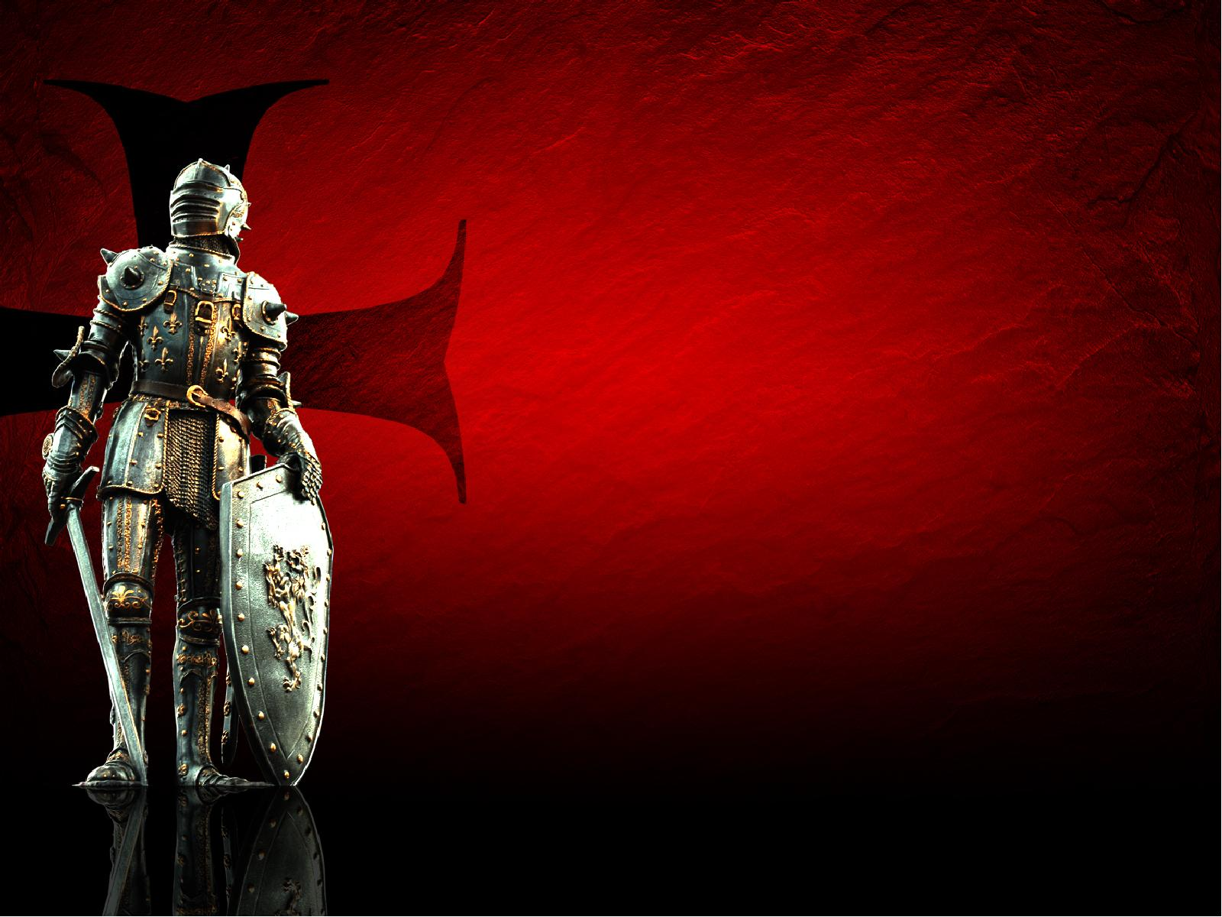
ARMOR
that
does
NOT
WORK
1 Samuel 17

Slide 2
1 SAMUEL 17:2
And Saul and the men of Israel were gathered together, and they encamped in the Valley of Elah, and drew up in battle array against the Philistines.

Slide 3
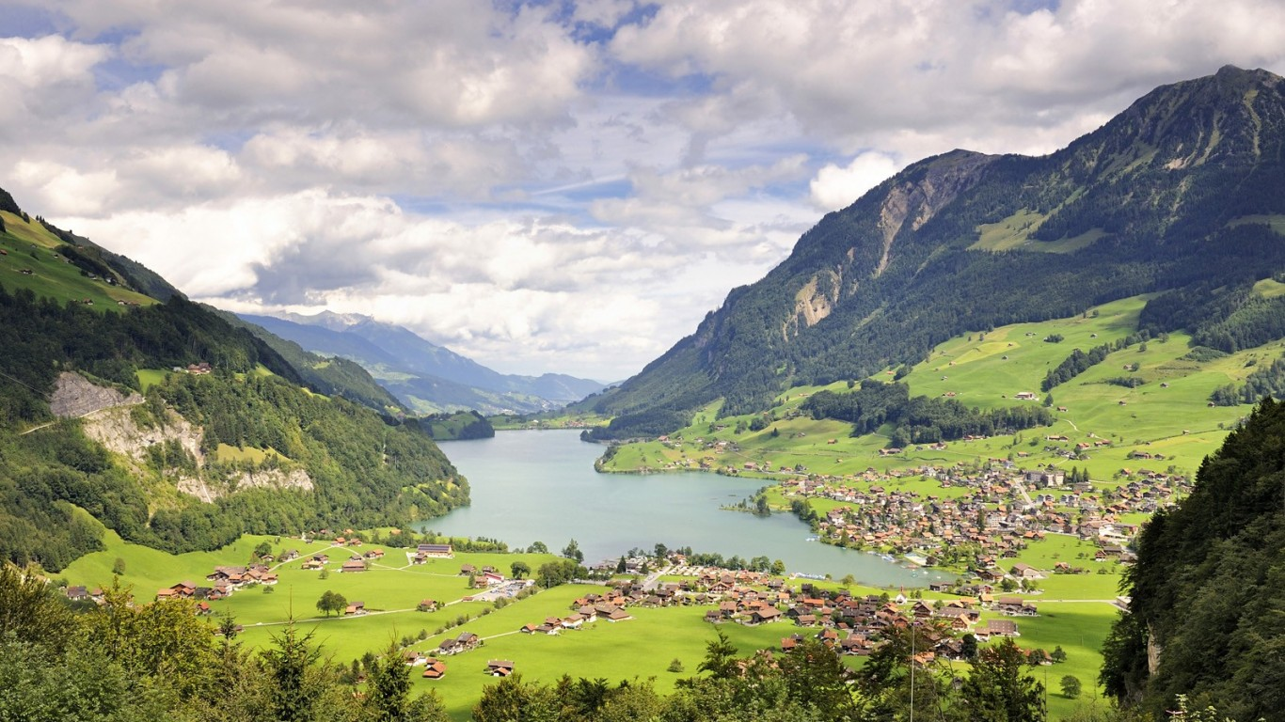

Slide 4
1 SAMUEL 17:3
The Philistines stood on a mountain on one side, and Israel stood on a mountain on the other side, with a valley between them.

Slide 5
1 SAMUEL 17:4
And a champion went out from the camp of the Philistines, named Goliath, …

Slide 6
1 SAMUEL 17:8
Then he stood and cried out to the armies of Israel, and said to them, “Why have you come out to line up for battle? Am I not a Philistine, and you the servants of Saul? Choose a man for yourselves, and let him come down to me.

Slide 7
1 SAMUEL 17:9
If he is able to fight with me and kill me, then we will be your servants. But if I prevail against him and kill him, then you shall be our servants and serve us.”

Slide 8
1 SAMUEL 17:10
And the Philistine said, “I defy the armies of Israel this day; give me a man, that we may fight together.”

Slide 9
1 SAMUEL 17:11
When Saul and all Israel heard these words of the Philistine, they were dismayed and greatly afraid.…

Slide 10
1 SAMUEL 17:16
And the Philistine drew near and presented himself forty days, morning and evening.

Slide 11
1 SAMUEL 17:17
Then Jesse said to his son David, “Take now for your brothers an ephah of this dried grain and these ten loaves, and run to your brothers at the camp.

Slide 12
1 SAMUEL 17:18
And carry these ten cheeses to the captain of their thousand, and see how your brothers fare, and bring back news of them.”

Slide 13
1 SAMUEL 17:20
So David rose early in the morning, left the sheep with a keeper, and took the things and went as Jesse had commanded him. And he came to the camp as the army was going out to the fight and shouting for
the battle.

Slide 14
1 SAMUEL 17:21
For Israel and the Philistines had drawn up in battle array, army against army.

Slide 15
1 SAMUEL 17:22
And David left his supplies in the hand of the supply keeper, ran to the army, and came and greeted his brothers.

Slide 16
1 SAMUEL 17:23
Then as he talked with them, there was the champion, the Philistine of Gath, Goliath by name, coming up from the armies of the Philistines; and he spoke according to the same words. So David heard them.

Slide 17
1 SAMUEL 17:24
And all the men of Israel, when they saw the man, fled from him and were dreadfully afraid.

Slide 18
1 SAMUEL 17:25
So the men of Israel said, “Have you seen this man who has come up? …

Slide 19
1 SAMUEL 17:26
Then David spoke to the men who stood by him, saying, “What shall be done for the man who kills this Philistine and takes away the reproach from Israel? For who is this uncircumcised Philistine, that he should defy the armies of the living God?”

Slide 20
1 SAMUEL 17:28
Now Eliab his oldest brother heard when he spoke to the men; and Eliab’s anger was aroused against David, and he said, “Why did you come down here? And with whom have you left those few sheep in the wilderness? I know your pride and the insolence of your heart, for you have come down to see the battle.”

Slide 21
1 SAMUEL 17:29
And David said, “What have I done now? Is there not a cause?”

Slide 22
1 SAMUEL 17:30
Then he turned from him toward another and said the same thing; and these people answered him as the first ones did.

Slide 23
1 SAMUEL 17:31
Now when the words which David spoke were heard, they reported them to Saul; and he sent for him.

Slide 24
1 SAMUEL 17:32
Then David said to Saul, “Let no man’s heart fail because of him; your servant will go and fight with this Philistine.”

Slide 25
1 SAMUEL 17:33
And Saul said to David, “You are not able to go against this Philistine to fight with him; for you are a youth, and he a man of war from his youth.”

Slide 26
1 SAMUEL 17:34
But David said to Saul, “Your servant used to keep his father’s sheep, and when a lion or a bear came and took a lamb out of
the flock,

Slide 27
1 SAMUEL 17:35
I went out after it and struck it, and delivered the lamb from its mouth; and when it arose against me, I caught it by its beard, and struck and killed it.

Slide 28
1 SAMUEL 17:36
Your servant has killed both lion and bear; and this uncircumcised Philistine will be like one of them, seeing he has defied the armies of the living God.”

Slide 29
1 SAMUEL 17:37
Moreover David said, “The Lord, who delivered me from the paw of the lion and from the paw of the bear, He will deliver me from the hand of this Philistine.” And Saul said to David, “Go, and the Lord be with you!”

Slide 30
1 SAMUEL 17:40
Then he took his staff in his hand; and he chose for himself five smooth stones from the brook, and put them in a shepherd’s bag, in a pouch which he had, and his sling was in his hand. And he drew near to the Philistine.

Slide 31
1 SAMUEL 17:41
So the Philistine came, and began drawing near to David, and the man who bore the shield went before him.

Slide 32
1 SAMUEL 17:42
And when the Philistine looked about and saw David, he disdained him; for he was only a youth, ruddy and good-looking.

Slide 33
1 SAMUEL 17:43
So the Philistine said to David, “Am I a dog, that you come to me with sticks?” And the Philistine cursed David by his gods.

Slide 34
1 SAMUEL 17:44
And the Philistine said to David, “Come to me, and I will give your flesh to the birds of the air and the beasts of the field!”

Slide 35
1 SAMUEL 17:45
Then David said to the Philistine, “You come to me with a sword, with a spear, and with a javelin. But I come to you in the name of the Lord of hosts, the God of the armies of Israel, whom you have defied.

Slide 36
1 SAMUEL 17:46
This day the Lord will deliver you into my hand, and I will strike you and take your head from you. And this day I will give the carcasses of the camp of the Philistines to the birds of the air and the wild beasts of the earth, that all the earth may know that there is a God
in Israel.

Slide 37
1 SAMUEL 17:47
Then all this assembly shall know that the Lord does not save with sword and spear; for the battle is the Lord’s, and He will give you into our hands.”

Slide 38
1 SAMUEL 17:48
So it was, when the Philistine arose and came and drew near to meet David, that David hurried and ran toward the army to meet the Philistine.

Slide 39
1 SAMUEL 17:49
Then David put his hand in his bag and took out a stone; and he slung it and struck the Philistine in his forehead, so that the stone sank into his forehead, and he fell on his face to the earth.

Slide 40
1 SAMUEL 17:50
So David prevailed over the Philistine with a sling and a stone, and struck the Philistine and killed him. But there was no sword in the hand of David.

Slide 41
1 SAMUEL 17:51
Therefore David ran and stood over the Philistine, took his sword and drew it out of its sheath and killed him, and cut off his head with it. And when the Philistines saw that their champion was dead,
they fled. ….

Slide 42
1 SAMUEL 17:54
And David took the head of the Philistine and brought it to Jerusalem, but he put his armor in his tent.

Slide 43
David killed
Goliath that day,
not because of
his PLAN.

Slide 44
David killed
Goliath that day,
not because of
his POWER.

Slide 45
David killed
Goliath that day
because of his
DEPENDENCE
on God.

Slide 46
No WEAPON

Slide 47
No EXPERIENCE

Slide 48
His ABILITY

Slide 49
His FAITHFULNESS

Slide 50
His POWER

Slide 51
ARMOR
that
does
NOT
WORK
1 Samuel 17

