Slide 1
Genesis 6-7
An Amazing
rescue

Slide 2
GENESIS 6:5 (NKJV)
Then the Lord saw that the wickedness of man was great in the earth, and that every intent of the thoughts of his heart was only evil continually.

Slide 3
JEREMIAH 17:9 (NKJV)
“The heart is deceitful above all things, and desperately wicked; Who can know it?

Slide 4
JEREMIAH 17:10 (NKJV)
I, the Lord, search the heart, I test the mind, even to give every man according to his ways, according to the fruit of his doings.

Slide 5
GENESIS 6:6 (NKJV)
And the Lord was sorry that He had made man on the earth, and He was grieved in His heart.

Slide 6
GENESIS 6:8 (NKJV)
But Noah found grace in the eyes of the Lord.
GENESIS 6:9 (NKJV)
This is the genealogy of Noah. Noah was a just man, perfect in his generations. Noah walked with God.

Slide 7
God pours out His
GRACE on SINFUL men.

Slide 8
God told Noah
EXACTLY what to do.

Slide 9
God’s command
was not EASY.

Slide 10
God honored Noah’s
FAITH and OBEDIENCE.

Slide 11
GENESIS 6:22 (NKJV)
Thus Noah did; according to all that God commanded him, so he did.

Slide 12
1 JOHN 2:6 (NKJV)
He who says he abides in Him ought himself also to walk just as He walked.
God will honor our faith.

Slide 13
ROMANS 3:10 (NKJV)
As it is written: “There is none righteous, no, not one;

Slide 14
ROMANS 10:11 (NKJV)
For the Scripture says, “Whoever believes on Him will not be put to shame.”

Slide 15
ROMANS 10:13 (NKJV)
For “whoever calls on the name of the Lord shall be saved.”

Slide 16
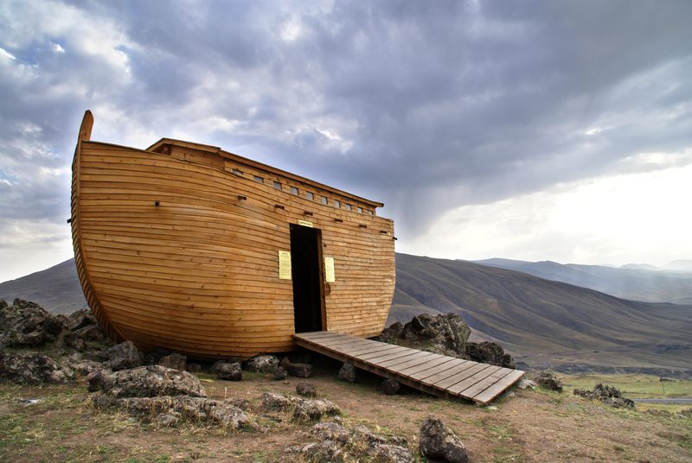

Slide 18
Genesis 6-7
An Amazing
rescue

