Slide 4
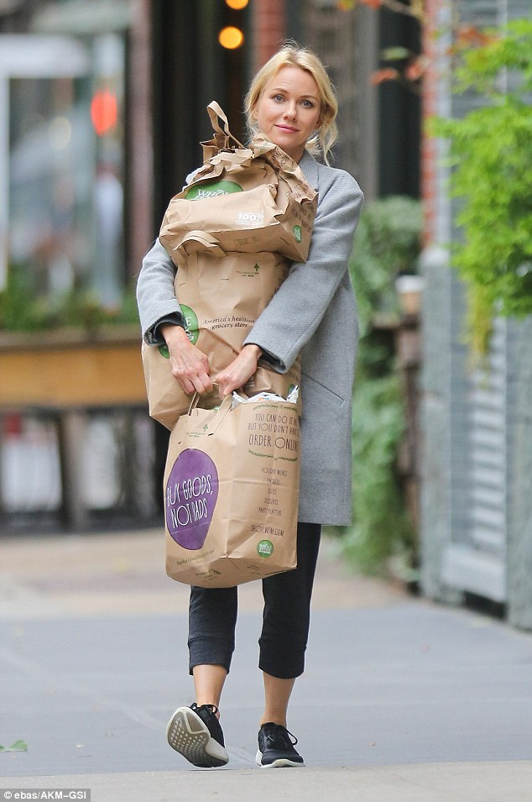

Slide 5
We fill our bags with
GUILT.

Slide 6
We fill our
bags with
DISCONTENT.

Slide 7
LUKE 12:15
And He said to them, “Take heed and beware of covetousness, for one’s life does not consist in the abundance of the things he possesses.”

Slide 8
PSALM 23:1
The Lord is my shepherd; I shall not want.

Slide 9
We fill our
bags with
WEARINESS.

Slide 10
ISAIAH 26:3
You will keep him in perfect peace, whose mind is stayed on You, Because he trusts in You.

Slide 11
We fill our
bags with
WORRY.

Slide 12
1 PETER 5:7
casting all your care upon Him, for He cares for you.

Slide 13
MATTHEW 6:34
(THE MESSAGE)
“Give your entire attention to what God is doing right now, and don’t get worked up about what may or may not happen tomorrow. God will help you deal with whatever hard things come up when the time comes.

Slide 14
PHILIPPIANS 4:6
Be anxious for nothing, but in everything by prayer and supplication, with thanksgiving, let your requests be made known to God;

Slide 15
PHILIPPIANS 4:7
and the peace of God, which surpasses all understanding, will guard your hearts and minds through Christ Jesus.

Slide 16
We fill our
bags with
HOPELESSNESS.

Slide 18
PSALM 121:1
I will lift up my eyes to the hills—from whence comes my help?

Slide 19
PSALM 121:2
My help comes from the Lord, Who made heaven and earth.

Slide 20
PSALM 121:3
He will not allow your foot to be moved; He who keeps you will not slumber.

Slide 21
PSALM 121:4
Behold, He who keeps Israel shall neither slumber nor sleep.

Slide 22
PSALM 121:5
The Lord is your keeper; the Lord is your shade at your right hand.

Slide 23
PSALM 121:6
The sun shall not strike you by day, nor the moon by night.

Slide 24
PSALM 121:7
The Lord shall preserve you from all evil; He shall preserve your soul.

