Slide 1
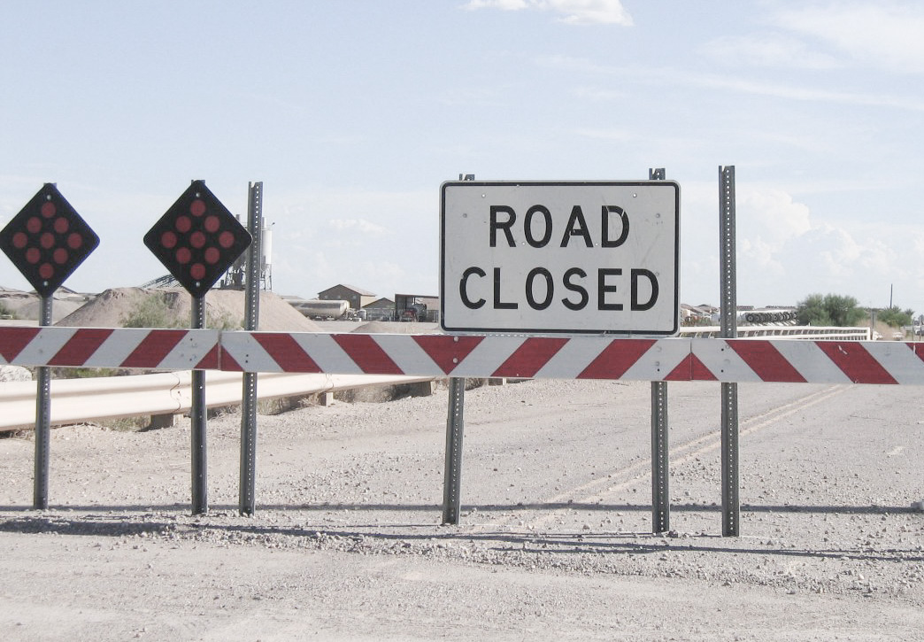
Part 1

Slide 2
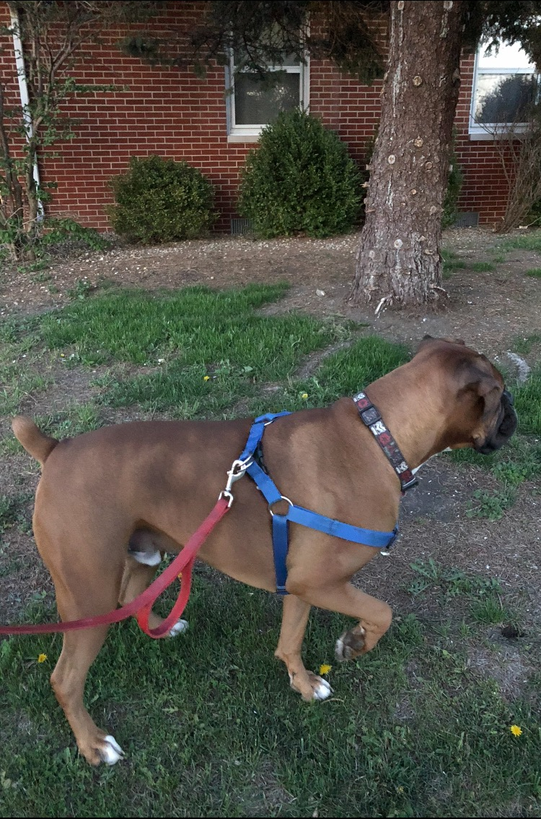

Slide 3

1 Corinthians 10:11
Now all these things happened to them as examples, and they were written for our admonition, upon whom the ends of the ages have come.

Slide 4
Deuteronomy 6:1
“Now this is the commandment, and these are the statutes and judgments which the Lord your God has commanded to teach you, that you may observe them in the land which you are crossing over to possess,

Slide 5
Deuteronomy 6:2
that you may fear the Lord your God, to keep all His statutes and His commandments which I command you, you and your son and your grandson, all the days of your life, and that your days may be prolonged.

Slide 6
Deuteronomy 6:3
Therefore hear, O Israel, and be careful to observe it, that it may be well with you, and that you may multiply greatly as the Lord God of your fathers has promised you—‘a land flowing with milk and honey.’

Slide 7
Deuteronomy 6:4
“Hear, O Israel: The Lord our God, the Lord is one!

Slide 8
Deuteronomy 6:5
You shall love the Lord your God with all your heart, with all your soul, and with all your strength.

Slide 9
Deuteronomy 6:6
“And these words which I command you today shall be in your heart.

Slide 10
Deuteronomy 6:7
You shall teach them diligently to your children, and shall talk of them when you sit in your house, when you walk by the way, when you lie down, and when you rise up.

Slide 11
Deuteronomy 6:8
You shall bind them as a sign on your hand, and they shall be as frontlets between your eyes.

Slide 12
Deuteronomy 6:9
You shall write them on the doorposts of your house and on your gates.

Slide 13
Deuteronomy 6:13
You shall fear the Lord your God and serve Him, and shall take oaths in His name.

Slide 14
Deuteronomy 6:14
You shall not go after other gods, the gods of the peoples who are all around you

Slide 15
The road of not
making God
PRIORITY.

Slide 16
The road of GREED.

Slide 17
The road of
PERMISSIVENESS.

Slide 18
The road of
OUTSOURCING.

Slide 19
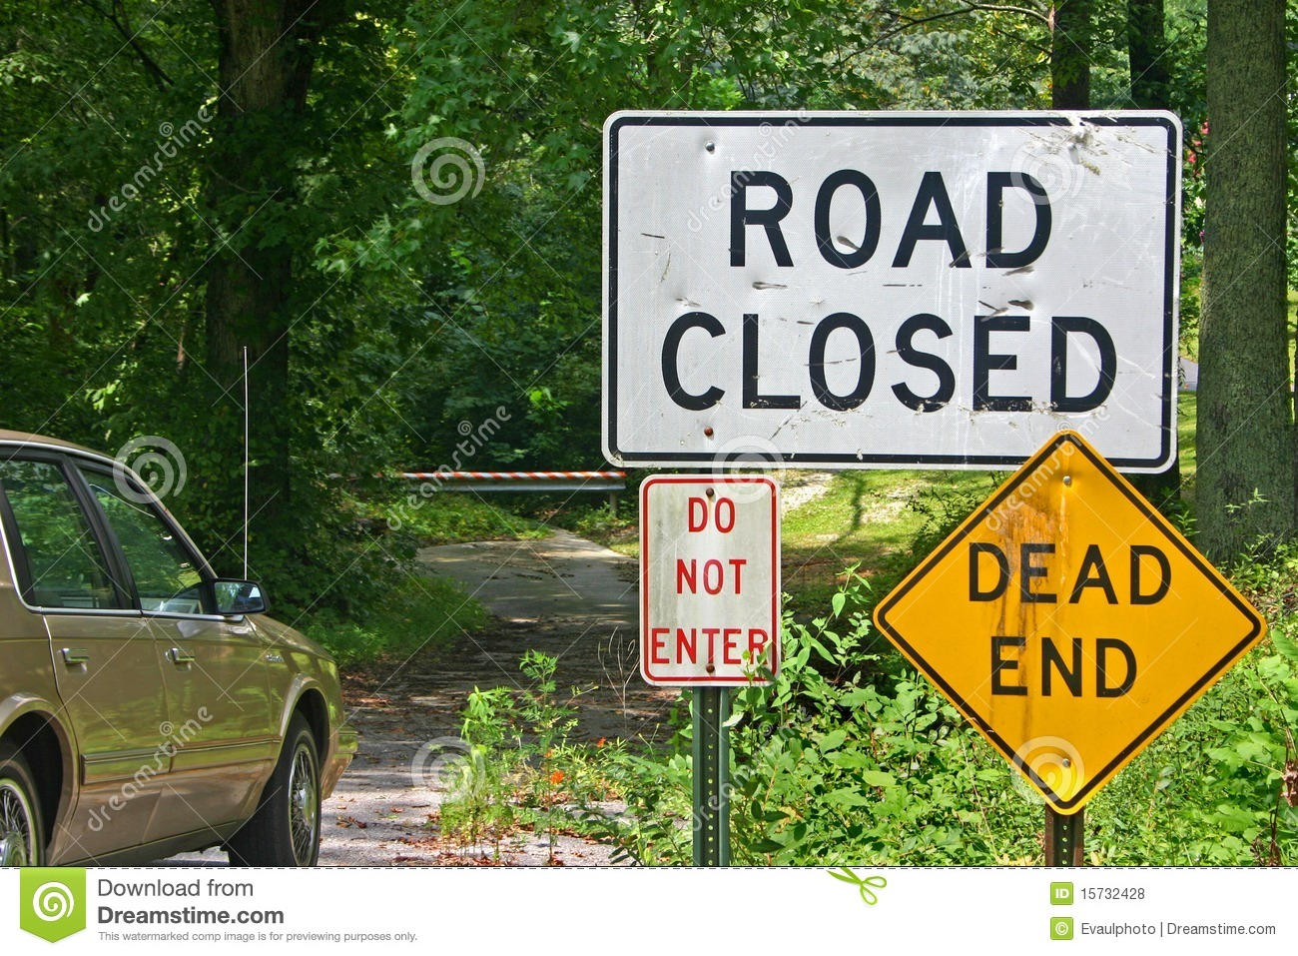

Slide 20
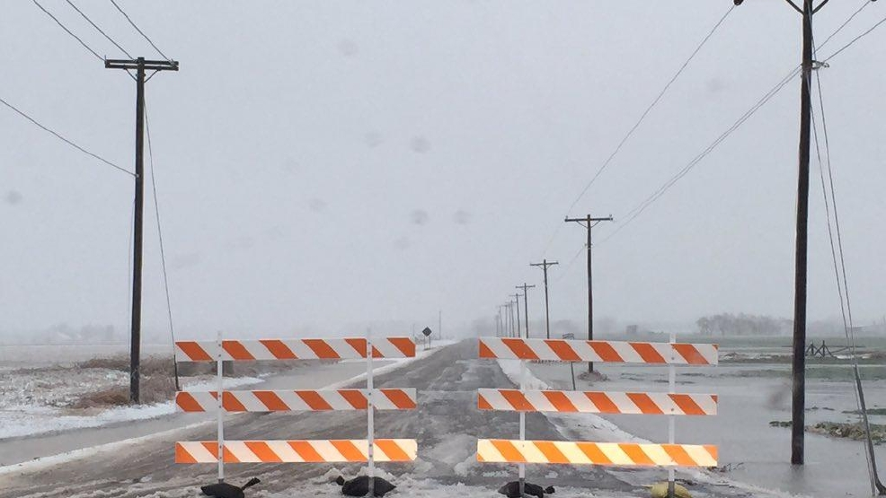
Welcome Back, Stupid!

