Slide 1
In the Fulness of Time
Daniel 9:24-27

Slide 3
GENESIS 12:1
Now the Lord had said to Abram: “Get out of your country, from your family and from your father’s house, to a land that I will show you.

Slide 4
GENESIS 12:2
I will make you a great nation; I will bless you and make your name great; and you shall be a blessing.

Slide 5
GENESIS 12:3
I will bless those who bless you, and I will curse him who curses you; and in you all the families of the earth shall be blessed.”

Slide 6
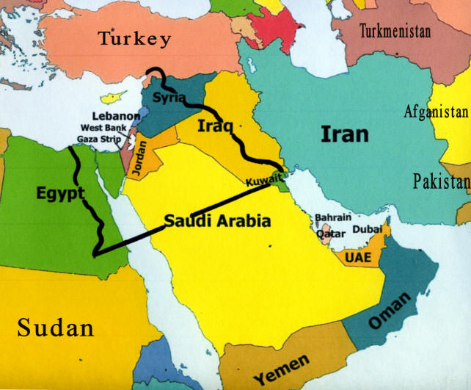

Slide 8
ZECHARIAH 12:2
“Behold, I will make Jerusalem a cup of drunkenness to all the surrounding peoples, when they lay siege against Judah and Jerusalem.

Slide 9
ZECHARIAH 12:3
And it shall happen in that day that I will make Jerusalem a very heavy stone for all peoples; all who would heave it away will surely be cut in pieces, though all nations of the earth are gathered against it.

Slide 11
ISAIAH 66:8
Who has heard such a thing? Who has seen such things? Shall the earth be made to give birth in one day? Or shall a nation be born at once? For as soon as Zion was in labor, She gave birth to her children.

Slide 12
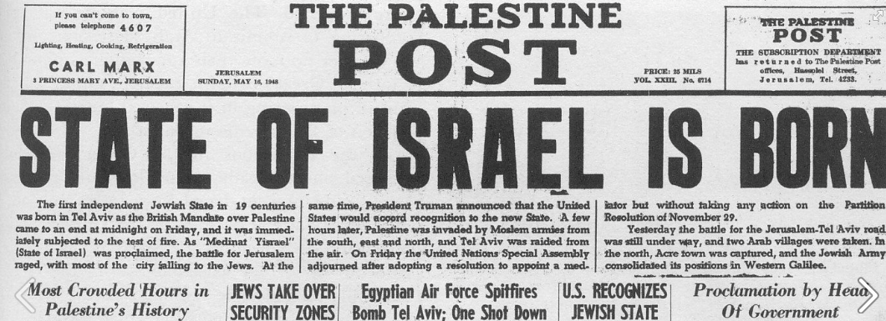

Slide 13
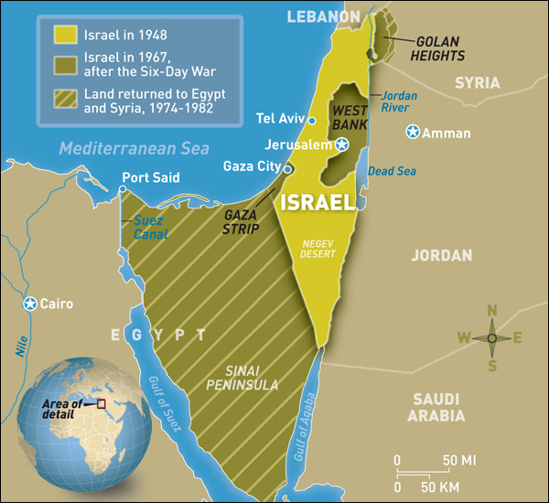

Slide 15
JEREMIAH 39:7
Moreover he put out Zedekiah’s eyes, and bound him with bronze fetters to carry him off to Babylon.

Slide 16
JEREMIAH 39:10
But Nebuzaradan the captain of the guard left in the land of Judah the poor people, who had nothing, and gave them vineyards and fields at the same time.

Slide 17
DANIEL 9:1
In the first year of Darius the son of Ahasuerus, of the lineage of the Medes, who was made king over the realm of the Chaldeans—

Slide 18
DANIEL 9:2
in the first year of his reign I, Daniel, understood by the books the number of the years specified by the word of the Lord through Jeremiah the prophet, that He would accomplish seventy years in the desolations of Jerusalem.

Slide 19
DANIEL 9:3
Then I set my face toward the Lord God to make request by prayer and supplications, with fasting, sackcloth, and ashes.

Slide 20
DANIEL 9:24
“Seventy weeks are determined for your people and for your holy city, to finish the transgression, to make an end of sins, to make reconciliation for iniquity, to bring in everlasting righteousness, to seal up vision and prophecy, and to anoint the Most Holy.

Slide 21
Finish rejecting
Messiah

Slide 22
Make an end of
sin for Jews

Slide 23
Jews will accept
Messiah

Slide 24
Everlasting righteousness -
Earthly kingdom

Slide 25
All Messianic
prophecy fulfilled

Slide 26
Anointing of
King of Kings

Slide 27
DANIEL 9:25
“Know therefore and understand, that from the going forth of the command to restore and build Jerusalem until Messiah the Prince, there shall be seven weeks and sixty-two weeks; the street shall be built again, and the wall, even in troublesome times.

Slide 28
GALATIONS 4:4
But when the fullness of the time had come, God sent forth His Son, born of a woman, born under the law,

Slide 29
DANIEL 9:26
“And after the sixty-two weeks Messiah shall be cut off, but not for Himself; and the people of the prince who is to come shall destroy the city and the sanctuary. The end of it shall be with a flood, and till the end of the war desolations are determined.

Slide 30
DANIEL 9:27
Then he shall confirm a covenant with many for one week; but in the middle of the week He shall bring an end to sacrifice and offering. And on the wing of abominations shall be one who makes desolate, even until the consummation, which is determined, is poured out on the desolate.”

Slide 31
2 THESSALONIANS 2:4
who opposes and exalts himself above all that is called God or that is worshiped, so that he sits as God in the temple of God, showing himself that he is God.

Slide 32
MATTHEW 24:15
“Therefore when you see the ‘abomination of desolation,’ spoken of by Daniel the prophet, standing in the holy place” (whoever reads, let him understand),

Slide 33
MATTHEW 24:16
“then let those who are in Judea flee to the mountains.

Slide 34
MATTHEW 24:17
Let him who is on the housetop not go down to take anything out of his house.

Slide 35
MATTHEW 24:18
And let him who is in the field not go back to get his clothes.

Slide 37
In the Fulness of Time
Daniel 9:24-27

