Slide 1
DAMASCUS’
FUture
Isaiah 17

Slide 2
Zechariah 2:8
For thus says the Lord of hosts: “He sent Me after glory, to the nations which plunder you; for he who touches you touches the apple of His eye.

Slide 3
Zechariah 2:9
For surely I will shake My hand against them, and they shall become spoil for their servants. Then you will know that the Lord of hosts has
sent Me.

Slide 4
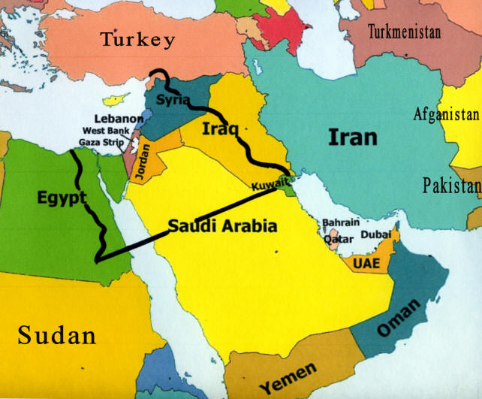

Slide 7
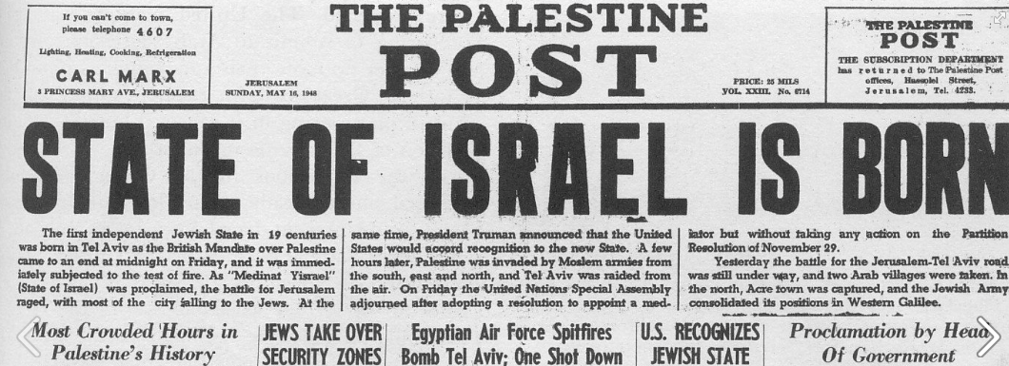

Slide 8
Jeremiah 49:23 (NLT)
This message was given concerning Damascus. This is what the Lord says: “The towns of Hamath and Arpad are struck with fear, for they have heard the news of their destruction. Their hearts are troubled like a wild sea in a
raging storm.

Slide 9
Jeremiah 49:24 (NLT)
Damascus has become feeble, and all her people turn to flee. Fear, anguish, and pain have gripped her as they grip a woman in labor.

Slide 10
Jeremiah 49:25 (NLT)
That famous city, a city of joy, will be forsaken!

Slide 11
Jeremiah 49:26 (NLT)
Her young men will fall in the streets and die. Her soldiers will all be killed,” says the Lord of Heaven’s Armies.

Slide 12
Isaiah 17:1 (NLT)
This message came to me concerning Damascus: “Look, the city of Damascus will disappear! It will become a heap of ruins.

Slide 13
Isaiah 17:2 (NLT)
The towns of Aroer will be deserted. Flocks will graze in the streets and lie down undisturbed, with no one to chase them away.

Slide 14
Isaiah 17:3 (NLT)
The fortified towns of Israel will also be destroyed, and the royal power of Damascus will end. All that remains of Syria will share the fate of Israel’s departed glory,” declares the Lord of Heaven’s Armies.

Slide 15
Isaiah 17:4 (NLT)
“In that day Israel’s glory will grow dim; its robust body will waste away.

Slide 16
Isaiah 17:5 (NLT)
The whole land will look like a grainfield after the harvesters have gathered the grain. It will be desolate, like the fields in the valley of Rephaim after the harvest.

Slide 17
Isaiah 17:6 (NLT)
Only a few of its people will be left, like stray olives left on a tree after the harvest. Only two or three remain in the highest branches, four or five scattered here and there on the limbs,” declares the Lord, the God of Israel.

Slide 18
Isaiah 17:7 (NLT)
Then at last the people will look to their Creator and turn their eyes to the Holy One of Israel.

Slide 19
Isaiah 17:8 (NLT)
They will no longer look to their idols for help or worship what their own hands have made. They will never again bow down to their Asherah poles or worship at the pagan shrines they have built.

Slide 20
Isaiah 17:9 (NLT)
Their largest cities will be like a deserted forest, like the land the Hivites and Amorites abandoned when the Israelites came here so long ago. It will be utterly desolate.

Slide 21
Isaiah 17:10 (NLT)
Why? Because you have turned from the God who can save you. You have forgotten the Rock who can hide you. So you may plant the finest grapevines and import the most expensive seedlings.

Slide 22
Isaiah 17:11 (NLT)
They may sprout on the day you set them out; yes, they may blossom on the very morning you plant them, but you will never pick any grapes from them. Your only harvest will be a load of grief and unrelieved pain.

Slide 23
Isaiah 17:12 (NLT)
Listen! The armies of many nations roar like the roaring of the sea. Hear the thunder of the mighty forces as they rush forward like thundering waves.

Slide 24
Isaiah 17:13 (NLT)
But though they thunder like breakers on a beach, God will silence them, and they will run away. They will flee like chaff scattered by the wind, like a tumbleweed whirling before a storm.

Slide 25
Isaiah 17:14 (NLT)
In the evening Israel waits in terror, but by dawn its enemies are dead. This is the just reward of those who plunder us, a fitting end for those who destroy us.

Slide 30
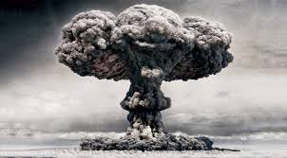

Slide 31
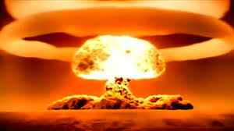

Slide 33
1 Thessalonians 1:9
For they themselves declare concerning us what manner of entry we had to you, and how you turned to God from idols to serve the living and
true God,

Slide 34
1 Thessalonians 1:10
and to wait for His Son from heaven, whom He raised from the dead, even Jesus who delivers us from the wrath to come.

Slide 35
Isaiah 46:8 (NLT)
Do not forget this! Keep it in mind! Remember this, you guilty ones.

Slide 36
Isaiah 46:9 (NLT)
Remember the things I have done in the past. For I alone am God! I am God, and there is none like me.

Slide 37
Isaiah 46:10 (NLT)
Only I can tell you the future before it even happens. Everything I plan will come to pass, for I do whatever I wish.

Slide 38
DAMASCUS’
FUture
Isaiah 17

