Slide 3
Acts 14:23
So when they had appointed elders in every church, and prayed with fasting, they commended them to the Lord in whom they had believed.

Slide 4
1 Peter 5:1
The elders who are among you I exhort, I who am a fellow elder and a witness of the sufferings of Christ, and also a partaker of the glory that will be revealed:

Slide 5
1 Peter 5:2
Shepherd the flock of God which is among you, serving as overseers, not by compulsion but willingly, not for dishonest gain but eagerly;

Slide 6
1 Peter 5:3
nor as being lords over those entrusted to you, but being examples to the flock;

Slide 7
1 Peter 5:4
and when the Chief Shepherd appears, you will receive the crown of glory that does not fade away.

Slide 9
Pastors
are to be
SERVANT LEADERS.

Slide 10
Pastors
are to serve and lead
WILLINGLY.

Slide 11
Pastors should serve with GODLY MOTIVES.

Slide 12
1 Corinthians 9:1
Am I not an apostle? Am I not free? Have I not seen Jesus Christ our Lord? Are you not my work in the Lord?

Slide 13
Pastors should serve with PASSION.

Slide 14
Pastors
should lead with LOVE.

Slide 15
Pastors should serve as STEWARDS of God’s people.

Slide 16
1 Thessalonians 2:11
as you know how we exhorted, and comforted, and charged every one of you, as a father does his own children,

Slide 17
Pastors
should serve as EXAMPLES to the church.

Slide 18
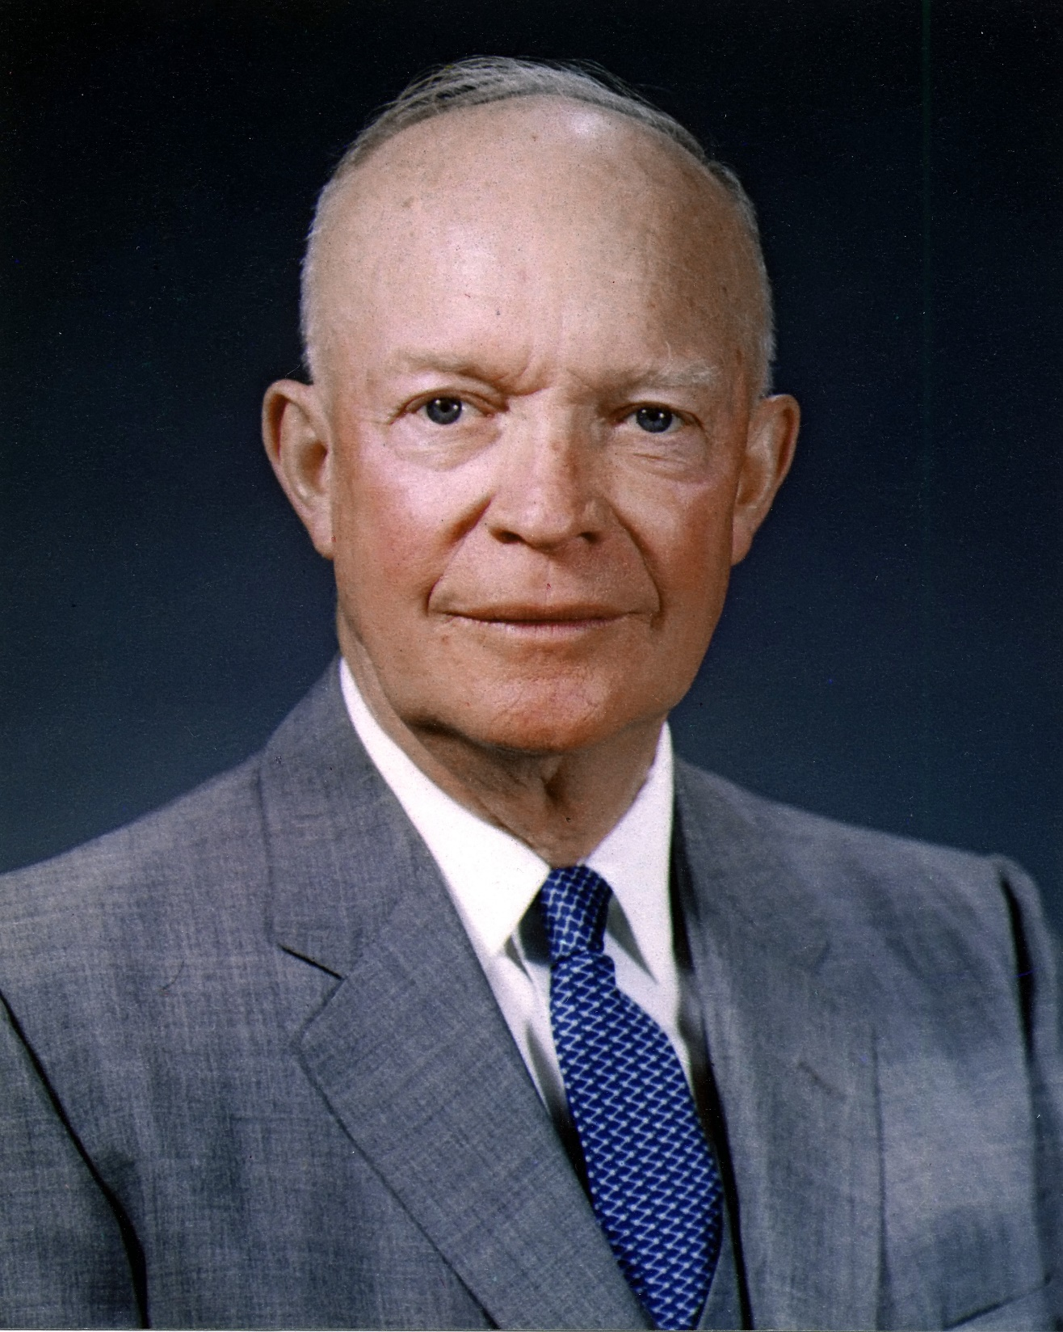

Slide 19
Pastoring God’s way brings ETERNAL REWARD.

Slide 20
Acts 20:28
Therefore take heed to yourselves and to all the flock, among which the Holy Spirit has made you overseers, to shepherd the church of God which He purchased with His own blood.

