Slide 2
1 Peter 4:12
Beloved, do not think it strange concerning the fiery trial which is to try you, as though some strange thing happened to you;

Slide 3
1 Peter 4:13
but rejoice to the extent that you partake of Christ’s sufferings, that when His glory is revealed, you may also be glad with exceeding joy.

Slide 4
1 Peter 4:14
If you are reproached for the name of Christ, blessed are you, for the Spirit of glory and of God rests upon you. On their part He is blasphemed, but on your part He is glorified.

Slide 5
1 Peter 4:15
But let none of you suffer as a murderer, a thief, an evildoer, or as a busybody in other people’s matters.

Slide 6
1 Peter 4:16
Yet if anyone suffers as a Christian, let him not be ashamed, but let him glorify God in this matter.

Slide 7
1 Peter 4:17
For the time has come for judgment to begin at the house of God; and if it begins with us first, what will be the end of those who do not obey the gospel of God?

Slide 8
1 Peter 4:18
Now “If the righteous one is scarcely saved, Where will the ungodly and the sinner appear?”

Slide 9
1 Peter 4:19
Therefore let those who suffer according to the will of God commit their souls to Him in doing good, as to a faithful Creator.

Slide 10
1 Peter 4:12
Beloved, do not think it strange concerning the fiery trial which is to try you, as though some strange thing happened to you;

Slide 11
Christians must not be SURPRISED that we will face trials and suffering.

Slide 12
1 Peter 4:13
but rejoice to the extent that you partake of Christ’s sufferings, that when His glory is revealed, you may also be glad with exceeding joy.

Slide 13
Christians are to REJOICE that they share in Christ’s sufferings.

Slide 14
1 Peter 4:14
If you are reproached for the name of Christ, blessed are you, for the Spirit of glory and of God rests upon you. On their part He is blasphemed, but on your part He is glorified.

Slide 15
Christians should see suffering for Christ as a PRIVILEGE and not
a PENALTY.

Slide 16
1 Peter 4:15
But let none of you suffer as a murderer, a thief, an evildoer, or as a busybody in other people’s matters.

Slide 17
Christians are not to do anything that would cause them to be called CRIMINALS or BUSYBODIES.

Slide 18
1 Peter 4:16
Yet if anyone suffers as a Christian, let him not be ashamed, but let him glorify God in this matter.

Slide 19
Christians should not be ASHAMED of suffering for Christ.

Slide 20
1 Peter 4:17
For the time has come for judgment to begin at the house of God; and if it begins with us first, what will be the end of those who do not obey the gospel of God?

Slide 21
1 Peter 4:18
Now “If the righteous one is scarcely saved, Where will the ungodly and the sinner appear?”

Slide 22
Christians’ faith is often REFINED by trials and suffering.

Slide 23
Hebrews 12:7
If you endure chastening, God deals with you as with sons; for what son is there whom a father does not chasten?

Slide 24
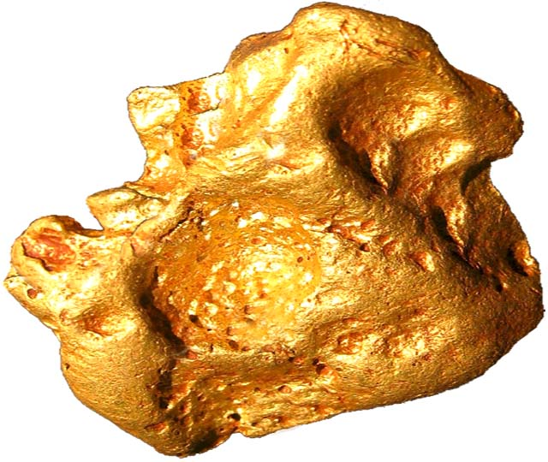

Slide 25
1 Peter 4:19
Therefore let those who suffer according to the will of God commit their souls to Him in doing good, as to a faithful Creator.

Slide 26
Christians can be confident in their trials because they are FILTERED by God.

Slide 27
Christians are to ENTRUST by FAITH themselves to God.

Slide 28
