Slide 1
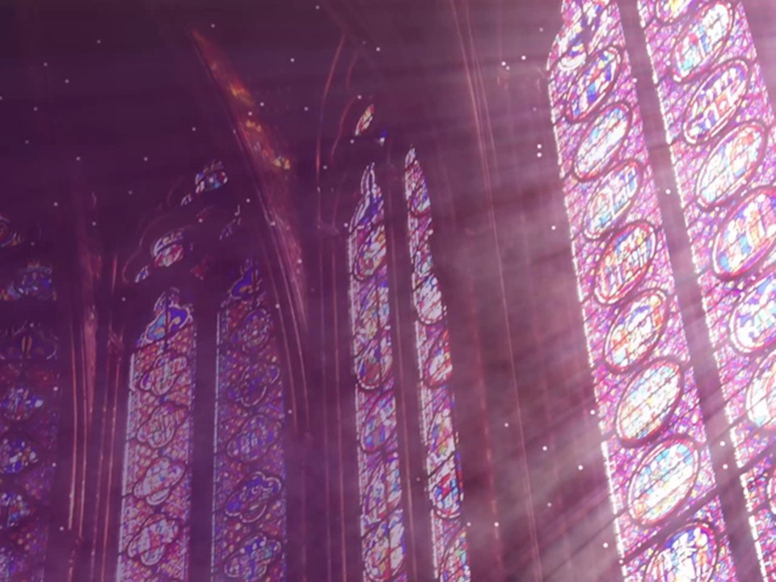
A
Stained
Glass
Window
1 Peter 4:7-11

Slide 2
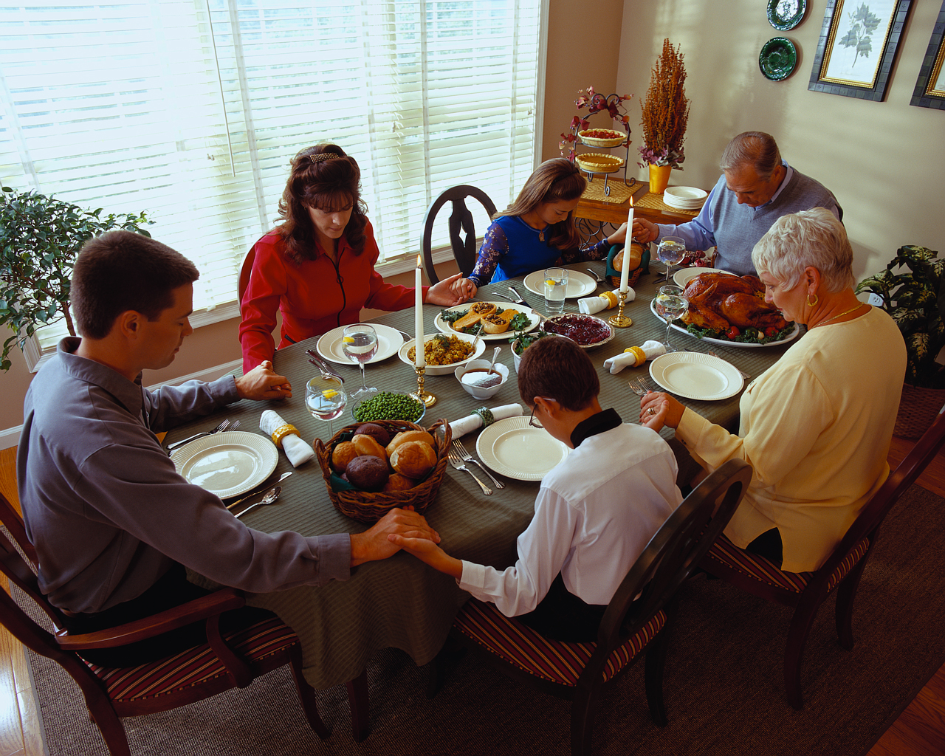

Slide 3
1 Peter 4:7
But the end of all things is at hand; therefore be serious and watchful in your prayers.

Slide 4
1 Peter 4:8
And above all things have fervent love for one another, for “love will cover a multitude of sins.”

Slide 5
1 Peter 4:9
Be hospitable to one another without grumbling.

Slide 6
1 Peter 4:10
As each one has received a gift, minister it to one another, as good stewards of the manifold grace of God.

Slide 7
1 Peter 4:11
If anyone speaks, let him speak as the oracles of God. If anyone ministers, let him do it as with the ability which God supplies, that in all things God may be glorified through Jesus Christ, to whom belong the glory and the dominion forever and ever. Amen.

Slide 8
1 Peter 4:7
But the end of all things is at hand; therefore be serious and watchful in your prayers.

Slide 9
Christians
are to be
SERIOUS about their faith.

Slide 10
Christians
are to be
WATCHFUL
in prayer.

Slide 11


Slide 12
1 Peter 4:8
And above all things have fervent love for one another, for “love will cover a multitude of sins.”

Slide 13
Christians are to be FERVENT
in love for each other.

Slide 14
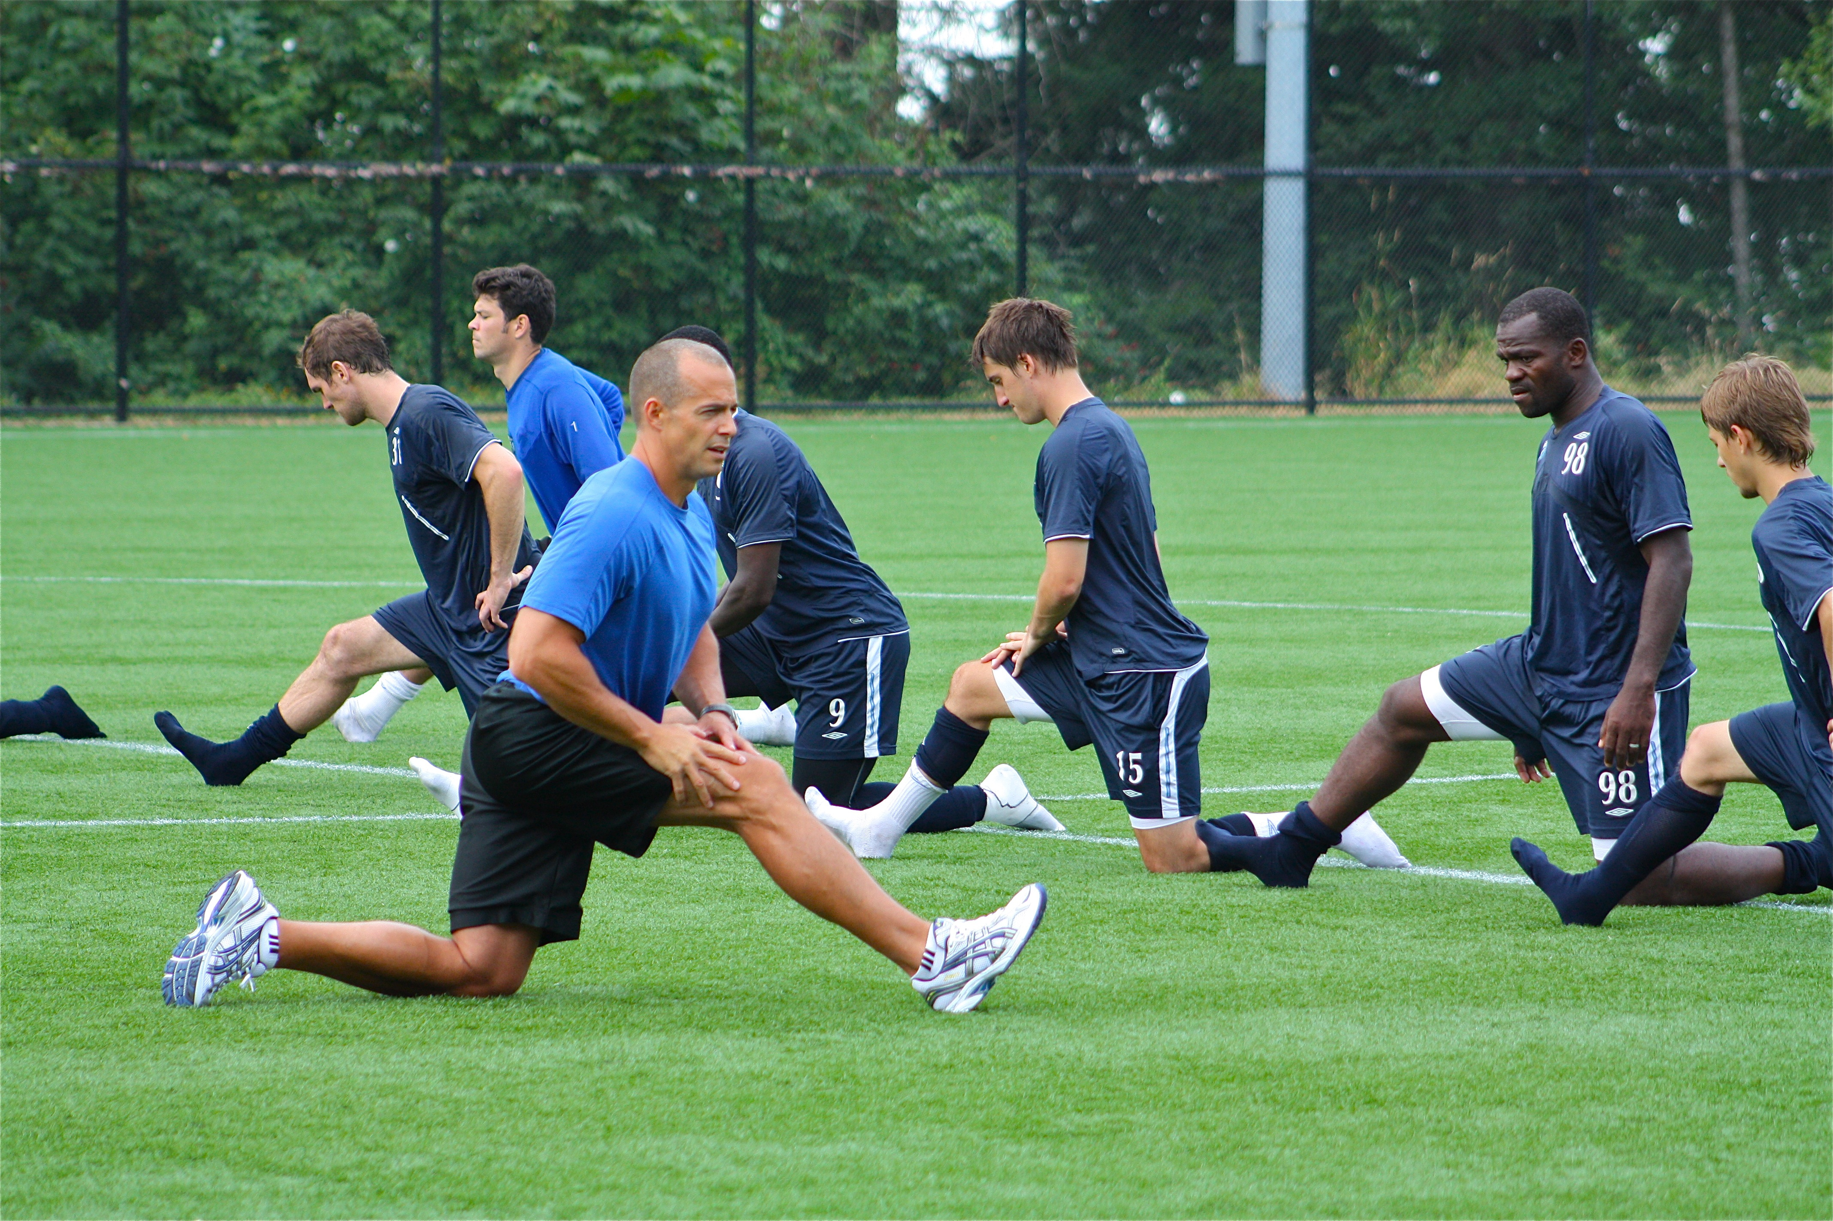

Slide 15
Proverbs 12:10
A righteous man regards the life of his animal, But the tender mercies of the wicked are cruel.

Slide 16
1 Corinthians 13:4
Love suffers long and is kind; love does not envy; love does not parade itself, is not puffed up;

Slide 17
1 Corinthians 13:5
does not behave rudely, does not seek its own, is not provoked, thinks no evil;

Slide 18
1 Corinthians 13:6
does not rejoice in iniquity, but rejoices in the truth;

Slide 19
1 Corinthians 13:7
bears all things, believes all things, hopes all things, endures all things.

Slide 20
1 Peter 4:9
Be hospitable to one another without grumbling.

Slide 21
Christians
are to be HOSPITABLE.

Slide 22
1 Peter 4:10
As each one has received a gift, minister it to one another, as good stewards of the manifold grace of God.

Slide 23
1 Peter 4:11
If anyone speaks, let him speak as the oracles of God. If anyone ministers, let him do it as with the ability which God supplies, that in all things God may be glorified through Jesus Christ, to whom belong the glory and the dominion forever and ever. Amen.

Slide 24
Christians are STEWARDS of their SPIRITUAL GIFTS.

Slide 25
