Slide 5
1 PETER 3:8
Finally, all of you be of one mind, having compassion for one another; love as brothers, be tenderhearted, be courteous;

Slide 6
1 PETER 3:9
not returning evil for evil or reviling for reviling, but on the contrary blessing, knowing that you were called to this, that you may inherit a blessing.

Slide 7
1 PETER 3:10
For “He who would love life And see good days, Let him refrain his tongue from evil, And his lips from speaking deceit.

Slide 8
1 PETER 3:11
Let him turn away from evil and do good; Let him seek peace and pursue it.

Slide 9
1 PETER 3:12
For the eyes of the Lord are on the righteous, And His ears are open to their prayers; But the face of the Lord is against those who do evil.”

Slide 10
We must keep our tongue from EVIL.

Slide 11
We must not return
EVIL for EVIL.

Slide 12
ROMANS 12:17
Repay no one evil for evil. Have regard for good things in the sight of all men.
Turning from evil means we can have no retaliation.

Slide 13
MATTHEW 5:39
But I tell you not to resist an evil person. But whoever slaps you on your right cheek, turn the other to him also.

Slide 14
We must look
for PEACE and PURSUE it.

Slide 15
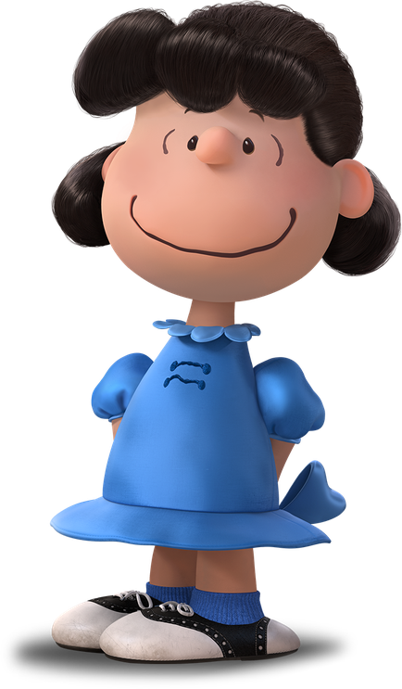
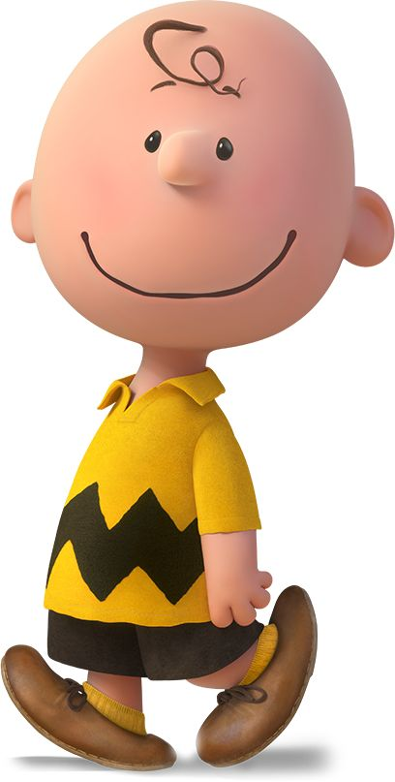

Slide 16
MATTHEW 5:44
But I say to you, love your enemies, bless those who curse you, do good to those who hate you, and pray for those who spitefully use you and persecute you,

Slide 17
1 CORINTHIANS 4:12
And we labor, working with our own hands. Being reviled, we bless; being persecuted, we endure;

Slide 18
We receive the
WATCHING and LISTENING of God.

Slide 19
1 PETER 2:25
For you were like sheep going astray, but have now returned to the Shepherd and Overseer of your souls.

