Slide 1
“FORGET IT!”
1 PETER 2:18-25

Slide 4
1 PETER 2:18
Servants, be submissive to your masters with all fear, not only to the good and gentle, but also to the harsh.

Slide 5
1 PETER 2:19
For this is commendable, if because of conscience toward God one endures grief, suffering wrongfully.

Slide 6
1 PETER 2:20
For what credit is it if, when you are beaten for your faults, you take it patiently? But when you do good and suffer, if you take it patiently, this is commendable before God.

Slide 7
1 PETER 2:21
For to this you were called, because Christ also suffered for us, leaving us an example, that you should follow His steps:

Slide 8
Enduring harshness patiently finds
FAVOR with God.

Slide 9
Enduring harshness patiently FOLLOWS Christ’s example.

Slide 10
1 PETER 2:22
“Who committed no sin, Nor was deceit found in His mouth”;

Slide 11
1 PETER 2:23
who, when He was reviled, did not revile in return; when He suffered, He did not threaten, but committed Himself to Him who judges righteously;

Slide 12
1 PETER 2:24
who Himself bore our sins in His own body on the tree, that we, having died to sins, might live for righteousness—by whose stripes you were healed.

Slide 13
1 PETER 2:25
For you were like sheep going astray, but have now returned to the Shepherd and Overseer of your souls.

Slide 14
We are to be submissive to those over us whether
they are KIND or UNKIND.

Slide 15
It is GRACE when
we suffer for wrong and take it.

Slide 16
It takes a
SPIRIT-FILLED believer to let God right the wrongs.

Slide 17
ROMANS 12:16
Be of the same mind toward one another. Do not set your mind on high things, but associate with the humble. Do not be wise in your own opinion.

Slide 18
ROMANS 12:17
Repay no one evil for evil. Have regard for good things in the sight of all men.

Slide 19
ROMANS 12:18
If it is possible, as much as depends on you, live peaceably with all men.

Slide 20
ROMANS 12:19
Beloved, do not avenge yourselves, but rather give place to wrath; for it is written, “Vengeance is Mine, I will repay,” says the Lord.

Slide 21
ROMANS 12:20
Therefore “If your enemy is hungry, feed him; If he is thirsty, give him a drink; For in so doing you will heap coals of fire on his head.”

Slide 22
ROMANS 12:21
Do not be overcome by evil, but overcome evil with good.

Slide 23
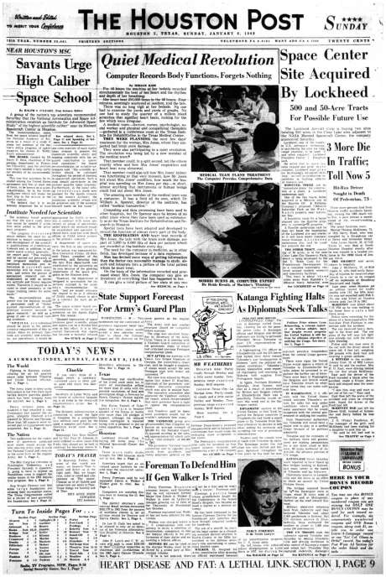

Slide 24
If you see a tall fellow ahead of a crowd,
A leader of men, marching fearless
and proud,
And you know of a tale whose
mere telling aloud
Would cause his proud head in
anguish be bowed,
It’s a pretty good plan to forget it.

Slide 25
If you know of a skeleton hidden away
In a closet, and guarded, and kept from the day
In the dark, whose showing, whose sudden display
Would cause grief and sorrow and pain and dismay,
It’s a pretty good plan to forget it.

Slide 26
If you know of a tale that will darken the joy
Of a man or woman, a girl or a boy,
That will wipe out a smile or the least bit annoy
A fellow, or cause any gladness to cloy,
It’s a pretty good plan to forget it!

Slide 27
“FORGET IT!”
1 PETER 2:18-25

