Slide 1


Slide 2
1 PETER 3:1A
Wives, likewise, be submissive to your own husbands…,..

Slide 3
1 PETER 3:1B
…that even if some do not obey the word, they, without a word, may be won by the conduct of their wives,

Slide 4
1 PETER 3:2
when they observe your chaste conduct accompanied by fear.

Slide 5
TITUS 2:5
to be discreet, chaste, homemakers, good, obedient to their own husbands, that the word of God may not be blasphemed.

Slide 6
1 PETER 3:3
Do not let your adornment be merely outward—arranging the hair, wearing gold, or putting on fine apparel—

Slide 7
1 PETER 3:4
rather let it be the hidden person of the heart, with the incorruptible beauty of a gentle and quiet spirit, which is very precious in the sight of God.

Slide 8
1 PETER 3:5
For in this manner, in former times, the holy women who trusted in God also adorned themselves, being submissive to their own husbands,

Slide 9
1 PETER 3:6
as Sarah obeyed Abraham, calling him lord, whose daughters you are if you do good and are not afraid with any terror.

Slide 10

Godly beauty comes from WITHIN.

Slide 11
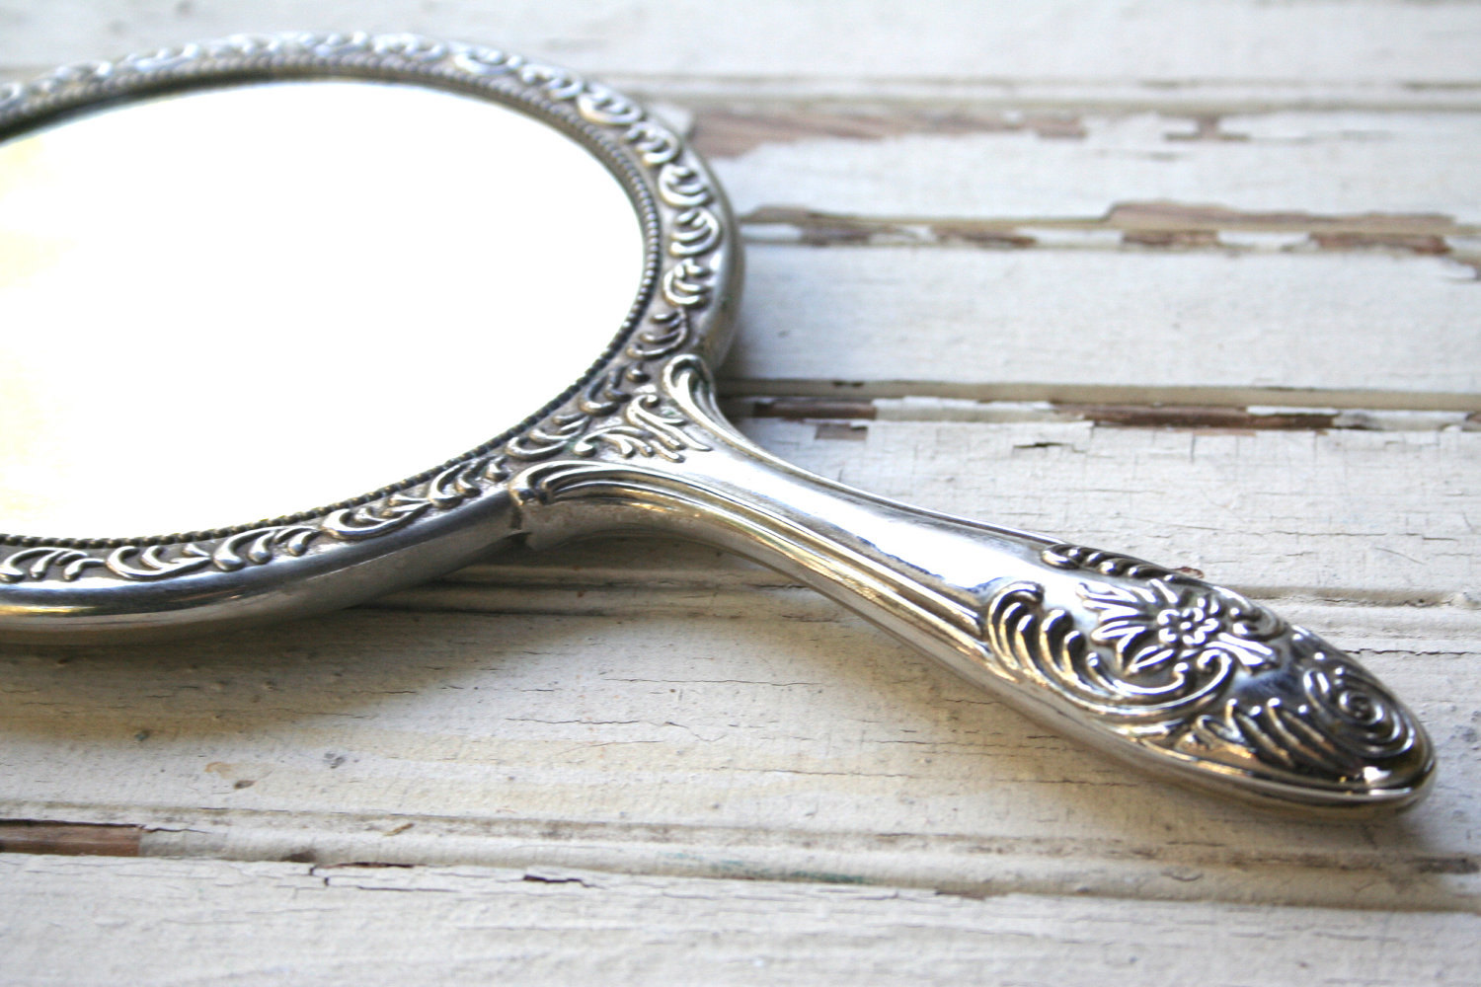

Slide 12
Godly beauty is a great WITNESS to unbelieving men.

Slide 13
Godly beauty affirms
GOD’S WORD.

Slide 14
Godly beauty
puts its’ trust in GOD alone.

Slide 15
1 PETER 3:7
Husbands, likewise, dwell with them with understanding, giving honor to the wife, as to the weaker vessel, and as being heirs together of the grace of life, that your prayers may not be hindered.

Slide 16
Husbands are to give their wives LOVE and UNDERSTANDING.

Slide 17
Husbands should love their wives like Christ loved the CHURCH.

Slide 18
EPHESIANS 5:28
So husbands ought to love their own wives as their own bodies; he who loves his wife loves himself.

Slide 19
EPHESIANS 5:29
For no one ever hated his own flesh, but nourishes and cherishes it, just as the Lord does the church.

Slide 20
EPHESIANS 5:30
For we are members of His body, of His flesh and of His bones.

Slide 21
Husbands must know that their relationship with their wives affects their
PRAYER LIFE.

Slide 22
1 PETER 3:7
Husbands, likewise, dwell with them with understanding, giving honor to the wife, as to the weaker vessel, and as being heirs together of the grace of life, that your prayers may not be hindered.

