Slide 1

3
0
PIECES
OF
___________
SILVER

Slide 2
Matthew 26:14
Then one of the twelve, called Judas Iscariot, went to the chief priests

Slide 3
Matthew 26:15
and said, “What are you willing to give me if I deliver Him to you?” And they counted out to him thirty pieces of silver.

Slide 4
Matthew 26:16
So from that time he sought opportunity to betray Him.

Slide 5
Exodus 21:32
If the ox gores a male or female servant, he shall give to their master thirty shekels of silver, and the ox shall be stoned.

Slide 6
Jewish shekel of silver = $128
____________________________________
30 pieces = $3,840
_____________________________________
Roman Denarius
(one days wage) = $32
______________________________________
120 days or 4 months wages

Slide 7
Matthew 16:24
Then Jesus said to His disciples, “If anyone desires to come after Me, let him deny himself, and take up his cross, and follow Me.

Slide 8
Matthew 16:25
For whoever desires to save his life will lose it, but whoever loses his life for My sake will find it.

Slide 9
Matthew 16:26
For what profit is it to a man if he gains the whole world, and loses his own soul? Or what will a man give in exchange for his soul?

Slide 10
Matthew 16:27
For the Son of Man will come in the glory of His Father with His angels, and then He will reward each according to
his works.

Slide 11
Luke 9:57
Now it happened as they journeyed on the road, that someone said to Him, “Lord, I will follow You wherever You go.”

Slide 12
Luke 9:58
And Jesus said to him, “Foxes have holes and birds of the air have nests, but the Son of Man has nowhere to lay His head.”

Slide 13
Luke 9:59
Then He said to another, “Follow Me.”
But he said, “Lord, let me first go and bury my father.”

Slide 14
Luke 9:60
Jesus said to him, “Let the dead bury their own dead, but you go and preach the kingdom of God.”

Slide 15
Luke 9:61
And another also said, “Lord, I will follow You, but let me first go and bid them farewell who are at my house.”

Slide 16
Luke 9:62
But Jesus said to him, “No one, having put his hand to the plow, and looking back, is fit for the kingdom of God.”

Slide 17
John 21:15
So when they had eaten breakfast, Jesus said to Simon Peter, “Simon, son of Jonah, do you love Me more than these?”
He said to Him, “Yes, Lord; You know that I love You.”
He said to him, “Feed My lambs.”

Slide 18
John 21:16
He said to him again a second time, “Simon, son of Jonah, do you love Me?” He said to Him, “Yes, Lord; You know that I love You.” He said to him, “Tend My sheep.”

Slide 19
John 21:17
He said to him the third time, “Simon, son of Jonah, do you love Me?” Peter was grieved because He said to him the third time, “Do you love Me?” And he said to Him, “Lord, You know all things; You know that I love You.” Jesus said to him, “Feed My sheep.

Slide 20
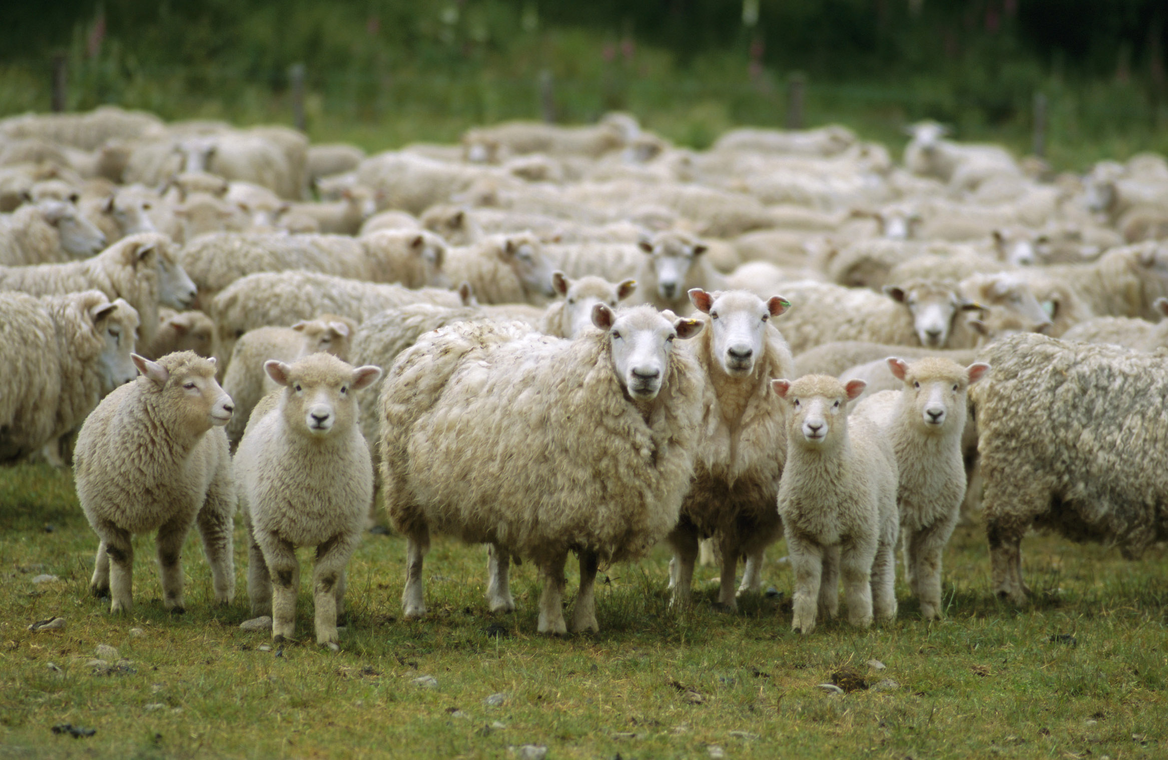

Slide 21
3
0
PIECES
OF
___________
SILVER

