Slide 1
WHAT’S MY
PURPOSE?
1 P E T E R 2 : 4 – 1 0

Slide 2
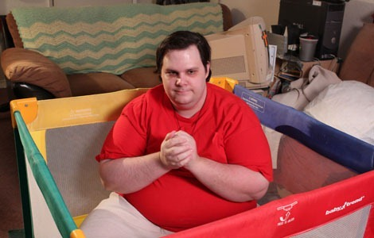

Slide 3
1 PETER 2:4a
“Coming to Him as to a living stone,…”

Slide 4
Holiness begins with continual FELLOWSHIP with Jesus.

Slide 5
1 PETER 2:4b
“…rejected indeed by men, but chosen by God and precious,”

Slide 6
Christ was REJECTED
by men, but LOVED
by God.

Slide 7
Believers are LIVING STONES
conforming to His image.

Slide 8
1 PETER 1:5
“you also, as living stones, are being built up a spiritual house,…”

Slide 9
Believers
are being CONFORMED
to the image
of Christ.

Slide 10
ROMANS 8:29
For whom He foreknew, He also predestined to be conformed to the image of His Son, that He might be the firstborn among
many brethren.

Slide 11
Believers
don‘t just make up the church, but they SERVE
in the church.

Slide 12
1 PETER 2:5b
“…a holy priesthood, to offer up spiritual sacrifices acceptable to God through Jesus Christ.”

Slide 13
Believers must have their faith in CHRIST ALONE.

Slide 14
1 PETER 2:6
Therefore it is also contained in the Scripture, “Behold, I lay in Zion A chief cornerstone, elect, precious, and he who believes on Him will by no means be put to shame.”

Slide 15
1 PETER 2:7
Therefore, to you who believe, He is precious; but to those who are disobedient, “The stone which the builders rejected has become the
chief cornerstone,”

Slide 16
1 PETER 2:8
and “A stone of stumbling and a rock of offense.” They stumble, being disobedient in the word, to which they also were appointed.

Slide 18
Christ will either be SAVIOR
or JUDGE.

Slide 19
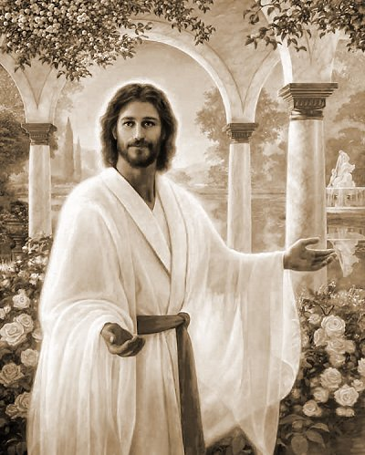
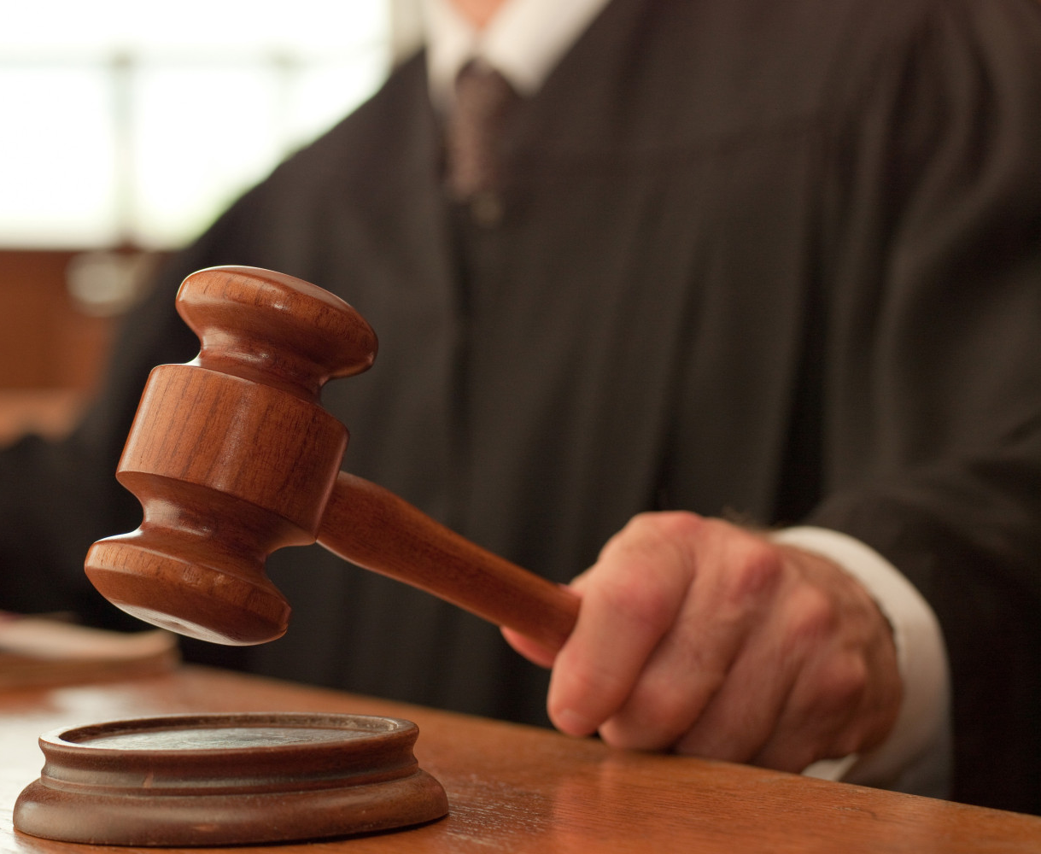

Slide 20
1 PETER 2:9
But you are a chosen generation, a royal priesthood, a holy nation, His own special people, that you may proclaim the praises of Him who called you out of darkness into His marvelous light;

Slide 21
1 PETER 2:10
who once were not a people but are now the people of God, who had not obtained mercy but now have obtained mercy.

Slide 22
The whole purpose of believers is to PROCLAIM
the praises
of God.

Slide 23
WHAT’S MY
PURPOSE?
1 P E T E R 2 : 4 – 1 0

