Slide 1
1 PETER 1:13-21
THIS SIDE UP

Slide 2
1 PETER 1:13A
Therefore gird up the loins of your mind,

Slide 3
Believers must
prepare their MINDS for action.

Slide 4
1 PETER 1:13B
“…be sober,…”

Slide 5
Believers
need to be
SELF-CONTROLLED.

Slide 6
Christians should
be directed from WITHIN.

Slide 7
Believers must realize we have a very real ENEMY.

Slide 8
1 PETER 5:8
Be sober, be vigilant; because your adversary the devil walks about like a roaring lion, seeking whom he may devour.

Slide 9
1 THESSALONIANS 5:6
Therefore let us not sleep, as others do, but let us watch and be sober.

Slide 10
1 PETER 1:13C
“…and rest your hope fully upon the grace that is to be brought to you at the revelation of Jesus Christ.”

Slide 11
Believers must
learn that holy living demands DETERMINATION.

Slide 12
Believers must
not CONFORM to the world’s ways.

Slide 13
1 PETER 1:14
as obedient children (children of obedience), not conforming yourselves to the former lusts, as in your ignorance;

Slide 14
ROMANS 12:2
And do not be conformed to this world, but be transformed by the renewing of your mind, that you may prove what is that good and acceptable and perfect will of God.

Slide 15
EPHESIANS 2:3
among whom also we all once conducted ourselves in the lusts of our flesh, fulfilling the desires of the flesh and of the mind, and were by nature children of wrath, just as the others.

Slide 16
Believers should REFLECT the holy nature of God.

Slide 17
1 PETER 1:15
but as He who called you is
holy, you also be holy in
all your conduct,

Slide 18
1 PETER 1:16
because it is written,
“Be holy, for I am holy.”

Slide 19
Can never become COMPLETELY holy.

Slide 20
Should be in the PROCESS of becoming holy.

Slide 21
Believers should be motivated by the HIGH COST of
our salvation.

Slide 22
1 PETER 1:17
And if you call on the Father, who without partiality judges according to each one’s work, conduct yourselves throughout the time of your stay here in fear;

Slide 23
1 PETER 1:18
knowing that you were not redeemed with corruptible things, like silver or gold, from your aimless conduct received by tradition from your fathers,

Slide 24
1 PETER 1:19
but with the precious blood of Christ, as of a lamb without blemish and without spot.

Slide 25
1 PETER 1:20
He indeed was foreordained before the foundation of the world, but was manifest in these last times for you

Slide 26
1 PETER 1:21
who through Him believe in God, who raised Him from the dead and gave Him glory, so that your faith and hope are in God.

Slide 27
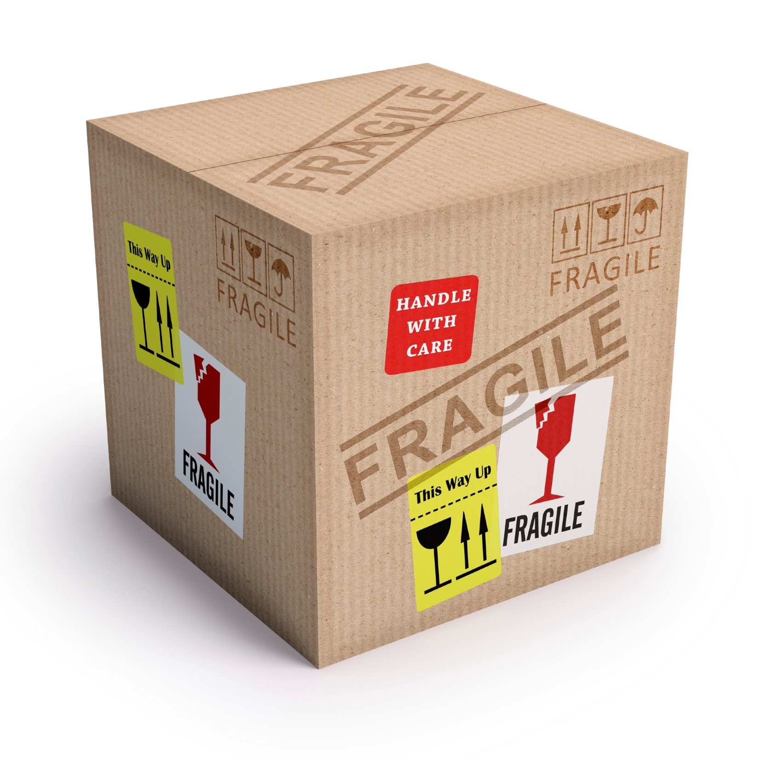

Slide 29
1 PETER 1:13-21
THIS SIDE UP

