Slide 2
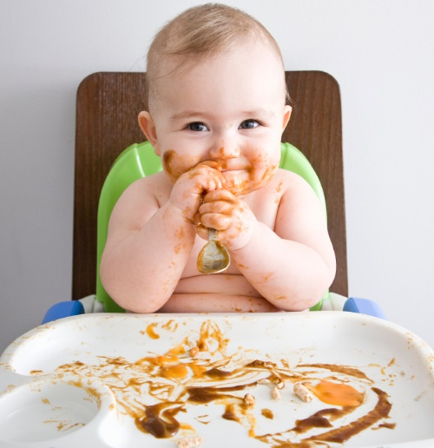

Slide 3
1 PETER 1:22
Since you have purified your souls in obeying the truth through the Spirit in sincere love of the brethren, love one another fervently with a pure heart,

Slide 4
1 PETER 1:23
having been born again,
not of corruptible seed but incorruptible, through the word of God which lives and
abides forever,

Slide 5
1 PETER 1:24
because “All flesh is as grass, and all the glory of man as the flower of the grass. The grass withers, and its flower
falls away,

Slide 6
1 PETER 1:25
But the word of the Lord endures forever.” Now this is the word which by the gospel was preached to you.

Slide 7
The right food is
the ETERNAL
Word of God.

Slide 8
The Scripture
CHANGES us.

Slide 9
Brings us
SALVATION.

Slide 10
Brings
FERVENT LOVE
for others.

Slide 11
Five things that rob our HUNGER for the Word:

Slide 12
Five things that rob our hunger for the Word:
MALICE:
wicked ill will

Slide 13
Five things that rob our hunger for the Word:
DECEIT:
deliberate dishonesty

Slide 14
Five things that rob our hunger for the Word:
HYPOCRISY:
pretending to be what you are not

Slide 15
Five things that rob our hunger for the Word:
ENVY:
resentful discontent

Slide 16
Five things that rob our hunger for the Word:
EVIL SPEAKING:
slandering, talking ill
of another

Slide 17
Scripture is
PURE and brings GROWTH to believers.

Slide 18
1 PETER 2:2
as newborn babes, desire the pure milk of the word, that you may grow thereby,

Slide 19
1 PETER 2:3
if indeed you have tasted that
the Lord is gracious.

Slide 20
