Slide 1

NAMES

Slide 2
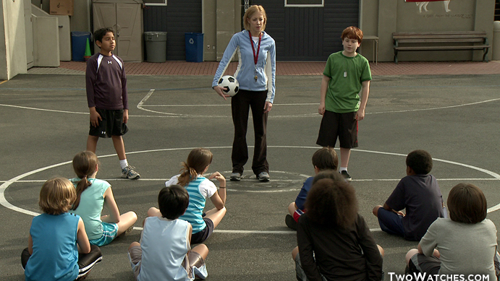

Slide 3

Names of the 12 Disciples of Christ
Simon
Andrew
James
John
Philip
Bartholomew
Thomas
Matthew
James
Lebbaeus
Simon
Judas Iscariot

Slide 4
1 CORINTHIANS 1:26
For you see your calling, brethren, that not many wise according to the flesh, not many mighty, not many noble, are called.

Slide 5
1 CORINTHIANS 1:27
But God has chosen the foolish things of the world to put to shame the wise, and God has chosen the weak things of the world to put to shame the things which are mighty;

Slide 6
1 CORINTHIANS 1:28
and the base things of the world and the things which are despised God has chosen, and the things which are not, to bring to nothing the things that are,

Slide 7
1 CORINTHIANS 1:29
that no flesh should glory in
His presence.

Slide 8
1 PETER 5:5
Likewise you younger people, submit yourselves to your elders. Yes, all of you be submissive to one another, and be clothed with humility, for “God resists the proud, but gives grace to the humble.”

Slide 9
1 PETER 5:6
Therefore humble yourselves under the mighty hand of God, that He may exalt you in due time,

Slide 10
1 PETER 5:7
casting all your care upon Him,
for He cares for you.

Slide 11
1 TIMOTHY 1:15
This is a faithful saying and worthy of all acceptance, that Christ Jesus came into the world to save sinners, of whom I am chief.

Slide 12
LUKE 1:37
For with God nothing will
be impossible.

Slide 13
NAMES

