Slide 1
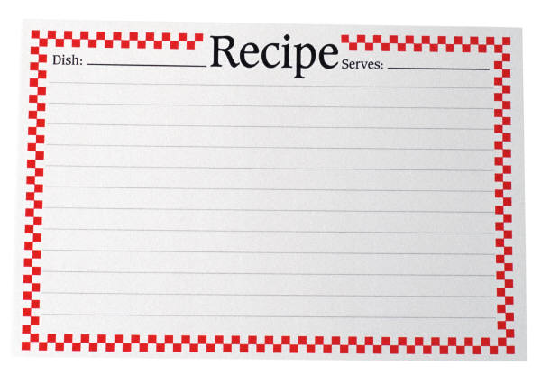
MYSTERY
INGREDIENT

Slide 2
1 PETER 1:10
Of this salvation the prophets have inquired and searched carefully, who prophesied of the grace that would come
to you,

Slide 3
1 PETER 1:11
searching what, or what manner of time, the Spirit of Christ who was in them was indicating when He testified beforehand the sufferings of Christ and the glories that would follow.

Slide 4
1 PETER 1:12
To them it was revealed that, not to themselves, but to us they were ministering the things which now have been reported to you through those who have preached the gospel to you by the Holy Spirit sent from heaven—things which angels desire to look into.

Slide 5
GENESIS 50:20
But as for you, you meant evil against me; but God meant it for good, in order to bring it about as it is this day, to save many people alive.

Slide 6
MATTHEW 5:10
Blessed are those who are persecuted for righteousness’ sake, for theirs is the kingdom of heaven.

Slide 7
MATTHEW 5:11
“Blessed are you when they revile and persecute you, and say all kinds of evil against you falsely for My sake.

Slide 8
MATTHEW 5:12
Rejoice and be exceedingly glad, for great is your reward in heaven, for so they persecuted the prophets who were before you.

Slide 9
MATTHEW 16:15
He said to them, “But who do you say that I am?”

Slide 10
MATTHEW 16:16
Simon Peter answered and said, “You are the Christ, the Son of the living God.”

Slide 11
MATTHEW 16:17
Jesus answered and said to him, “Blessed are you, Simon Bar-Jonah, for flesh and blood has not revealed this to you, but My Father who is in heaven.

Slide 12
MATTHEW 16:18
And I also say to you that you are Peter, and on this rock I will build My church, and the gates of Hades shall not prevail against it.

Slide 13
MATTHEW 16:19
And I will give you the keys of the kingdom of heaven, and whatever you bind on earth will be bound in heaven, and whatever you loose on earth will be loosed in heaven.”

Slide 14
MATTHEW 16:20
Then He commanded His disciples that they should tell no one that He was Jesus the Christ.

Slide 15
MATTHEW 16:21
From that time Jesus began to show to His disciples that He must go to Jerusalem, and suffer many things from the elders and chief priests and scribes, and be killed, and be raised the third day.

Slide 16
MATTHEW 16:22
Then Peter took Him aside and began to rebuke Him, saying, “Far be it from You, Lord; this shall not happen to you!”

Slide 17
MATTHEW 16:23
But He turned and said to Peter, “Get behind Me, Satan! You are an offense to Me, for you are not mindful of the things of God, but the things of men.”

Slide 18
LUKE 22:17
Then He took the cup, and gave thanks, and said, “Take this and divide it among yourselves;

Slide 19
LUKE 22:18
for I say to you, I will not drink of the fruit of the vine until the kingdom of God comes.”

Slide 20
LUKE 22:19
And He took bread, gave thanks and broke it, and gave it to them, saying, “This is My body which is given for you; do this in remembrance of Me.”

Slide 21
LUKE 22:20
Likewise He also took the cup after supper, saying, “This cup is the new covenant in My blood, which is shed for you.

Slide 22
MYSTERY
INGREDIENT

