Slide 1
Trials
in
1 Peter 1:3-12

Slide 2
1 Peter 1:3
Blessed be the God and Father of our Lord Jesus Christ, who according to His abundant mercy has begotten us again to a living hope through the resurrection of Jesus Christ from the dead,

Slide 3
1 Peter 1:4
to an inheritance incorruptible and undefiled and that does not fade away, reserved in heaven
for you,

Slide 4
1 Peter 1:5
who are kept by the power of God through faith for salvation ready to be revealed in the last time.

Slide 5
1 Peter 1:6
In this you greatly rejoice, though now for a little while, if need be, you have been grieved by various trials,

Slide 6
1 Peter 1:7
that the genuineness of your faith, being much more precious than gold that perishes, though it is tested by fire, may be found to praise, honor, and glory at the revelation of Jesus Christ,

Slide 7
1 Peter 1:8
whom having not seen you love. Though now you do not see Him, yet believing, you rejoice with joy inexpressible and full of glory,

Slide 8
1 Peter 1:9
receiving the end of your faith—the salvation of your souls.

Slide 9
1 Peter 1:10
Of this salvation the prophets have inquired and searched carefully, who prophesied of the grace that would come to you,

Slide 10
1 Peter 1:11
searching what, or what manner of time, the Spirit of Christ who was in them was indicating when He testified beforehand the sufferings of Christ and the glories that would follow.

Slide 11
1 Peter 1:12
To them it was revealed that, not to themselves, but to us they were ministering the things which now have been reported to you through those who have preached the gospel to you by

Slide 12
the Holy Spirit sent from
Heaven– things which angels desire to look into.

Slide 13
To have joy in trials
we must get God’s
PERSPECTIVE
on trials.

Slide 14
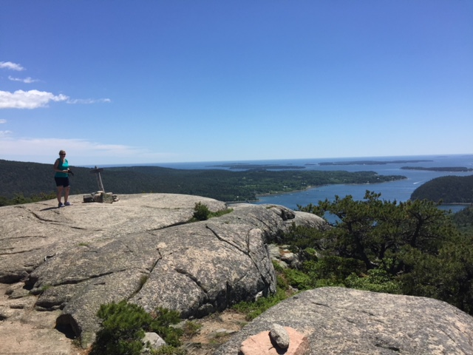

Slide 15
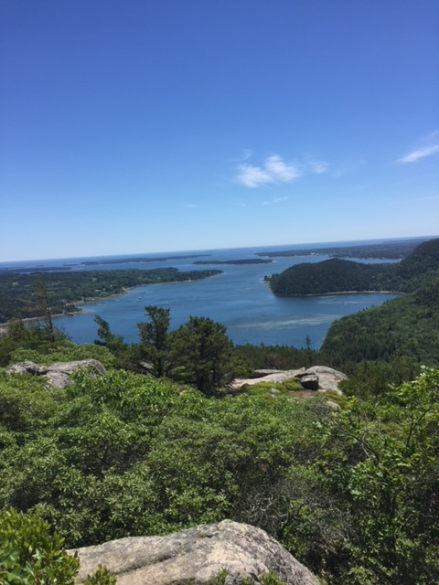

Slide 16
God never tests
us to see us
FAIL.

Slide 17
Trials and suffering
are for our BENEFIT
and GROWTH.

Slide 18
Hebrews 12:11
Now no chastening seems to be joyful for the present, but painful; nevertheless, afterward it yields the peaceable fruit of righteousness to those who have been trained by it.

Slide 19
Trials can be used by God for a WITNESS
to others.

Slide 20
Acts 16:25
But at midnight Paul and Silas were praying and singing hymns to God, and the prisoners were listening to them.

Slide 21
God uses trials and suffering to REFINE
us for SERVICE.

Slide 22
1 Peter 1:6
In this you greatly rejoice, though now for a little while, if need be, you have been grieved by various trials,

Slide 23
1 Peter 1:7
that the genuineness of your faith, being much more precious than gold that perishes, though it is tested by fire, may be found to praise, honor, and glory at the revelation of Jesus Christ,

Slide 24
1 Peter 1:8
whom having not seen you love. Though now you do not see Him, yet believing, you rejoice with joy inexpressible and full of glory,

Slide 25
1 Peter 1:9
receiving the end of your faith—the salvation of your souls.

Slide 26
Trials and chastening come to those
God LOVES.

Slide 27
Hebrews 12:6
For whom the Lord loves He chastens, And scourges every son whom He receives.”

Slide 28
Hebrews 12:8
But if you are without
chastening, of which all have become partakers, then you are illegitimate and not sons.

Slide 29
It is easier to have joy when we EXPECT
trials to come.

Slide 30
2 Timothy 3:12
Yes, and all who desire to live godly in Christ Jesus will suffer persecution.

Slide 31
1 Peter 4:12
Beloved, do not think it strange concerning the fiery trial which is to try you, as though some strange thing happened to you;

Slide 32
Acts 5:41
So they departed from the presence of the council, rejoicing that they were counted worthy to suffer shame for His name.

Slide 33
We can have confidence in trials because CHRIST
has DEFEATED
the enemy.

Slide 34
John 16:33
These things I have spoken to you, that in Me you may have peace. In the world you will have tribulation; but be of good cheer, I have overcome the world.”

Slide 35
We can have joy when we remember trials are TEMPORARY.

Slide 36
2 Corinthians 4:17
For our light affliction, which is but for a moment, is working for us a far more exceeding and eternal weight of glory,

Slide 37
2 Corinthians 4:18
while we do not look at the things which are seen, but at the things which are not seen. For the things which are seen are temporary, but the things which are not seen are eternal.

Slide 39
Trials
in
1 Peter 1:3-12

