Slide 2
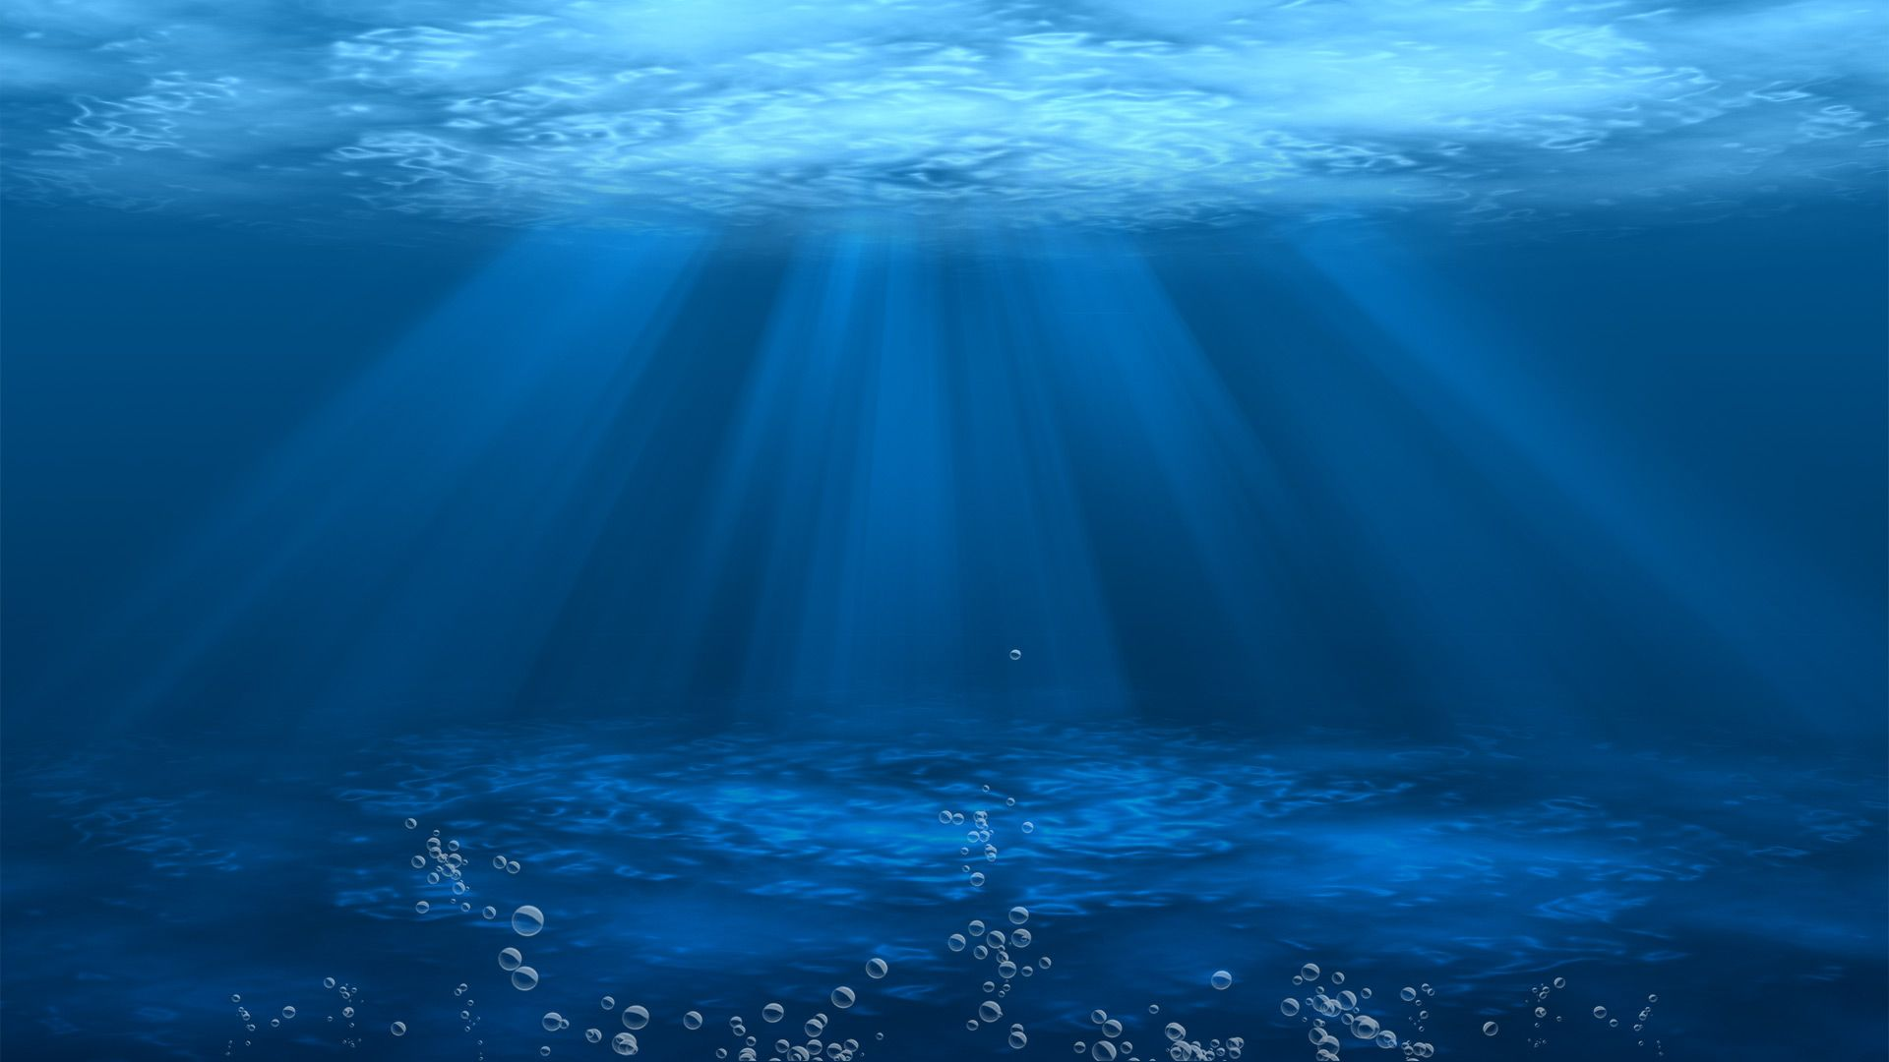
JONAH 1:17
Now the Lord had prepared a great fish to swallow Jonah. And Jonah was in the belly of the fish three days and three nights.

Slide 3
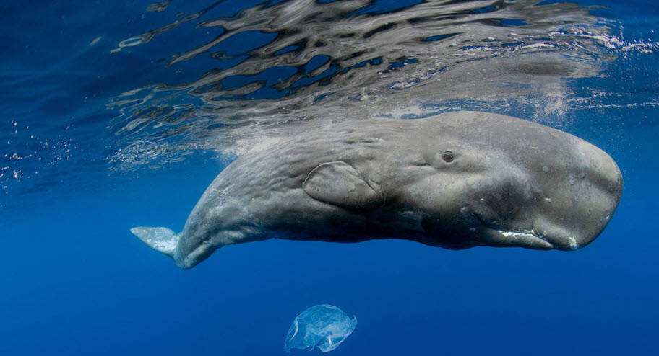

Slide 4
JONAH 2:1
Then Jonah prayed to the Lord his God from the fish’s belly.

Slide 5
JONAH 2:2
And he said: “I cried out to the Lord because of my affliction, and He answered me. “Out of the belly of Sheol I cried, and You heard my voice.

Slide 6
JONAH 2:3
For You cast me into the deep, into the heart of the seas, and the floods surrounded me; all Your billows and Your waves passed over me.

Slide 7
JONAH 2:4
Then I said, ‘I have been cast out of Your sight; yet I will look again toward Your holy temple.’

Slide 8
JONAH 2:5
The waters surrounded me, even to my soul; the deep closed around me; weeds were wrapped around my head.

Slide 9
JONAH 2:6
I went down to the moorings of the mountains; the earth with its bars closed behind me forever; yet You have brought up my life from the pit, O Lord, my God.

Slide 10
JONAH 2:7
“When my soul fainted within me, I remembered the Lord; and my prayer went up to You, into Your holy temple.

Slide 11
JONAH 2:4
Then I said, ‘I have been cast out of Your sight; yet I will look again toward Your holy temple.’

Slide 12
JONAH 2:9
But I will sacrifice to You with the voice of thanksgiving; I will pay what I have vowed. Salvation is of the Lord.”

Slide 13
PSALM 51:17
The sacrifices of God are a broken spirit, a broken and a contrite heart – These, O God, You will not despise.

Slide 14
JONAH 2:10
So the Lord spoke to the fish, and it vomited Jonah onto dry land.

Slide 15
Jonah RESISTED
the will of God.

Slide 16
Jonah REPENTS
of his rebellion.

Slide 17
Jonah is REVIVED
spiritually.

Slide 18
Jonah RE-ENLISTS
in God’s service.

