Slide 1

Second Chances
Jonah 3:1-4

Slide 2

JONAH 2:8
“Those who regard worthless idols forsake their own mercy.

Slide 3
JONAH 2:9
But I will sacrifice to You with the voice of thanksgiving; I will pay what I have vowed. Salvation is of the Lord.”

Slide 4
JONAH 2:10
So the Lord spoke to the fish, and it vomited Jonah onto dry land.

Slide 5
JONAH 3:1
Now the word of the Lord came to Jonah the second time, saying,

Slide 6
JOHN 5:14
Afterward Jesus found him in the temple, and said to him, “See, you have been made well. Sin no more, lest a worse thing come upon you.”

Slide 7
JONAH 3:2
“Arise, go to Nineveh, that great city, and preach to it the message that I tell you.”

Slide 8
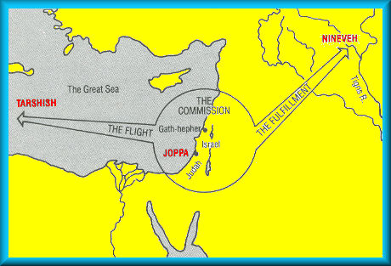

Slide 9
JONAH 3:3
So Jonah arose and went to Nineveh, according to the word of the Lord. Now Nineveh was an exceedingly great city, a three-day
journey in extent.

Slide 10
JONAH 3:4
And Jonah began to enter the city on the first day’s walk. Then he cried out and said, “Yet forty days, and Nineveh shall be overthrown!”

Slide 11
PSALM 119:71
It is good for me that I have been afflicted, that I may learn Your statutes.

Slide 12
Second Chances
Jonah 3:1-4

