Slide 1
GRACE
in
UNLIKELY PLACES
______
Jonah 3:4-10

Slide 2
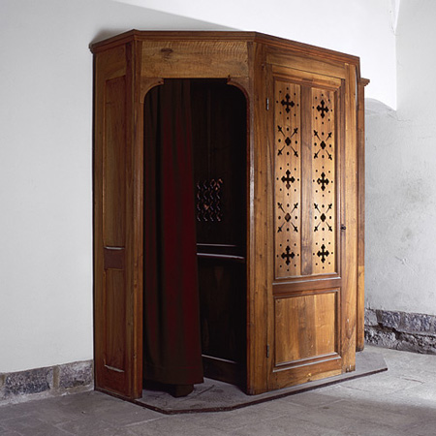

Slide 3
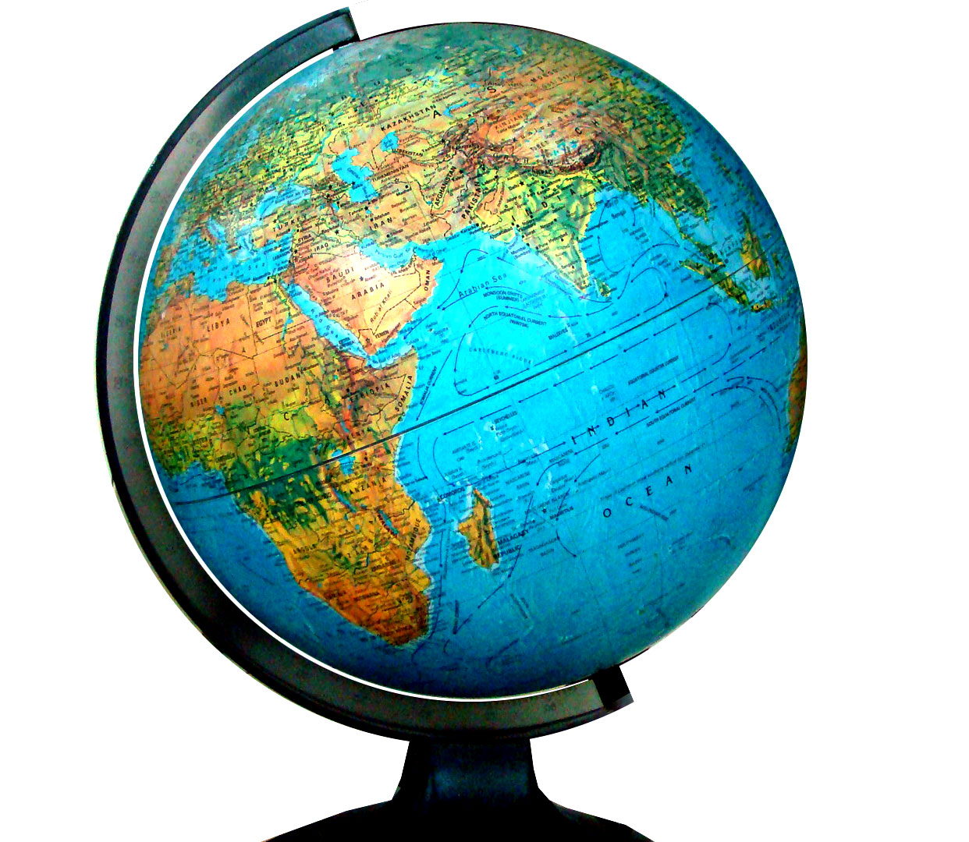
GUILT

Slide 4
1 TIMOTHY 2:5
For there is one God and one Mediator between God and men, the Man Christ Jesus,

Slide 5
JONAH 3:4
And Jonah began to enter the city on the first day’s walk. Then he cried out and said, “Yet forty days, and Nineveh shall be overthrown!”

Slide 6
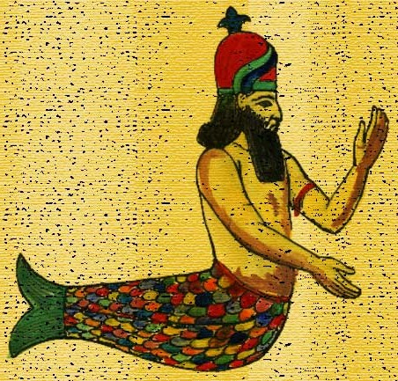

Slide 7
JONAH 3:5
So the people of Nineveh believed God, proclaimed a fast, and put on sackcloth, from the greatest to the least of them.

Slide 8
JONAH 3:6
Then word came to the king of Nineveh; and he arose from his throne and laid aside his robe, covered himself with sackcloth and sat in ashes.

Slide 9
True repentance and confession changes people radically in their
PERSONAL lives.

Slide 10
To avoid the Lord
is to avoid true CONFESSION.

Slide 11
To avoid true
confession is to miss true FORGIVENESS.

Slide 12
True repentance and confession changes people radically in their
PUBLIC lives.

Slide 13
JONAH 3:7
And he caused it to be proclaimed and published throughout Nineveh by the decree of the king and his nobles, saying, Let neither man nor beast, herd nor flock, taste anything; do not let them eat, or drink water.

Slide 14
JONAH 3:8
But let man and beast be covered with sackcloth, and cry mightily to God; yes, let every one turn from his evil way and from the violence that is in his hands.

Slide 15
JONAH 3:9
Who can tell if God will turn and relent, and turn away from His fierce anger, so that we may not perish?

Slide 16
JONAH 3:10
Then God saw their works, that they turned from their evil way; and God relented from the disaster that He had said He would bring upon them, and He did not do it.

Slide 17
God responded
with GRACE to their change of heart.

Slide 18
God’s grace
breaks through in
UNEXPECTED ways.

Slide 19
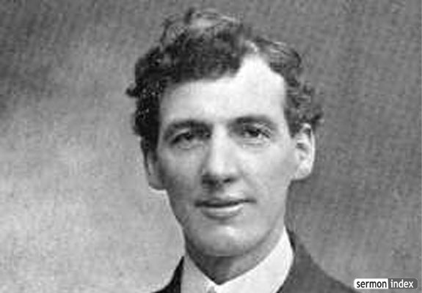

Slide 20
Confess all
KNOWN sin.

Slide 21
Get rid of all
DOUBTFUL things.

Slide 22
Follow intently the
HOLY SPIRIT.

Slide 23
Make Christ known
in your PUBLIC life.

Slide 24
GRACE
in
UNLIKELY PLACES
______
Jonah 3:4-10

