Slide 1
COMFORT
__________________
COMPASSION
Jonah 4:1-11

Slide 2
Who
cares?

Slide 3
JONAH 3:9
Who can tell if God will turn and relent, and turn away from His fierce anger, so that we may not perish?

Slide 4
JONAH 3:10
Then God saw their works, that they turned from their evil way; and God relented from the disaster that He had said He would bring upon them, and He did not do it.

Slide 5
God turns
FROM anger.

Slide 6
Jonah turns
TO anger.

Slide 7
JONAH 4:1
But it displeased Jonah exceedingly, and he became angry.

Slide 8
JONAH 4:2
So he prayed to the Lord, and said, “Ah, Lord, was not this what I said when I was still in my country? Therefore I fled previously to Tarshish; for I know that You are a gracious and merciful God, slow to anger and abundant in lovingkindness, One who relents from doing harm.

Slide 9
OBJECT of God’s compassion had
NO compassion.

Slide 10
JONAH 4:3
Therefore now, O Lord, please take my life from me, for it is better for me to die than to live!”

Slide 11
JONAH 4:4
Then the Lord said, “Is it right for you to be angry?”

Slide 12
JONAH 4:5
So Jonah went out of the city and sat on the east side of the city. There he made himself a shelter and sat under it in the shade, till he might see what would become of the city.

Slide 15
Even though he had received MERCY, he wanted God to JUDGE harshly.

Slide 17
JONAH 4:6
And the Lord God prepared a plant and made it come up over Jonah, that it might be shade for his head to deliver him from his misery. So Jonah was very grateful for the plant.

Slide 18
JONAH 4:7
But as morning dawned the next day God prepared a worm, and it so damaged the plant that it withered.

Slide 19
JONAH 4:8
And it happened, when the sun arose, that God prepared a vehement east wind; and the sun beat on Jonah’s head, so that he grew faint. Then he wished death for himself, and said, “It is better for me to die than to live.”

Slide 20
JONAH 4:9
Then God said to Jonah, “Is it right for you to be angry with the plant?” And he said “It is right for me to be angry, even to death!”

Slide 21
JONAH 4:10
But the Lord said, “You have had pity on the plant for which you have not labored, nor made it grow, which came up in a night and perished in a night.

Slide 22
JONAH 4:11
And should I not pity Nineveh, that great city, in which are more than one hundred and twenty thousand persons who cannot discern between their right hand and their left – and much livestock?

Slide 23
Jonah cares more for his COMFORT
than Nineveh’s JUDGMENT.

Slide 24
Jonah was more concerned for
a PLANT
than PEOPLE.

Slide 25
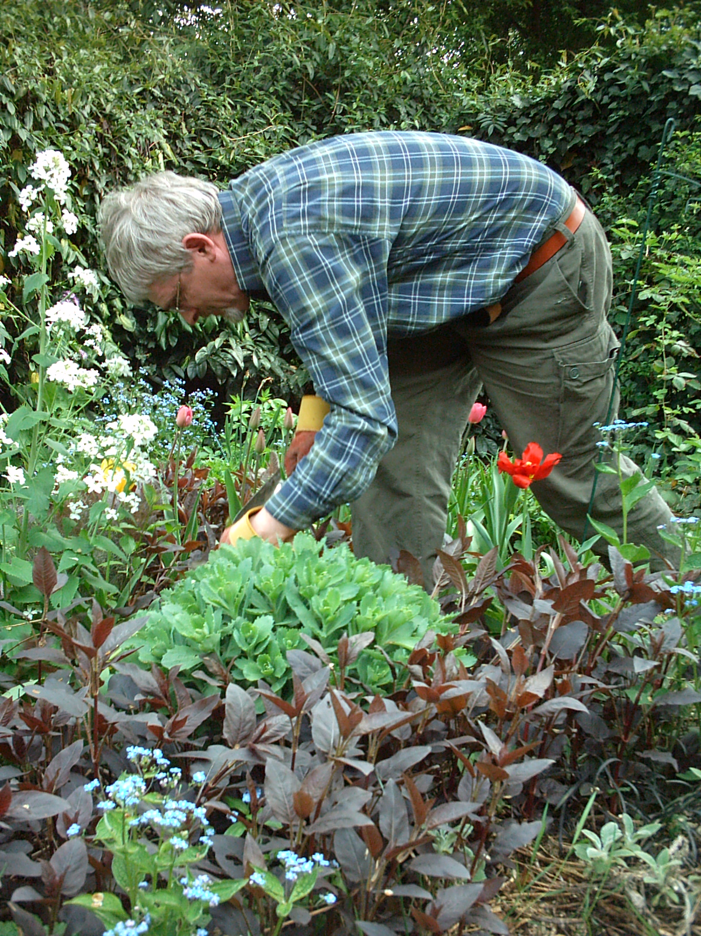

Slide 26
God is
UNSELFISH
with His grace.

Slide 27
God is gracious
to ALL.

Slide 28
God is SOVEREIGN.

Slide 29
God PUNISHES
rebellion.

Slide 30
God wants His people to be LOVING.

Slide 31
COMFORT
__________________
COMPASSION
Jonah 4:1-11

