Slide 1
SEEING
THE NEED
ACTS 3

Slide 2
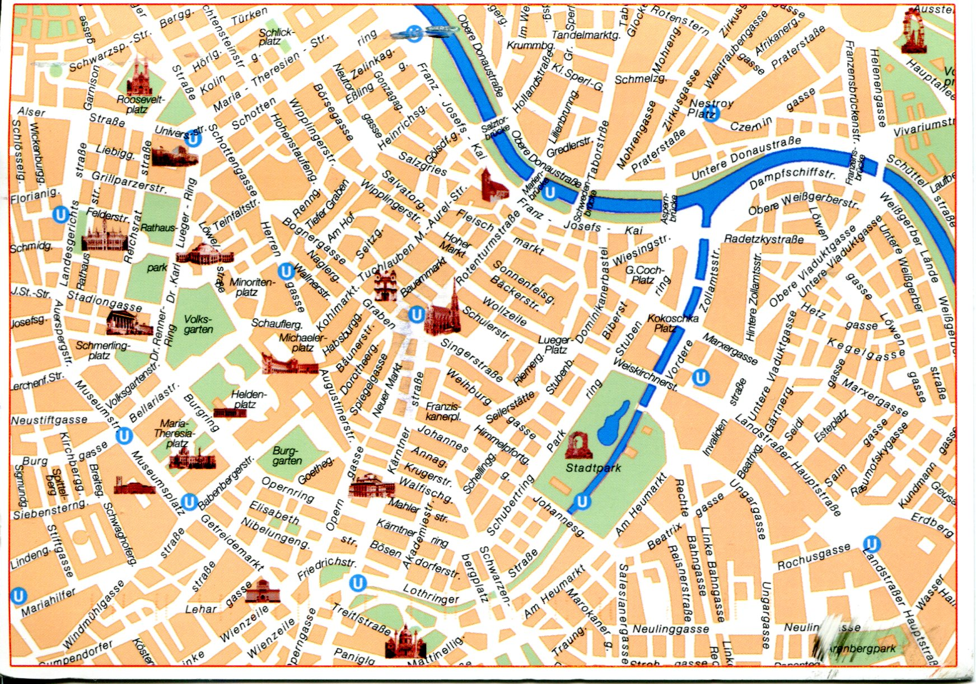

Slide 5
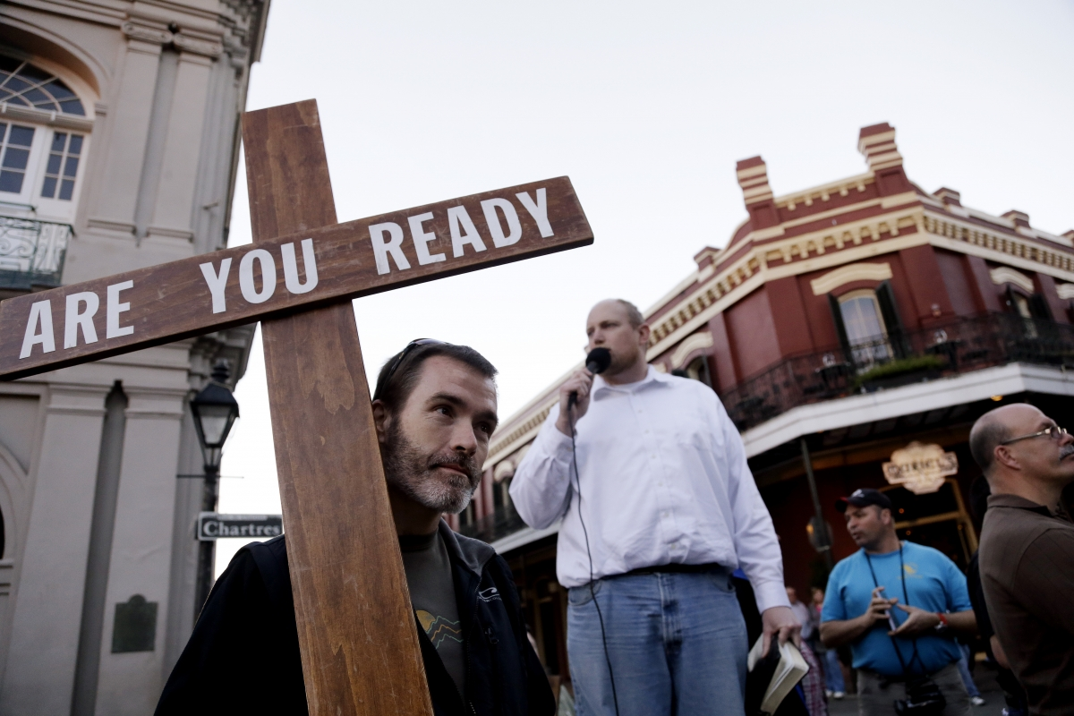

Slide 6
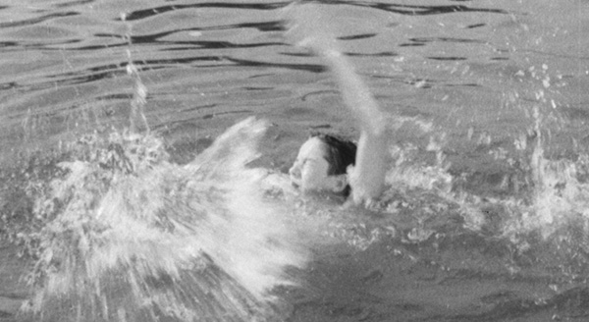

Slide 7
ACTS 3:1-10
1. Now Peter and John went up together to the temple at the hour of prayer, the ninth hour.

Slide 8
ACTS 3:1-10
2. And a certain man lame from his mother’s womb was carried, whom they laid daily at the gate of the temple which is called Beautiful, to ask alms from those who entered the temple;

Slide 9
ACTS 3:1-10
3. who, seeing Peter and John about to go into the temple, asked for alms.

Slide 10
ACTS 3:1-10
4. And fixing his eyes on him, with John, Peter said, “Look at us.”

Slide 11
ACTS 3:1-10
5. So he gave them his attention, expecting to receive something from them.

Slide 12
ACTS 3:1-10
6. Then Peter said, “Silver and gold I do not have, but what I do have I give you: In the name of Jesus Christ of Nazareth, rise up and walk.”

Slide 13
ACTS 3:1-10
7. And he took him by the right hand and lifted him up, and immediately his feet and ankle bones received strength.

Slide 14
ACTS 3:1-10
8. So he, leaping up, stood and walked and entered the temple with them– walking, leaping, and praising God.

Slide 15
ACTS 3:1-10
9. And all the people saw him walking and praising God.

Slide 16
ACTS 3:1-10
10. Then they knew that it was he who sat begging alms at the Beautiful Gate of the temple; and they were filled with wonder and amazement at what had happened to him.

Slide 18
We must make Christ be very REAL in our lives.

Slide 19
We must believe that
the lost are LOST.

Slide 20
LUKE 19:10
for the Son of Man has come to seek and to save that which was lost.”

Slide 21
We must believe that Jesus is the ONLY HOPE for the lost.

Slide 22
ACTS 4:10-12
10. let it be known to you all, and to all the people of Israel, that by the name of Jesus Christ of Nazareth, whom you crucified, whom God raised from the dead, by Him this man stands here before you whole.

Slide 23
ACTS 4:10-12
11. This is the ‘stone which was rejected by you builders, which has become the chief cornerstone.’

Slide 24
ACTS 4:10-12
12. Nor is there salvation in any other, for there is no other name under heaven given among men by which we must be saved.”

Slide 25
We must value TIME with Jesus.

Slide 26
ACTS 4:13
13. Now when they saw the boldness of Peter and John, and perceived that they were uneducated and untrained men, they marveled. And they realized that they had been with Jesus.

Slide 27
SEEING
THE NEED
ACTS 3

