Slide 1
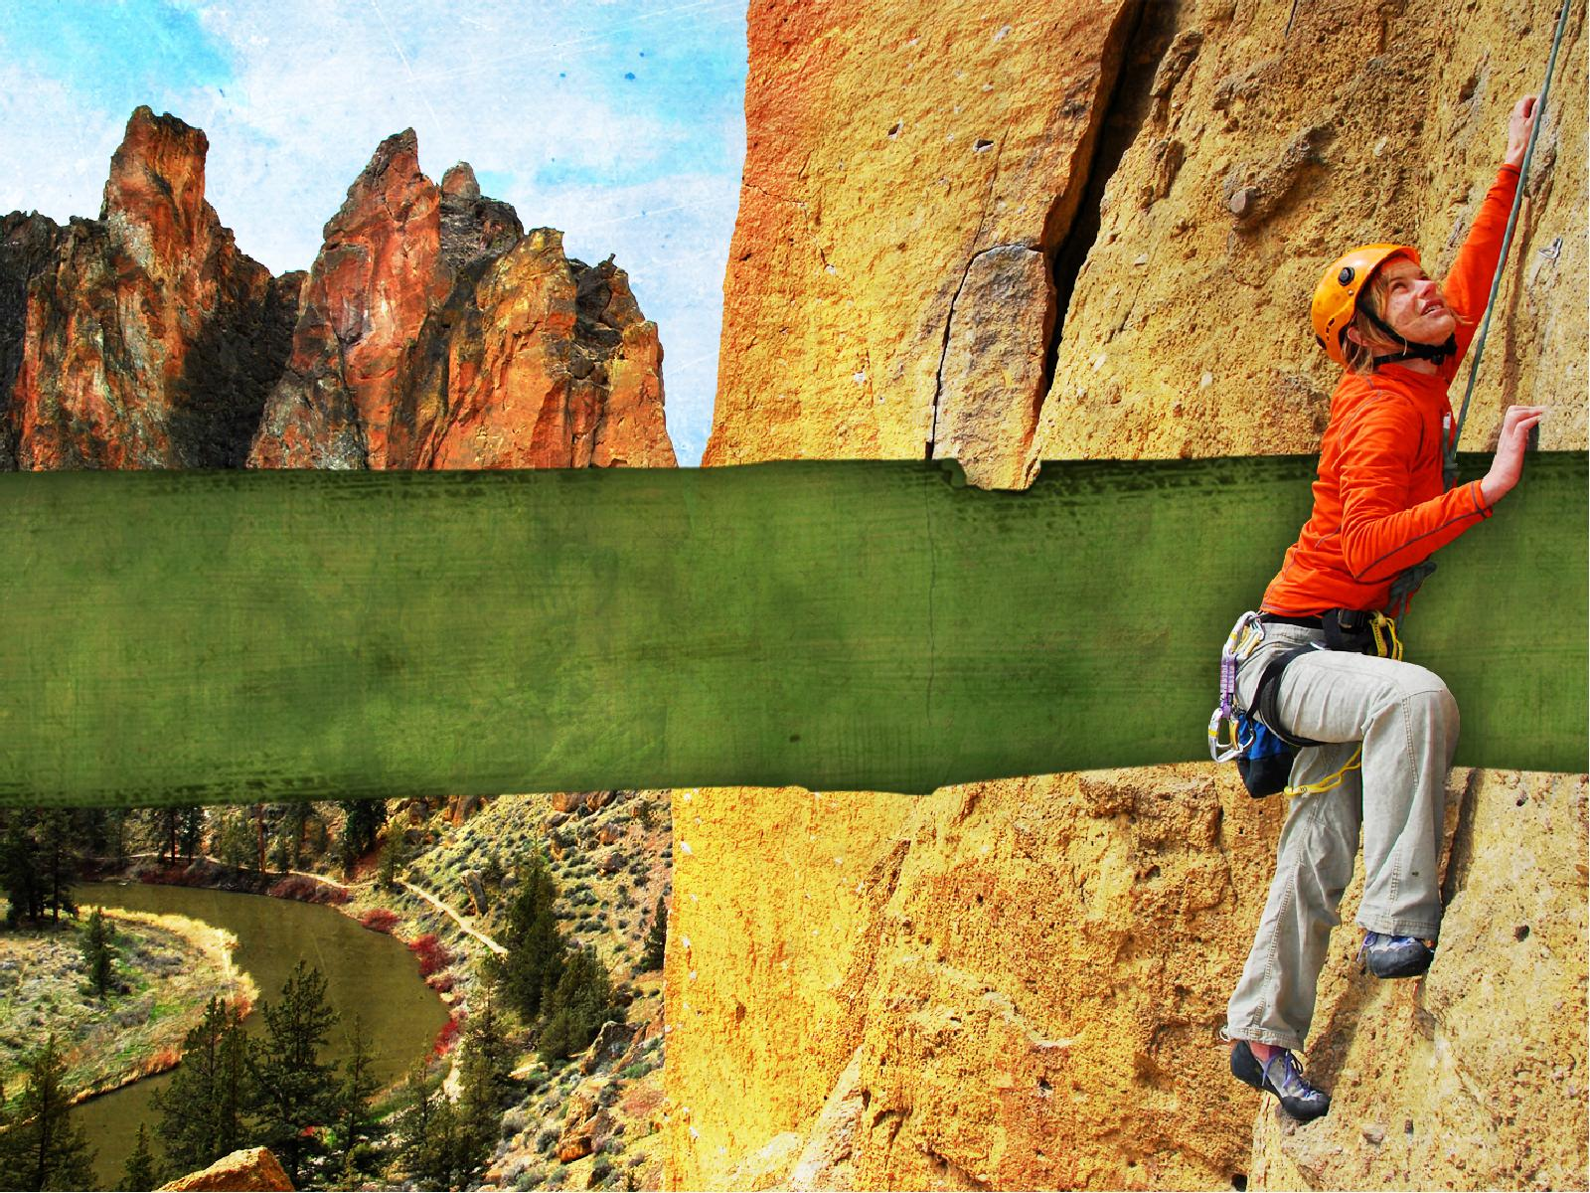
OVERCOMING FEAR

Slide 2
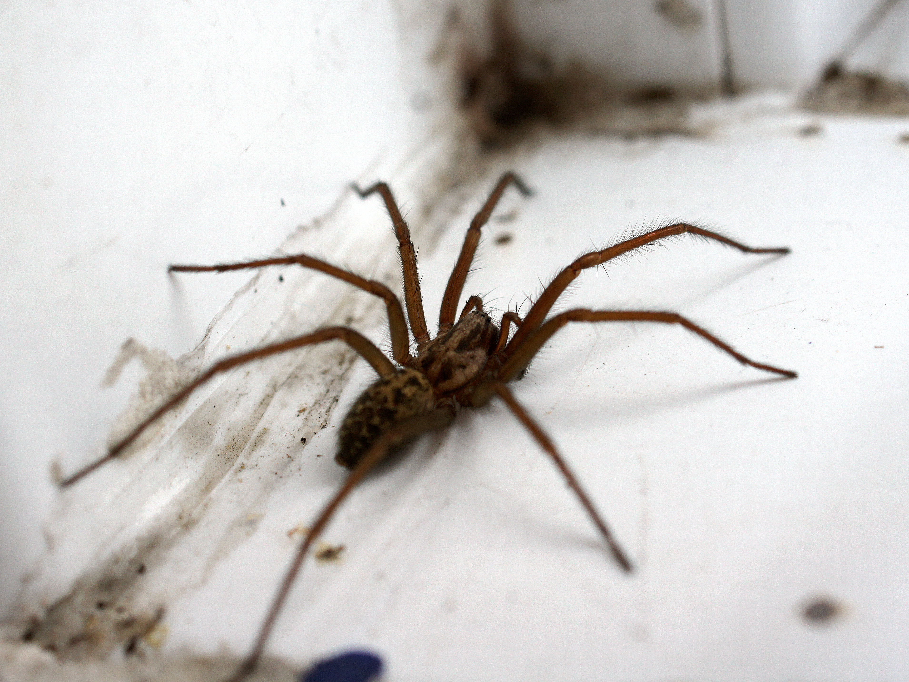

Slide 3


Slide 4
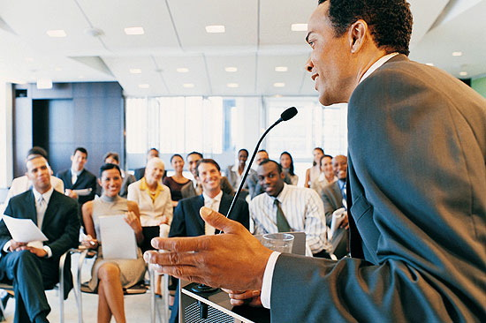

Slide 5


Slide 6
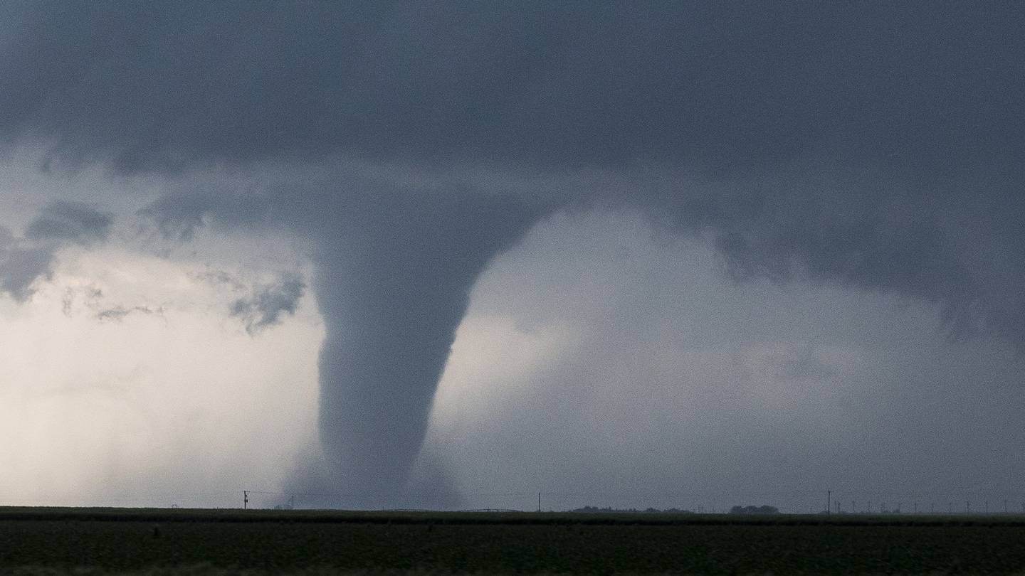

Slide 7
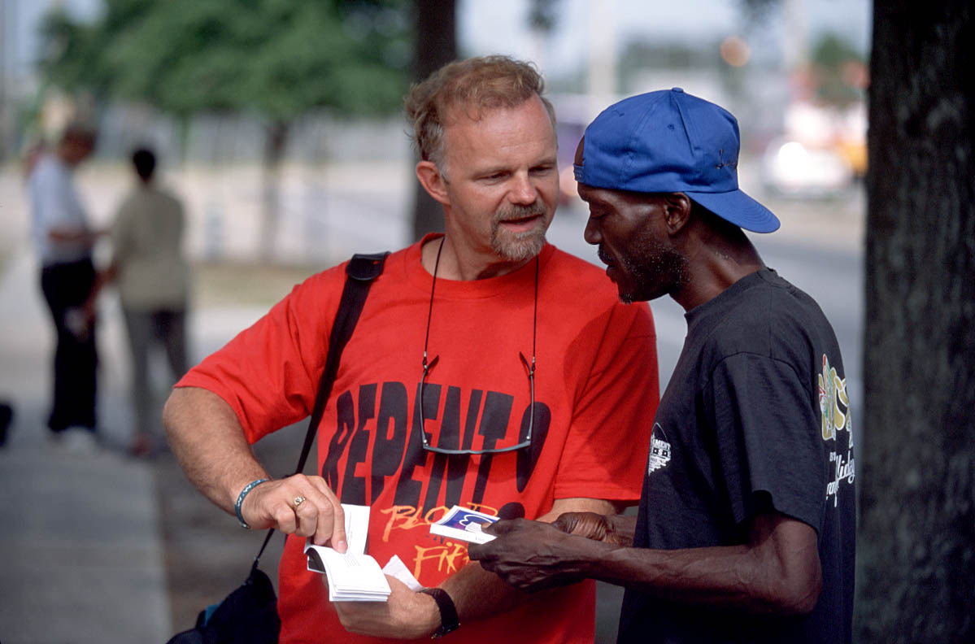

Slide 8

Fear is
NORMAL.

Slide 9
Fear can teach
us to DEPEND
on GOD.

Slide 10
1 Corinthians 2:1-5
1. And I, brethren, when I came to you, did not come with excellence of speech or of wisdom declaring to you the testimony of God.

Slide 11
1 Corinthians 2:1-5
2. For I determined not to know anything among you except Jesus Christ and Him crucified.

Slide 12
1 Corinthians 2:1-5
3. I was with you in weakness, in fear, and in much trembling.

Slide 13
1 Corinthians 2:1-5
4. And my speech and my preaching were not with persuasive words of human wisdom, but in demonstration of the Spirit and of power,

Slide 14
1 Corinthians 2:1-5
5. that your faith should not be in the wisdom of men but in the power of God.

Slide 15
Fear can CRIPPLE
us from serving the Lord.

Slide 16
John 20:19a
19. Then, the same day at evening, being the first day of the week, when the doors were shut where the disciples were assembled, for fear of the Jews,…

Slide 17
Fear sometimes
is based on LEGITIMATE REASONS.

Slide 18
Matthew 26:55
In that hour Jesus said to the multitudes, “Have you come out, as against a robber, with swords and clubs to take Me? I sat daily with you, teaching in the temple, and you did not seize Me.

Slide 19
Realize Christ’s PRESENCE.

Slide 20
Know this is
God’s PLAN to reach the lost.

Slide 21
John 20:21
21. So Jesus said to them again, “Peace to you! As the Father has sent Me, I also send you.”

Slide 22
Remember God is at work BEFORE we are.

Slide 23
Acts 2:37-41
37. Now when they heard this, they were cut to the heart, and said to Peter and the rest of the apostles, “Men and brethren, what shall we do?”

Slide 24
Acts 2:37-41
38. Then Peter said to them, “Repent, and let every one of you be baptized in the name of Jesus Christ for the remission of sins; and you shall receive the gift of the Holy Spirit.

Slide 25
Acts 2:37-41
39. For the promise is to you and to your children, and to all who are afar off, as many as the Lord our God will call.”

Slide 26
Acts 2:37-41
40. And with many other words he testified and exhorted them, saying, “Be saved from this perverse generation.”

Slide 27
Acts 2:37-41
41. Then those who gladly received his word were baptized; and that day about three thousand souls were added to them.

Slide 28
Allow the
HOLY SPIRIT
to guide you.

Slide 29
1 Corinthians 2:4-5
4. And my speech and my preaching were not with persuasive words of human wisdom, but in demonstration of the Spirit and of power,

Slide 30
1 Corinthians 2:4-5
5. that your faith should not be in the wisdom of men but in the power of God.

Slide 31
Letting Christ be Lord EMPOWERS
our witness.

Slide 32
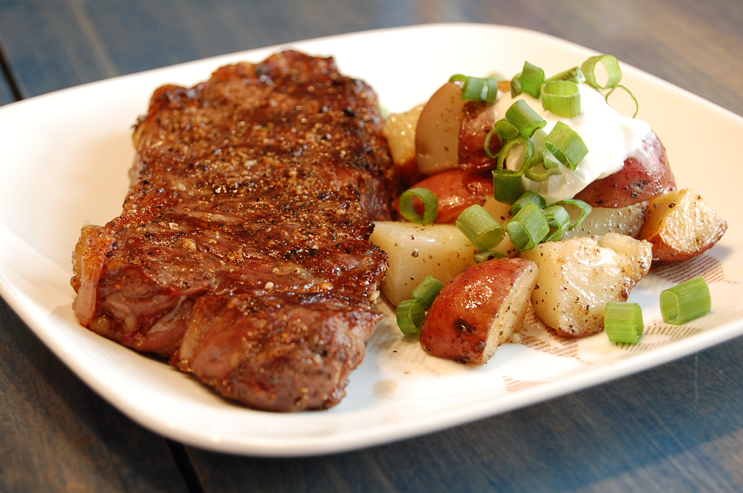

Slide 33
2 Timothy 1:7
7. For God has not given us a spirit of fear, but of power and of love and of a sound mind.

Slide 34
OVERCOMING FEAR

