Slide 1
CORRECTIVE
LENSES
MATTHEW 9:35-38

Slide 2
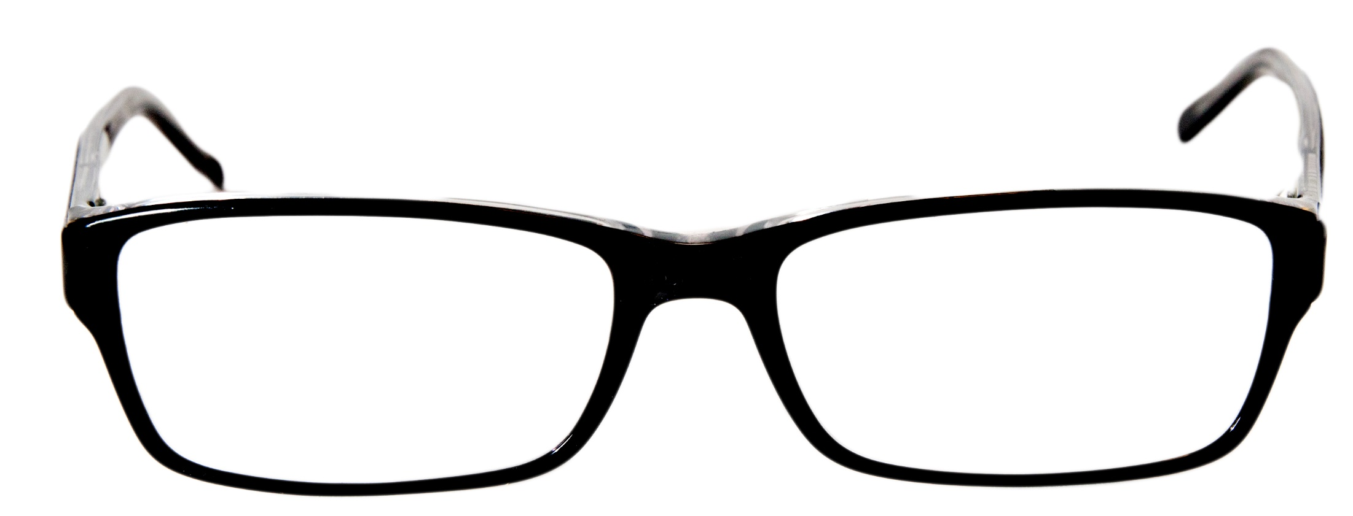

Slide 3
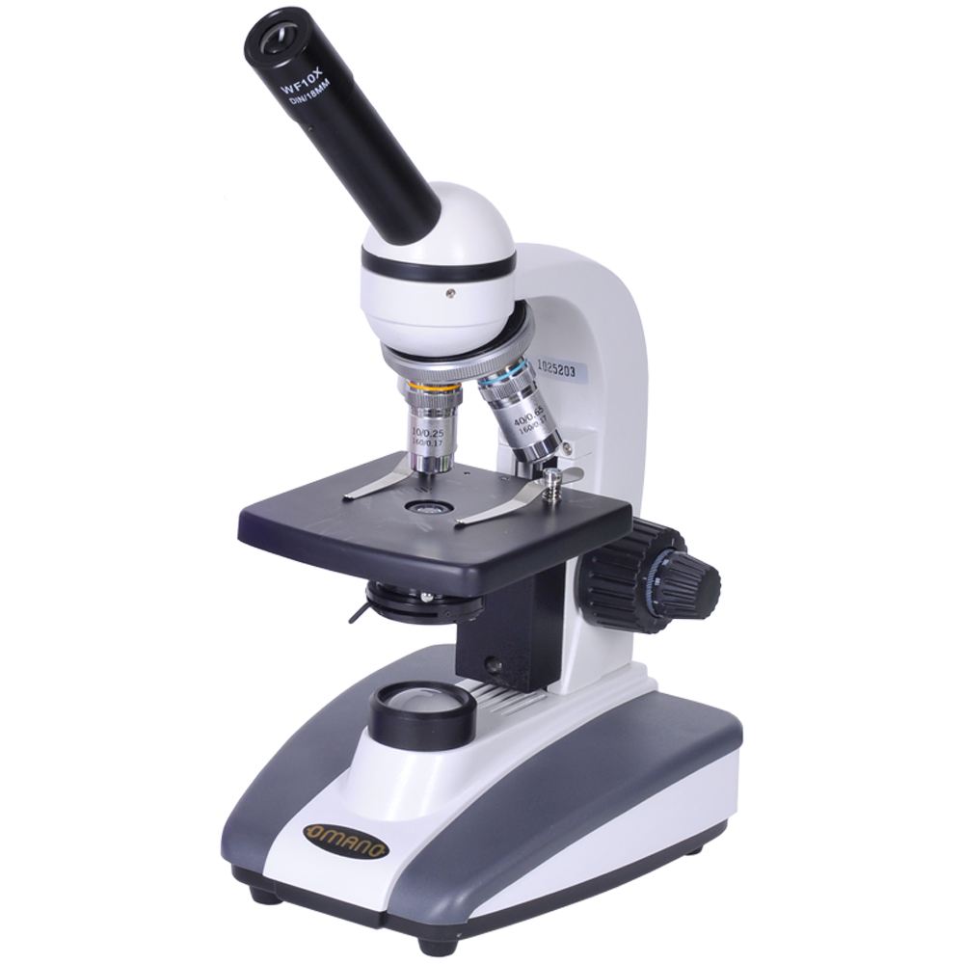

Slide 7
LUKE 7:34
The Son of Man has come eating and drinking, and you say, ‘Look, a glutton and a winebibber, a friend of tax collectors and sinners!’

Slide 8
LUKE 15:2
And the Pharisees and scribes complained, saying, “This Man receives sinners and eats with them.”

Slide 9
MATTHEW 9:35
Then Jesus went about all the cities and villages, teaching in their synagogues, preaching the gospel of the kingdom, and healing every sickness and every disease among the people.

Slide 10
MATTHEW 9:36
But when He saw the multitudes, He was moved with compassion for them, because they were weary and scattered, like sheep having no shepherd.

Slide 11
MATTHEW 9:37
Then He said to His disciples, “The harvest truly is plentiful, but the laborers are few.

Slide 12
MATTHEW 9:38
Therefore pray the Lord of the harvest to send out laborers into His harvest.”

Slide 13
The need to share
is GREAT and
should MOVE us.

Slide 14
The love needed comes only from GOD.

Slide 15
1 JOHN 4:7
Beloved, let us love one another, for love is of God; and everyone who loves is born of God and knows God.

Slide 16
1 JOHN 4:8
He who does not love does not know God, for God is love.

Slide 17
Unconditional love is a FRUIT of the SPIRIT.

Slide 18
Spirit filled people will love UNCONDITIONALLY.

Slide 19
1 CORINTHIANS 13:1
Though I speak with the tongues of men and of angels, but have not love, I have become sounding brass or a clanging cymbal.

Slide 20
1 CORINTHIANS 13:2
And though I have the gift of prophecy, and understand all mysteries and all knowledge, and though I have all faith, so that I could remove mountains, but have not love, I am nothing.

Slide 21
1 CORINTHIANS 13:3
And though I bestow all my goods to feed the poor, and though I give my body to be burned, but have not love, it profits me nothing.

Slide 22
1 CORINTHIANS 13:4
Love [Jesus] suffers long and is kind; love [Jesus] does not envy; love [Jesus] does not parade itself, [Jesus] is not puffed up;

Slide 23
1 CORINTHIANS 13:5
[Jesus] does not behave rudely, [Jesus] does not seek its own, [Jesus] is not provoked, [Jesus] thinks no evil;

Slide 24
1 CORINTHIANS 13:6
[Jesus] does not rejoice in iniquity, but rejoices in the truth;

Slide 25
1 CORINTHIANS 13:7
bears all things, believes all things, hopes all things, endures all things.

Slide 26
1 CORINTHIANS 13:8
Love [Jesus] never fails. But whether there are prophecies, they will fail; whether there are tongues, they will cease; whether there is knowledge, it will vanish away.

Slide 27
1 CORINTHIANS 13:9
For we know in part and we prophesy in part.

Slide 28
1 CORINTHIANS 13:10
But when that which is perfect has come, then that which is in part will be done away.

Slide 29
1 CORINTHIANS 13:11
When I was a child, I spoke as a child, I understood as a child, I thought as a child; but when I became a man, I put away childish things.

Slide 30
1 CORINTHIANS 13:12
For now we see in a mirror, dimly, but then face to face. Now I know in part, but then I shall know just as I also am known.

Slide 31
1 CORINTHIANS 13:13
And now abide faith, hope, love, these three; but the greatest of these is love.

Slide 32
When believers love like Christ people NOTICE.

Slide 33
1 PETER 3:15
But sanctify the Lord God in your hearts, and always be ready to give a defense to everyone who asks you a reason for the hope that is in you, with meekness and fear;

Slide 34
CORRECTIVE
LENSES
MATTHEW 9:35-38

