Slide 1
The Greatest Teacher’s Aide
EXODUS 20

Slide 4
The first four commandments deal with man’s relationship
with GOD.

Slide 5
1. And God spoke all these words, saying:
EXODUS 20:1-11

Slide 6
2. “I am the Lord your God, who brought you out of the land of Egypt, out of the house of bondage.
EXODUS 20:1-11

Slide 7
3. “You shall have no other gods before Me.
EXODUS 20:1-11

Slide 8
4. “You shall not make for yourself a carved image – any likeness of anything that is in heaven above, or that is in the earth beneath, or that is in the water under the earth;
EXODUS 20:1-11

Slide 9
5. you shall not bow down to them nor serve them. For I, the Lord your God, am a jealous God, visiting the iniquity of the fathers upon the children to the third and fourth generations of those who hate Me,
EXODUS 20:1-11

Slide 10
6. but showing mercy to thousands, to those who love Me and keep My commandments.
EXODUS 20:1-11

Slide 11
7. “You shall not take the name of the Lord your God in vain, for the Lord will not hold him guiltless who takes His name
in vain.
EXODUS 20:1-11

Slide 12
8. “Remember the Sabbath day, to keep it holy.
EXODUS 20:1-11

Slide 13
9. Six days you shall labor and do all your work,
EXODUS 20:1-11

Slide 14
10. but the seventh day is the Sabbath of the Lord your God. In it you shall do no work: you, nor your son, nor your daughter, nor your male servant, nor your female servant, nor your cattle, nor your stranger who is within your gates.
EXODUS 20:1-11

Slide 15
11. For in six days the Lord made the heavens and the earth, the sea, and all that is in them, and rested the seventh day. Therefore the Lord blessed the Sabbath day and hallowed it.
EXODUS 20:1-11

Slide 16
The last six commandments deal with man’s relationship with EACH OTHER.

Slide 17
12. “Honor your father and your mother, that your days may be long upon the land which the Lord your God is giving you.
EXODUS 20:12-17

Slide 18
13. “You shall not murder.
EXODUS 20:12-17

Slide 19
14. “You shall not commit adultery.
EXODUS 20:12-17

Slide 20
15. “You shall not steal.
EXODUS 20:12-17

Slide 21
16. “You shall not bear false witness against your neighbor.
EXODUS 20:12-17

Slide 22
17. “You shall not covet your neighbor’s house; you shall not covet your neighbor’s wife, nor his male servant, nor his female servant, nor his ox, nor his donkey, nor anything that is your neighbor’s.”
EXODUS 20:12-17

Slide 23
Israel’s RESPONSE to
God’s words.

Slide 24
18. Now all the people witnessed the thunderings, the lightning flashes, the sound of the trumpet, and the mountain smoking; and when the people saw it, they trembled and stood afar off.
EXODUS 20:18-21

Slide 25
19. Then they said to Moses, “You speak with us, and we will hear; but let not God speak with us, lest we die.”
EXODUS 20:18-21

Slide 26
20. And Moses said to the people, “Do not fear; for God has come to test you, and that His fear may be before you, so that you may not sin.”
EXODUS 20:18-21

Slide 27
21. So the people stood afar off, but Moses drew near the thick darkness where God was.
EXODUS 20:18-21

Slide 28
It does not provide SALVATION.

Slide 29
20. Therefore by the deeds of the law no flesh will be justified in His sight, for by the law is the knowledge of sin.
ROMANS 3:20

Slide 30
1. Therefore, having been justified by faith, we have peace with God through our
Lord Jesus Christ,
ROMANS 5:1

Slide 31
The law is a
TUTOR.

Slide 32
24. Therefore the law was our tutor to bring us to Christ, that
we might be justified by faith.
GALATIANS 3:24-25

Slide 33
25. But after faith has come, we are no longer under a tutor.
GALATIANS 3:24-25

Slide 34
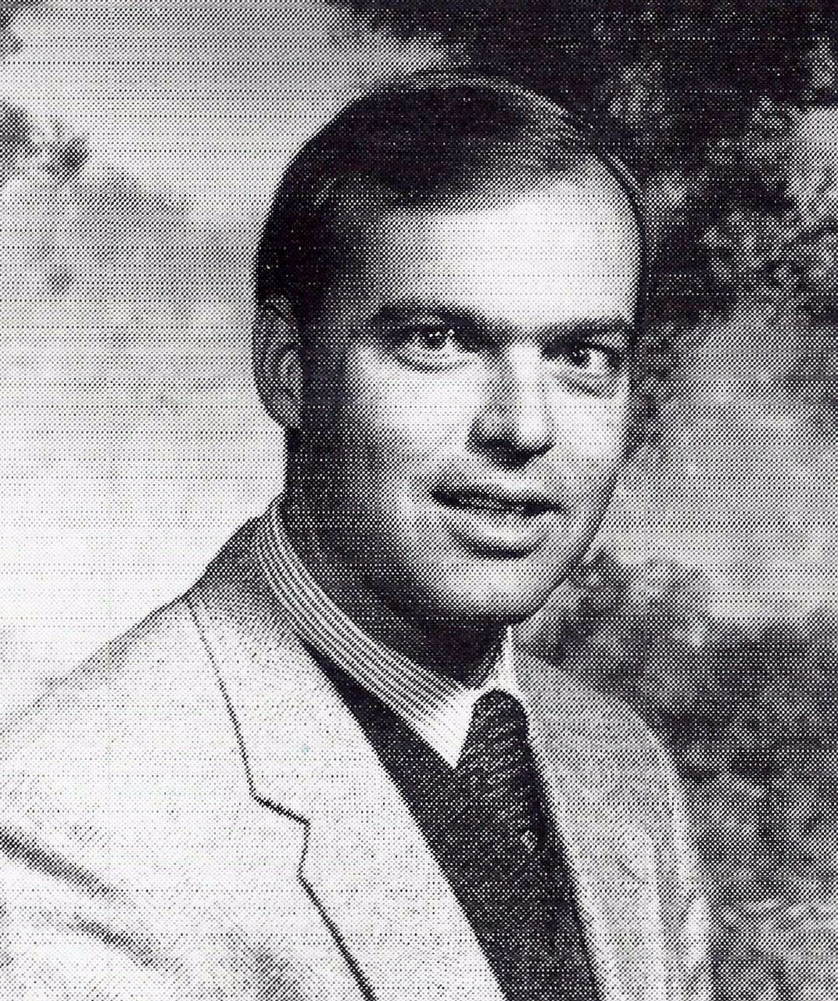
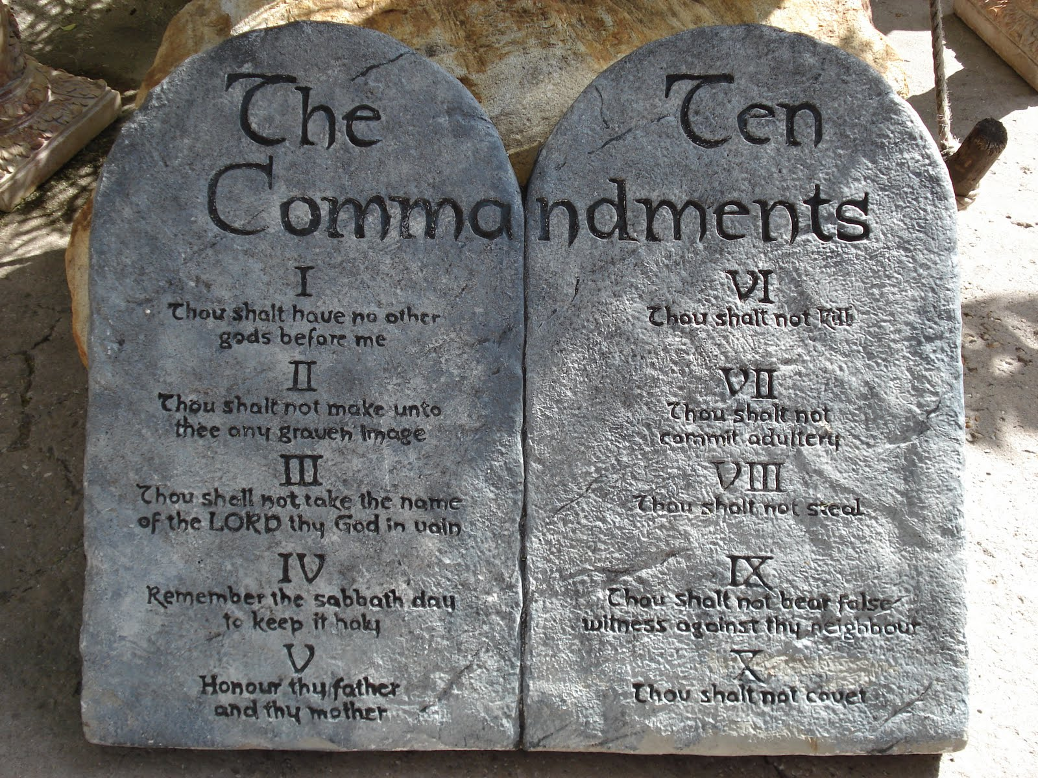

Slide 35
The Greatest Teacher’s Aide
EXODUS 20

