Slide 1
Moses’
Legacy
Hebrews 11 – Deuteronomy 34

Slide 2
Hebrews 11:25-28
25. choosing rather to suffer affliction with the people of God than to enjoy the passing pleasures of sin,

Slide 3
Hebrews 11:25-28
26. esteeming the reproach of Christ greater riches than the treasures in Egypt; for he looked to the reward.

Slide 4
Hebrews 11:25-28
27. By faith he forsook Egypt, not fearing the wrath of the king; for he endured as seeing Him who is invisible.

Slide 5
Hebrews 11:25-28
28. By faith he kept the Passover and the sprinkling of blood, lest he who destroyed the firstborn should touch them.

Slide 6
Moses REFUSED
to compromise his commitment to God.

Slide 8
Makes a CHOICE between SEEN and UNSEEN.

Slide 9
Joshua 24:15
And if it seems evil to you to serve the Lord, choose for yourselves this day whom you will serve, whether the gods which your fathers served that were on the other side of the River, or the gods of the Amorites, in whose land you dwell. But as for me and my house, we will serve the Lord.”

Slide 10
Choices cannot be based on FEELINGS.

Slide 11
Moses LEFT the familiar and comfortable.

Slide 12
Moses DID.

Slide 13
FAITH was
his rock.

Slide 14
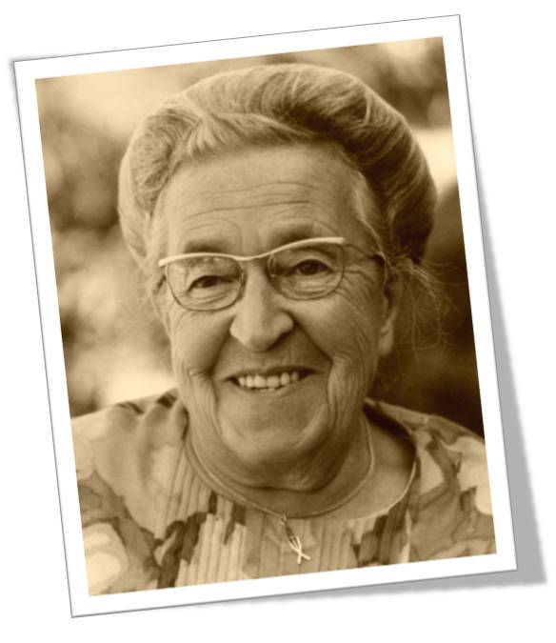

Slide 16
Deuteronomy 34:1-12
1. Then Moses went up from the plains of Moab to Mount Nebo, to the top of Pisgah, which is across from Jericho. And the Lord showed him all the land of Gilead as far as Dan,

Slide 17
Deuteronomy 34:1-12
2. all Naphtali and the land of Ephraim and Manasseh, all the land of Judah as far as the Western Sea,

Slide 18
Deuteronomy 34:1-12
3. the South, and the plain of the Valley of Jericho, the city of palm trees, as far as Zoar.

Slide 19
Deuteronomy 34:1-12
4. Then the Lord said to him, “This is the land of which I swore to give Abraham, Isaac, and Jacob, saying, ‘I will give it to your descendants.’ I have caused you to see it with your eyes, but you shall not cross over there.”

Slide 20
Deuteronomy 34:1-12
5. So Moses the servant of the Lord died there in the land of Moab, according to the word of the Lord.

Slide 21
Deuteronomy 34:1-12
6. And He buried him in a valley in the land of Moab, opposite Beth Peor; but no one knows his grave to this day.

Slide 22
Deuteronomy 34:1-12
7. Moses was one hundred and twenty years old when he died. His eyes were not dim nor his natural vigor diminished.

Slide 23
Deuteronomy 34:1-12
8. And the children of Israel wept for Moses in the plains of Moab thirty days. So the days of weeping and mourning for Moses ended.

Slide 24
Deuteronomy 34:1-12
9. Now Joshua the son of Nun was full of the spirit of wisdom, for Moses had laid his hands on him; so the children of Israel heeded him, and did as the Lord had commanded Moses.

Slide 25
Deuteronomy 34:1-12
10. But since then there has not arisen in Israel a prophet like Moses, whom the Lord knew face to face,

Slide 26
Deuteronomy 34:1-12
11. in all the signs and wonders which the Lord sent him to do in the land of Egypt, before Pharaoh, before all his servants, and in all his land,

Slide 27
Deuteronomy 34:1-12
12. and by all that mighty power and all the great terror which Moses performed in the sight of all Israel.

Slide 28
Philippians 1:21-22
21. For to me, to live is Christ, and to die is gain.

Slide 29
Philippians 1:21-22
22. But if I live on in the flesh, this will mean fruit from my labor; yet what I shall choose I cannot tell.

Slide 30
Death puts things
in PERSPECTIVE.

Slide 31
Moses’
Legacy
Hebrews 11 – Deuteronomy 34

