Slide 1
LOOK
LIVE
and
NUMBERS 21:4-9

Slide 3
NUMBERS 21:4-9
4. Then they journeyed from Mount Hor by the Way of the Red Sea, to go around the land of Edom; and the soul of the people became very discouraged on the way.

Slide 4
NUMBERS 21:4-9
5. And the people spoke against God and against Moses: “Why have you brought us up out of Egypt to die in the wilderness? For there is no food and no water, and our soul loathes this worthless bread.”

Slide 5
NUMBERS 21:4-9
6. So the Lord sent fiery serpents among the people, and they bit the people; and many of the people of Israel died.

Slide 6
NUMBERS 21:4-9
7. Therefore the people came to Moses, and said, “We have sinned, for we have spoken against the Lord and against you; pray to the Lord that He take away the serpents from us.” So Moses prayed for the people.

Slide 7
NUMBERS 21:4-9
8. Then the Lord said to Moses, “Make a fiery serpent, and set it on a pole; and it shall be that everyone who is bitten, when he looks at it, shall live.”

Slide 8
NUMBERS 21:4-9
9. So Moses made a bronze serpent, and put it on a pole; and so it was, if a serpent had bitten anyone, when he looked at the bronze serpent, he lived.

Slide 9
Discouragement can
get us to…
PRAY the wrong prayers.

Slide 10
Discouragement can
get us to…
SAY the wrong words.

Slide 11
Discouragement can
get us to…
ACT in wrong ways.

Slide 12
Discouragement can
get us to…
THINK wrong thoughts.

Slide 13
Everyone is in
SPIRITUAL WARFARE.

Slide 14
God knows exactly
WHERE we ARE.

Slide 15
God is
ALWAYS WITH
His children.

Slide 16
Hope comes when we
LOOK and LIVE.

Slide 17
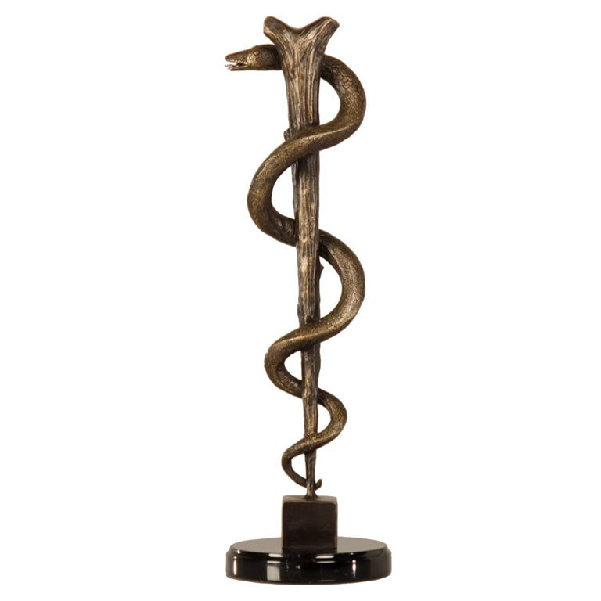

Slide 18
JOHN 3:14-17
14. And as Moses lifted up the serpent in the wilderness, even so must the Son of Man be lifted up,

Slide 19
JOHN 3:14-17
15. that whoever believes in Him should not perish but have eternal life.

Slide 20
JOHN 3:14-17
16. For God so loved the world that He gave His only begotten Son, that whoever believes in Him should not perish but have everlasting life.

Slide 21
JOHN 3:14-17
17. For God did not send His Son into the world to condemn the world, but that the world through Him might be saved.

Slide 22
2 CORINTHIANS 5:21
21. For He made Him who knew no sin to be sin for us, that we might become the righteousness of God in Him.

Slide 24
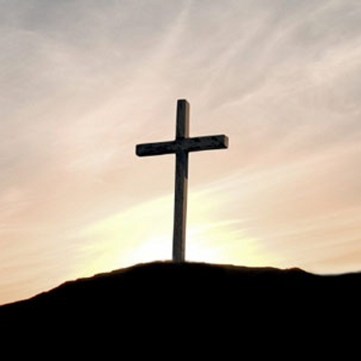

Slide 25
LOOK
LIVE
and
NUMBERS 21:4-9

