Slide 1
ANGRY ANTLERS
NUMBERS 20:1-12

Slide 3
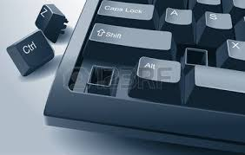

Slide 4
NUMBERS 20:1-10
1. Then the children of Israel, the whole congregation, came into the Wilderness of Zin in the first month, and the people stayed in Kadesh; and Miriam died there and was buried there.

Slide 5
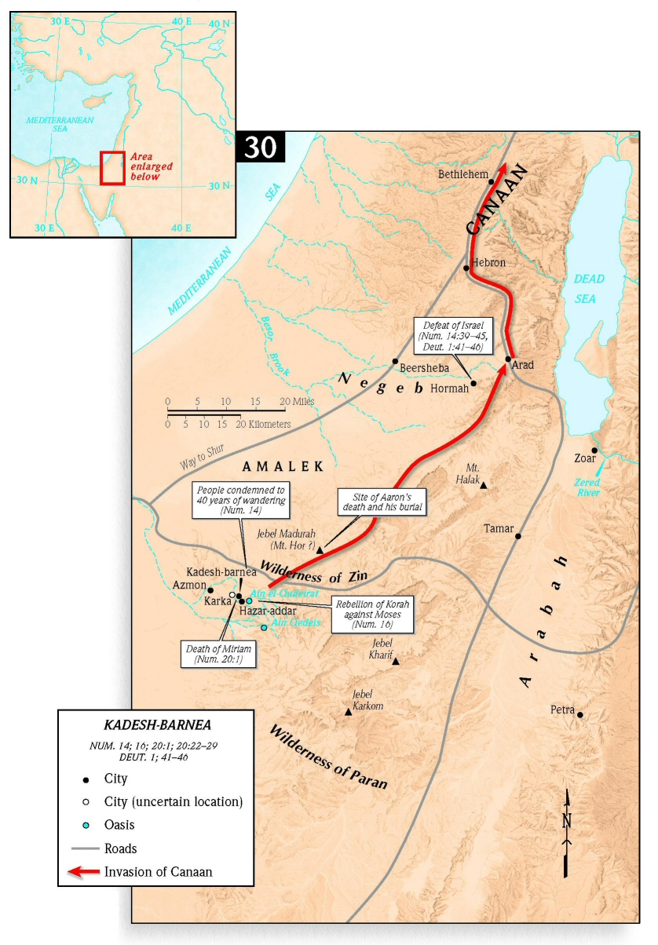

Slide 6
NUMBERS 20:1-10
2. Now there was no water for the congregation; so they gathered together against Moses and Aaron.

Slide 7
NUMBERS 20:1-10
3. And the people contended with Moses and spoke, saying: “If only we had died when our brethren died before the Lord!

Slide 8
NUMBERS 20:1-10
4. Why have you brought up the assembly of the Lord into this wilderness, that we and our animals should die here?

Slide 9
NUMBERS 20:1-10
5. And why have you made us come up out of Egypt, to bring us to this evil place? Is it not a place of grain or figs or vines or pomegranates; nor is there any water to drink.”

Slide 10
NUMBERS 20:1-10
6. So Moses and Aaron went from the presence of the assembly to the door of the tabernacle of meeting, and they fell on their faces. And the glory of the Lord appeared to them.

Slide 11
NUMBERS 20:1-10
7. Then the Lord spoke to Moses, saying,

Slide 12
NUMBERS 20:1-10
8. “Take the rod; you and your brother Aaron gather the congregation together. Speak to the rock before their eyes, and it will yield its water; thus you shall bring water for them out of the rock, and give drink to the congregation and their animals.”

Slide 13
NUMBERS 20:1-10
9. So Moses took the rod from before the Lord as He commanded him.

Slide 14
NUMBERS 20:1-10
10. And Moses and Aaron gathered the assembly together before the rock; and he said to them, “Hear now, you rebels! Must we bring water for you out of this rock?”

Slide 15
JAMES 1:19-20
19. So then, my beloved brethren, let every man be swift to hear, slow to speak, slow to wrath;

Slide 16
JAMES 1:19-20
20. for the wrath of man does not produce the righteousness of God.

Slide 17
ROMANS 12:19
19. Beloved, do not avenge yourselves, but rather give place to wrath; for it is written, “Vengeance is Mine, I will repay,” says the Lord.

Slide 18
ROMANS 12:21
21. Do not be overcome by evil, but overcome evil with good.

Slide 19
NUMBERS 20:11A
11. Then Moses lifted his hand and struck the rock twice with his rod;…

Slide 20
NUMBERS 20:11B
11. and water came out abundantly, and the congregation and their animals drank.

Slide 22
NUMBERS 20:12A
12. Then the Lord spoke to Moses and Aaron, “Because you did not believe Me, to hallow Me in the eyes of the children of Israel,

Slide 24
JAMES 4:17
17. Therefore, to him who knows to do good and does not do it, to him it is sin.

Slide 25
NUMBERS 20:12B
12. …therefore you shall not bring this assembly into the land which I have given them.”

Slide 27
HEBREWS 3:18-19
18. And to whom did He swear that they would not enter His rest, but to those who did not obey?

Slide 28
HEBREWS 3:18-19
19. So we see that they could not enter in because of unbelief.

Slide 29
GALATIONS 6:7
7. Do not be deceived, God is not mocked; for whatever a man sows, that he will also reap.

Slide 31
PSALM 19:12 (NLT)
12. How can I know all the sins lurking in my heart? Cleanse me from these hidden faults.

Slide 32
PSALM 103:11-12
11. For as the heavens are high above the earth, so great is His mercy toward those who fear Him;

Slide 33
PSALM 103:11-12
12. As far as the east is from the west, so far has He removed our transgressions from us.

Slide 35
ANGRY ANTLERS
NUMBERS 20:1-12

