Slide 1

Long Lines
and
Short Fuses
Exodus 18

Slide 2

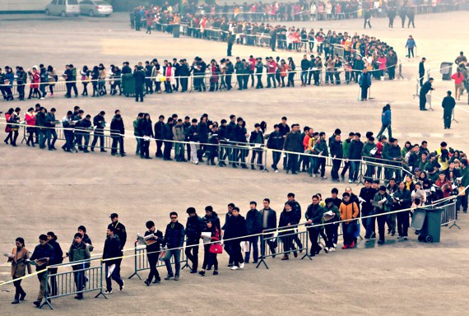

Slide 3


Slide 4


Slide 5

In life or ministry
everyone has
PROBLEMS.

Slide 6
EXODUS 18:13-16
13. And so it was, on the next day, that Moses sat to judge the people; and the people stood before Moses from morning until evening.

Slide 7
EXODUS 18:13-16
14. So when Moses’ father-in-law saw all that he did for the people, he said, “What is this thing that you are doing for the people? Why do you alone sit, and all the people stand before you from morning until evening?”

Slide 8
EXODUS 18:13-16
15. And Moses said to his father-in-law, “Because the people come to me to inquire of God.

Slide 9
EXODUS 18:13-16
16. When they have a difficulty, they come to me, and I judge between one and another; and I make known the statutes of God and His laws.”

Slide 10
In life or
ministry NO ONE
can do it all.

Slide 11
In life or ministry
we need PROBLEM SOLVERS.

Slide 12
EXODUS 18:17-19
17. So Moses’ father-in-law said to him, “The thing that you do is not good.

Slide 13
EXODUS 18:17-19
18. Both you and these people who are with you will surely wear yourselves out. For this thing is too much for you; you are not able to perform it by yourself.

Slide 14
EXODUS 18:17-19
19. Listen now to my voice; I will give you counsel, and God will be with you: Stand before God for the people, so that you may bring the difficulties to God.

Slide 15
In life or ministry
we must LISTEN to godly counsel.

Slide 16
PROVERBS 15:22
22. Without counsel, plans go awry, but in the multitude of counselors they are established.

Slide 17
PROVERBS 19:20
20. Listen to counsel and receive instruction, that you may be wise in your latter days.

Slide 18
In life or ministry
we must work TOGETHER.

Slide 19
EXODUS 18:20-22
20. And you shall teach them the statutes and the laws, and show them the way in which they must walk and the work they must do.

Slide 20
EXODUS 18:20-22
21. Moreover you shall select from all the people able men, such as fear God, men of truth, hating covetousness; and place such over them to be rulers of thousands, rulers of hundreds, rulers of fifties, and rulers of tens.

Slide 21
EXODUS 18:20-22
22. And let them judge the people at all times. Then it will be that every great matter they shall bring to you, but every small matter they themselves shall judge. So it will be easier for you, for they will bear the burden with you.

Slide 22
In life or ministry
we must take ACTION.

Slide 23
EXODUS 18:23-26
23. If you do this thing, and God so commands you, then you will be able to endure, and all this people will also go to their place in peace.”

Slide 24
EXODUS 18:23-26
24. So Moses heeded the voice of his father-in-law and did all that he had said.

Slide 25
EXODUS 18:23-26
25. And Moses chose able men out of all Israel, and made them heads over the people: rulers of thousands, rulers of hundreds, rulers of fifties, and rulers of tens.

Slide 26
EXODUS 18:23-26
26. So they judged the people at all times; the hard cases they brought to Moses, but they judged every small case themselves.

Slide 27
1 CORINTHIANS 1:27-29
27. But God has chosen the foolish things of the world to put to shame the wise, and God has chosen the weak things of the world to put to shame the things which are mighty;

Slide 28
1 CORINTHIANS 1:27-29
28. and the base things of the world and the things which are despised God has chosen, and the things which are not, to bring to nothing the things that are,

Slide 29
1 CORINTHIANS 1:27-29
29. that no flesh should glory in His presence.

Slide 30
God doesn’t call the EQUIPPED,
but He EQUIPS
the called.

Slide 31
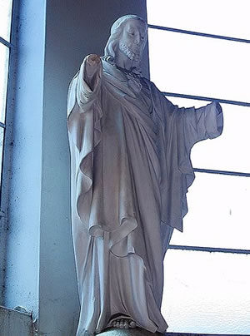

Slide 32
Long Lines
and
Short Fuses
Exodus 18

