Slide 1


The message of
Exodus 11-12

Slide 2

Exodus 12:5-8
5. Your lamb shall be without blemish, a male of the first year. You may take it from the sheep or from the goats.

Slide 3
Exodus 12:5-8
6. Now you shall keep it until the fourteenth day of the same month. Then the whole assembly of the congregation of Israel shall kill it at twilight.

Slide 4
Exodus 12:5-8
7. And they shall take some of the blood and put it on the two doorposts and on the lintel of the houses where they eat it.

Slide 5
Exodus 12:5-8
8. Then they shall eat the flesh on that night; roasted in fire, with unleavened bread and with bitter herbs they shall
eat it.

Slide 6
Exodus 12:11-15
11. And thus you shall eat it: with a belt on your waist, your sandals on your feet, and your staff in your hand. So you shall eat it in haste. It is the
Lord’s Passover.

Slide 7
Exodus 12:11-15
12. ‘For I will pass through the land of Egypt on that night, and will strike all the firstborn in the land of Egypt, both man and beast; and against all the gods of Egypt I will execute judgment: I am the Lord.

Slide 8
Exodus 12:11-15
13. Now the blood shall be a sign for you on the houses where you are. And when I see the blood, I will pass over you; and the plague shall not be on you to destroy you when I strike the land of Egypt.

Slide 9
Exodus 12:11-15
14. ‘So this day shall be to you a memorial; and you shall keep it as a feast to the Lord throughout your generations. You shall keep it as a feast by an everlasting ordinance.

Slide 10
Exodus 12:11-15
15. Seven days you shall eat unleavened bread. On the first day you shall remove leaven from your houses. For whoever eats leavened bread from the first day until the seventh day, that person shall be cut off from Israel.

Slide 11
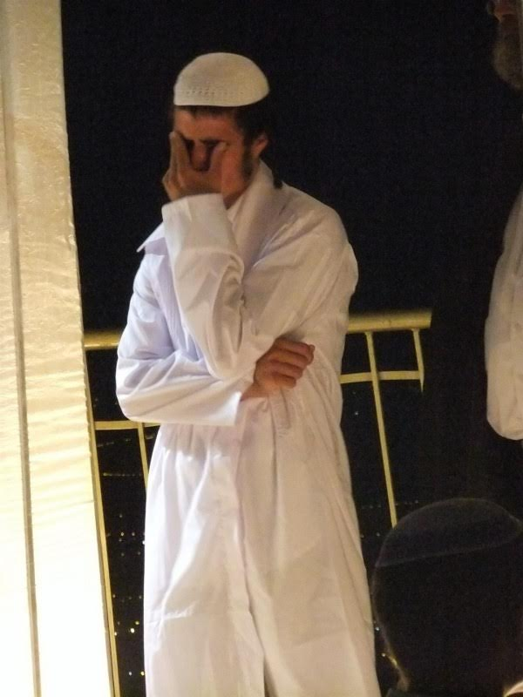

Slide 12
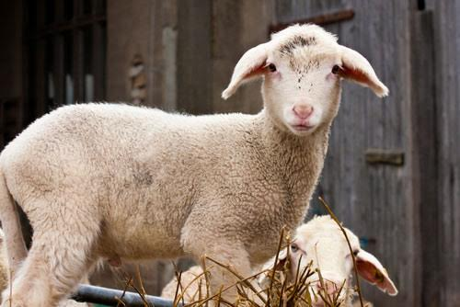

Slide 13
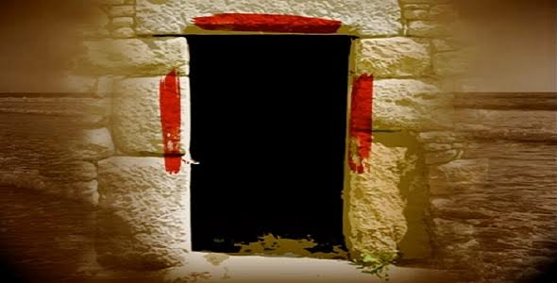

Slide 14


Slide 15
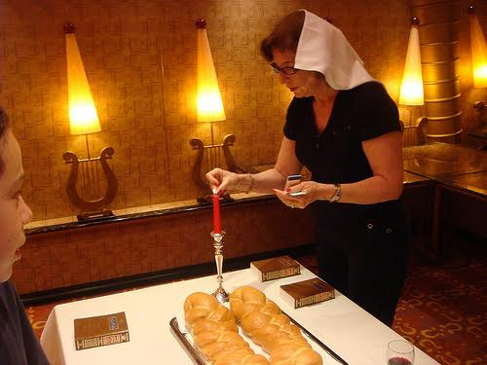

Slide 16
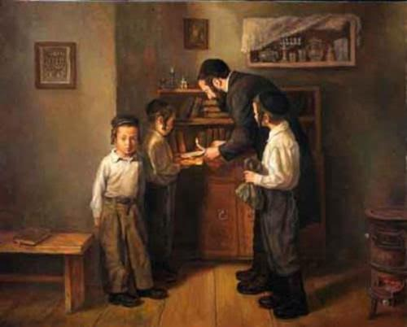

Slide 17
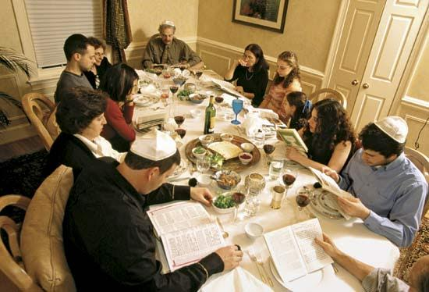

Slide 18


Slide 19
John 1:29
29. John saw Jesus coming toward him, and said, “Behold! The Lamb of God who takes away the sin of the world!

Slide 20


Slide 21
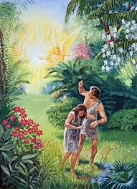

Slide 22
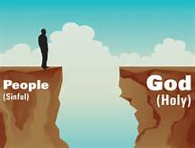

Slide 23
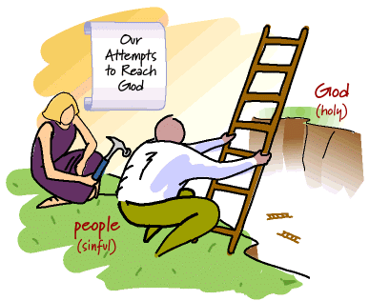

Slide 24
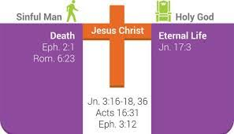

Slide 25
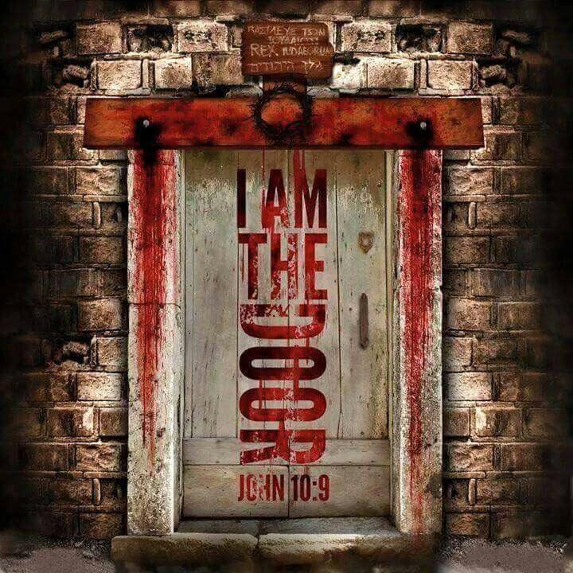

Slide 26
Romans 10:13
13. For “whoever calls on the name of the Lord shall be saved.”

Slide 27
The message of
Exodus 11-12

