Slide 1
You’ve Got on Your
Gum
Shoes
Exodus 3:1-10

Slide 2
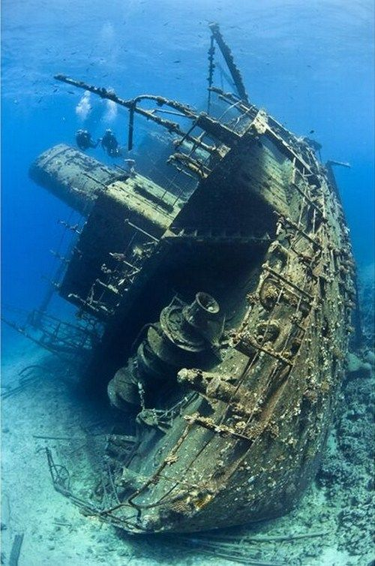

Slide 3
EXODUS 3:1-2
1. Now Moses was tending the flock of Jethro his father-in-law, the priest of Midian. And he led the flock to the back of the desert, and came to Horeb, the mountain of God.

Slide 4
EXODUS 3:1-2
2. And the Angel of the Lord appeared to him in a flame of fire from the midst of a bush. So he looked, and behold, the bush was burning with fire, but the bush was not consumed.

Slide 5
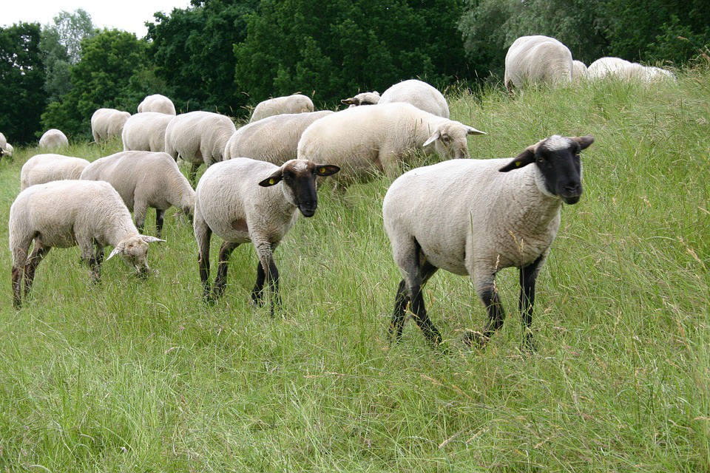

Slide 6
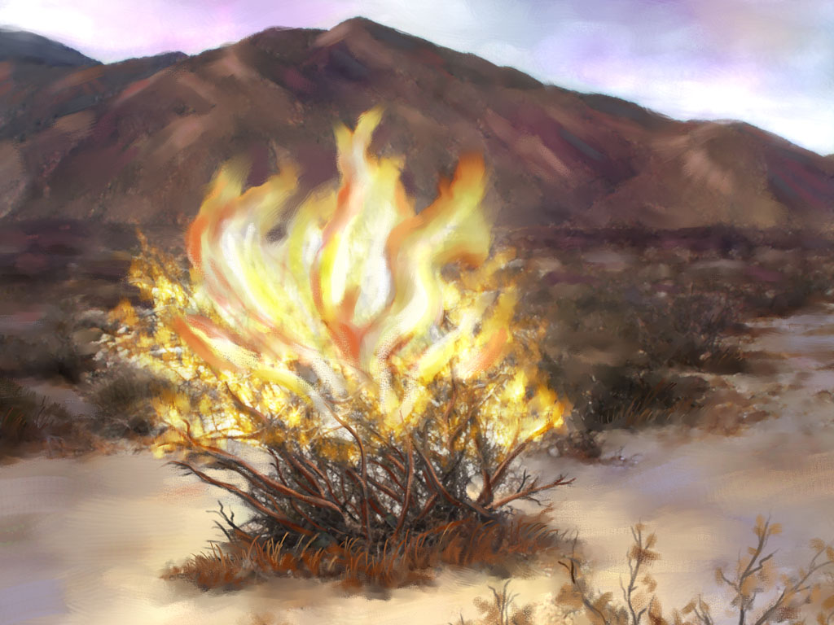

Slide 7
EXODUS 3:3-6
3. Then Moses said, “I will now turn aside and see this great sight, why the bush does not burn.”

Slide 8
EXODUS 3:3-6
4. So when the Lord saw that he turned aside to look, God called to him from the midst of the bush and said, “Moses, Moses!” And he said, “Here I am.”

Slide 9
EXODUS 3:3-6
5. Then He said, “Do not draw near this place. Take your sandals off your feet, for the place where you stand is holy ground.”

Slide 10
EXODUS 3:3-6
6. Moreover He said, “I am the God of your father – the God of Abraham, the God of Isaac, and the God of Jacob.” And Moses hid his face, for he was afraid to look upon God.

Slide 11
We must be ready
for God to
SPEAK and MOVE.

Slide 12
We need a quiet
SPIRIT and open
HEART to hear Him.

Slide 13
We must STOP so God can speak to us.

Slide 14
EXODUS 3:7-9
7. And the Lord said: “I have surely seen the oppression of My people who are in Egypt, and have heard their cry because of their taskmasters, for I know their sorrows.

Slide 15
EXODUS 3:7-9
8. So I have come down to deliver them out of the hand of the Egyptians, and to bring them up from that land to a good and large land, to a land flowing with milk and honey, to the place of the Canaanites and the Hittites

Slide 16
EXODUS 3:7-9
and the Amorites and the Perizzites and the Hivites and the Jebusites.

Slide 17
EXODUS 3:7-9
9. Now therefore, behold, the cry of the children of Israel has come to Me, and I have also seen the oppression with which the Egyptians oppress them.

Slide 18
We must remember God
is WORKING even when we don’t see it.

Slide 19
God knows right
WHERE you are in life.

Slide 20
God is very AWARE
of your situation.

Slide 21
We must SURRENDER
to God’s call.

Slide 22
EXODUS 3:10
10. Come now, therefore, and I will send you to Pharaoh that you may bring My people, the children of Israel, out of Egypt.”

Slide 23
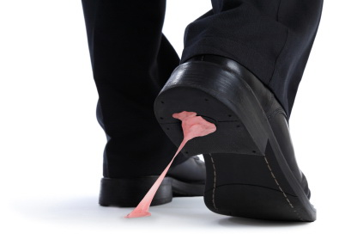

Slide 24
You’ve Got on Your
Gum
Shoes
Exodus 3:1-10

