Slide 1

EXODUS 4:18-31
SWIMMING
in a Kiddie Pool

Slide 2
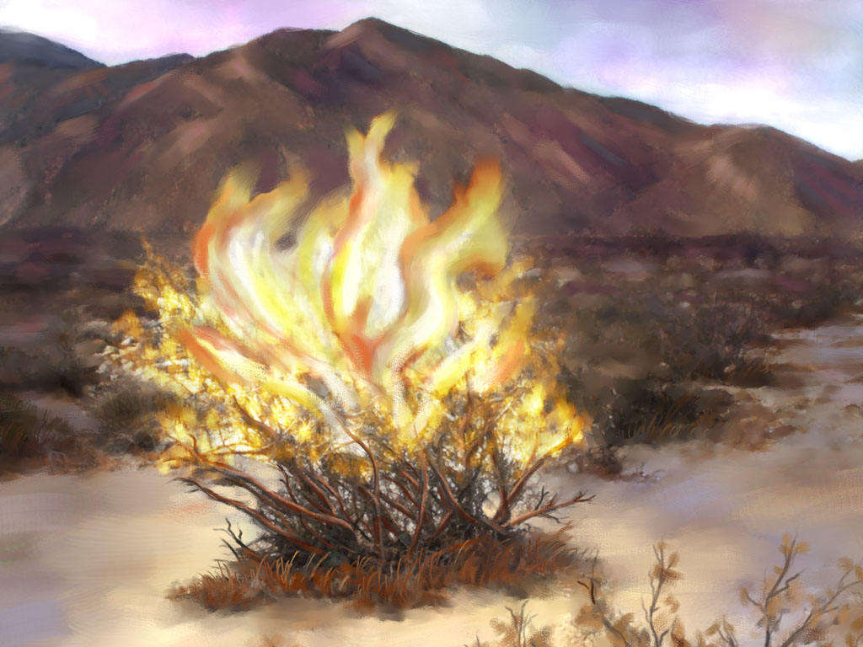

Slide 3
EXODUS 4:18
18. So Moses went and returned to Jethro his father-in-law, and said to him, “Please let me go and return to my brethren who are in Egypt, and see whether they are still alive.” And Jethro said to Moses, “Go in peace.”

Slide 4
God uses His Word, events, and godly counselors to
DIRECT us.

Slide 5
EXODUS 4:19-20
19. Now the Lord said to Moses in Midian, “Go, return to Egypt; for all the men who sought your life are dead.”

Slide 6
EXODUS 4:19-20
20. Then Moses took his wife and his sons and set them on a donkey, and he returned to the land of Egypt. And Moses took the rod of God in his hand.

Slide 7
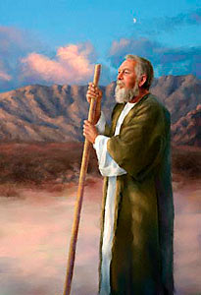

Slide 8
God cares about the
things that WORRY us.

Slide 9
1 PETER 5:7
7. casting all your care upon Him, for He cares for you.

Slide 10
1 PETER 5:7 (Phillips)
7. You can throw the whole weight of your anxieties upon him, for you are his personal concern.

Slide 11
EXODUS 4:20
20. Then Moses took his wife and his sons and set them on a donkey, and he returned to the land of Egypt. And Moses took the rod of God in his hand.

Slide 12
WHATEVER we have becomes the property
or the tool of God.

Slide 13
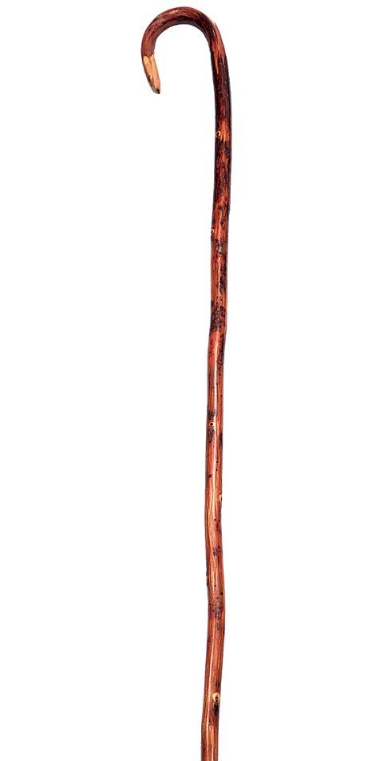
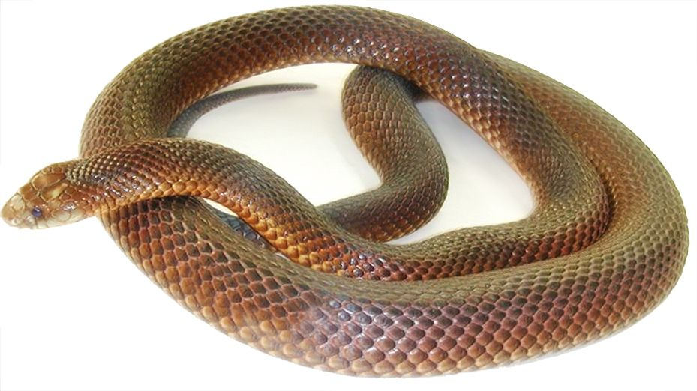

Slide 14
EXODUS 4:21
21. And the Lord said to Moses, “When you go back to Egypt, see that you do all those wonders before Pharaoh which I have put in your hand. But I will harden his heart, so that he will not let the people go.

Slide 15
ROMANS 11:33-34
33. Oh, the depth of the riches both of the wisdom and knowledge of God! How unsearchable are His judgments and His ways past finding out!

Slide 16
ROMANS 11:33-34
34. “For who has known the mind of the Lord? Or who has become His counselor?”

Slide 17

?

Slide 18
We don’t have to
EXPLAIN the will
of God.

Slide 19
We have to
OBEY it.

Slide 20
EXODUS 4:22-23
22. Then you shall say to Pharaoh, ‘Thus says the Lord: “Israel is My son, My firstborn.

Slide 21
EXODUS 4:22-23
23. So I say to you, let My son go that he may serve Me. But if you refuse to let him go, indeed I will kill your son, your firstborn.”

Slide 22
Knowing you’re in the
will of God gives
STRENGTH.

Slide 23
EXODUS 4:25-26
25. Then Zipporah took a sharp stone and cut off the foreskin of her son and cast it at Moses’ feet, and said, “Surely you are a husband of blood to me!”

Slide 24
EXODUS 4:25-26
26. So He let him go. Then she said, “You are a husband of blood!” – because of the circumcision.

Slide 25


Slide 26
God does not take
areas of NEGLECT
lightly.

Slide 27
EXODUS 4:27-28
27. And the Lord said to Aaron, “Go into the wilderness to meet Moses.” So he went and met him on the mountain of God, and kissed him.

Slide 28
EXODUS 4:27-28
28. So Moses told Aaron all the words of the Lord who had sent him, and all the signs which He had commanded him.

Slide 29
EXODUS 4:29-30
29. Then Moses and Aaron went and gathered together all the elders of the children of Israel.

Slide 30
EXODUS 4:29-30
30. And Aaron spoke all the words which the Lord had spoken to Moses. Then he did the signs in the sight of the people.

Slide 31
EXODUS 4:31
31. So the people believed; and when they heard that the Lord had visited the children of Israel and that He had looked on their affliction, then they bowed their heads and worshiped.

Slide 32
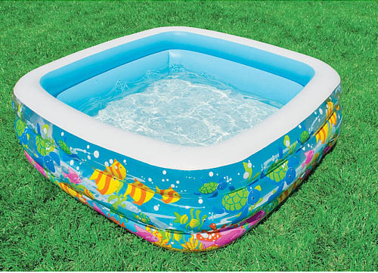

Slide 33
PROVERBS 3:5-6
5. Trust in the Lord with all your heart, and lean not on your own understanding;

Slide 34
PROVERBS 3:5-6
6. In all your ways acknowledge Him, and He shall direct your paths.

Slide 35
PROVERBS 16:7
7. When a man’s ways please the Lord, He makes even his enemies to be at peace with him.

Slide 36
EXODUS 4:18-31
SWIMMING
in a Kiddie Pool

