Slide 1
God’s School
of the
Wilderness
Part 2
DEUTERONOMY 8:2

Slide 3
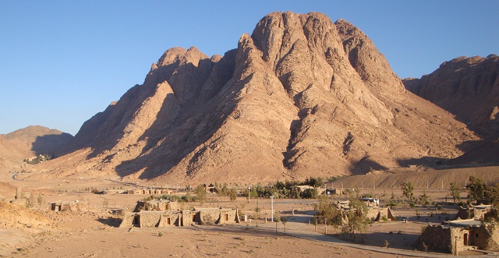

Slide 4
DEUTERONOMY 8:2
2. And you shall remember that the Lord your God led you all the way these forty years in the wilderness, to humble you and test you, to know what was in your heart, whether you would keep His commandments or not.

Slide 5
In the desert…
we become OBSCURE.

Slide 6
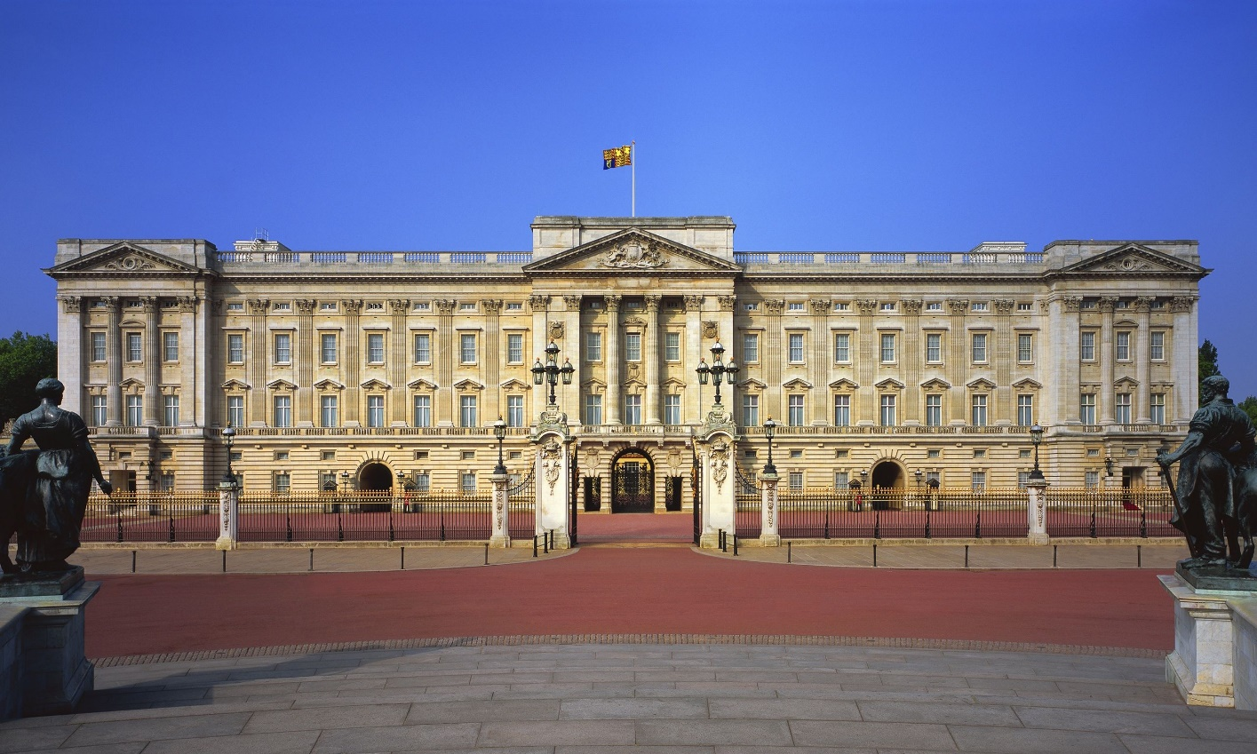
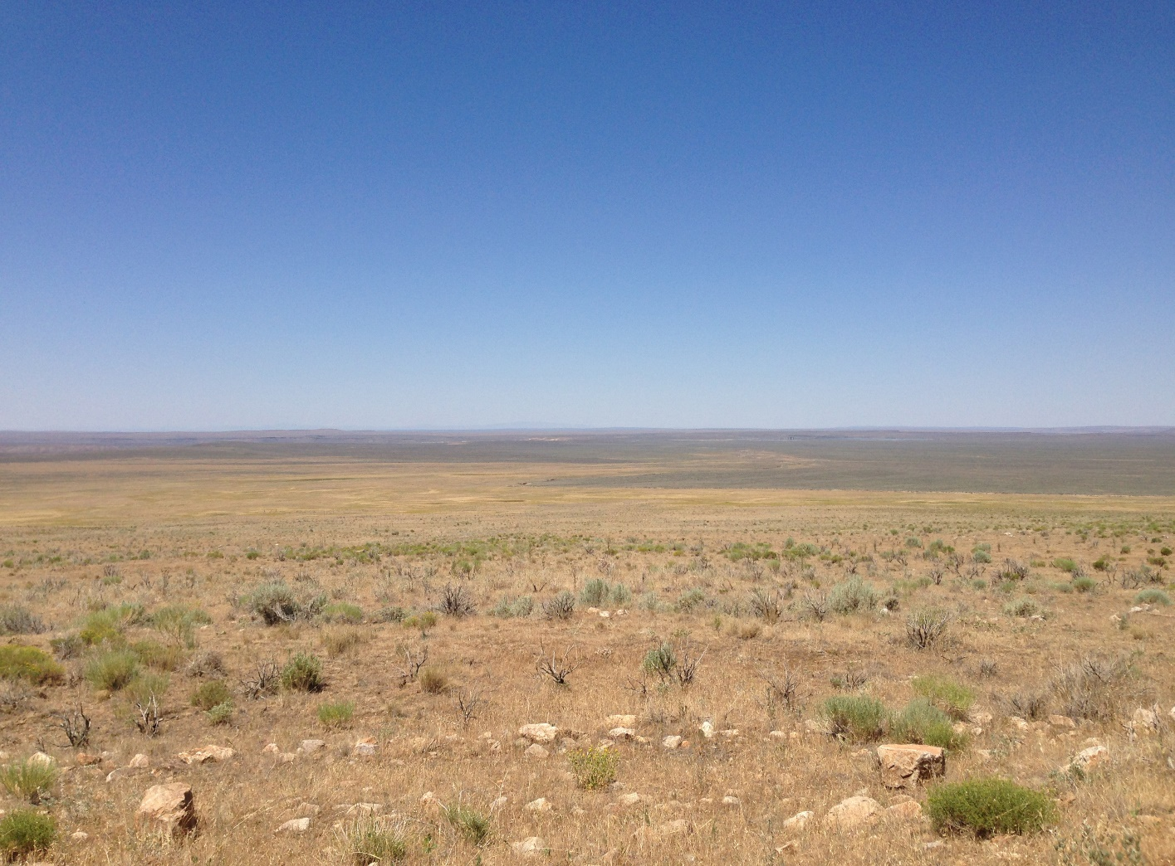

Slide 7
In the desert…
TIME is forgotten.

Slide 9
In the desert…
we experience SOLITUDE.

Slide 11
In the desert, we…
will experience
DISCOMFORT.

Slide 12
In the desert, we…
have different
REACTIONS.

Slide 13
“I don’t NEED this.”

Slide 14
“I’m TIRED of this.”

Slide 15
“I ACCEPT this.”

Slide 17
ACTS 7:29-30
29. Then, at this saying, Moses fled and became a dweller in the land of Midian, where he had two sons.

Slide 18
ACTS 7:29-30
30. “And when forty years had passed, an Angel of the Lord appeared to him in a flame of fire in a bush, in the wilderness of Mount Sinai.

Slide 19
PSALM 119:74
74. Those who fear You will be glad when they see me, because I have hoped in Your word.

Slide 20
PSALM 119:79
79. Let those who fear You turn to me, those who know Your testimonies.

Slide 21
God’s School
of the
Wilderness
Part 2
DEUTERONOMY 8:2

