Slide 1
God’s School
of the
Wilderness
Part 1
DEUTERONOMY 32:10-12

Slide 2
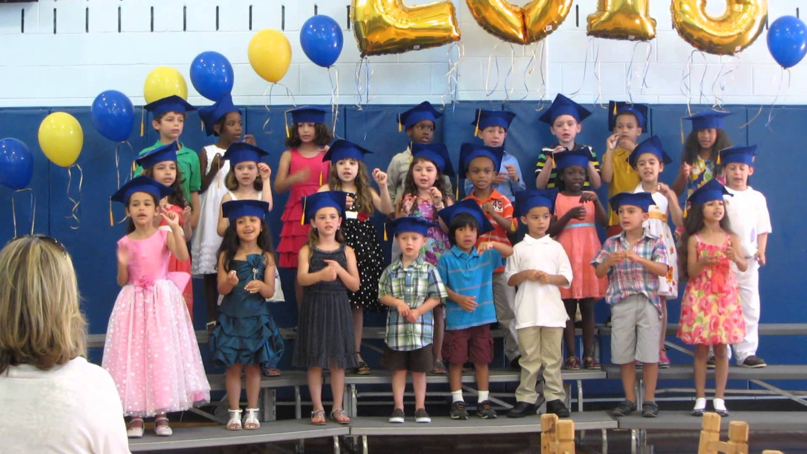

Slide 6
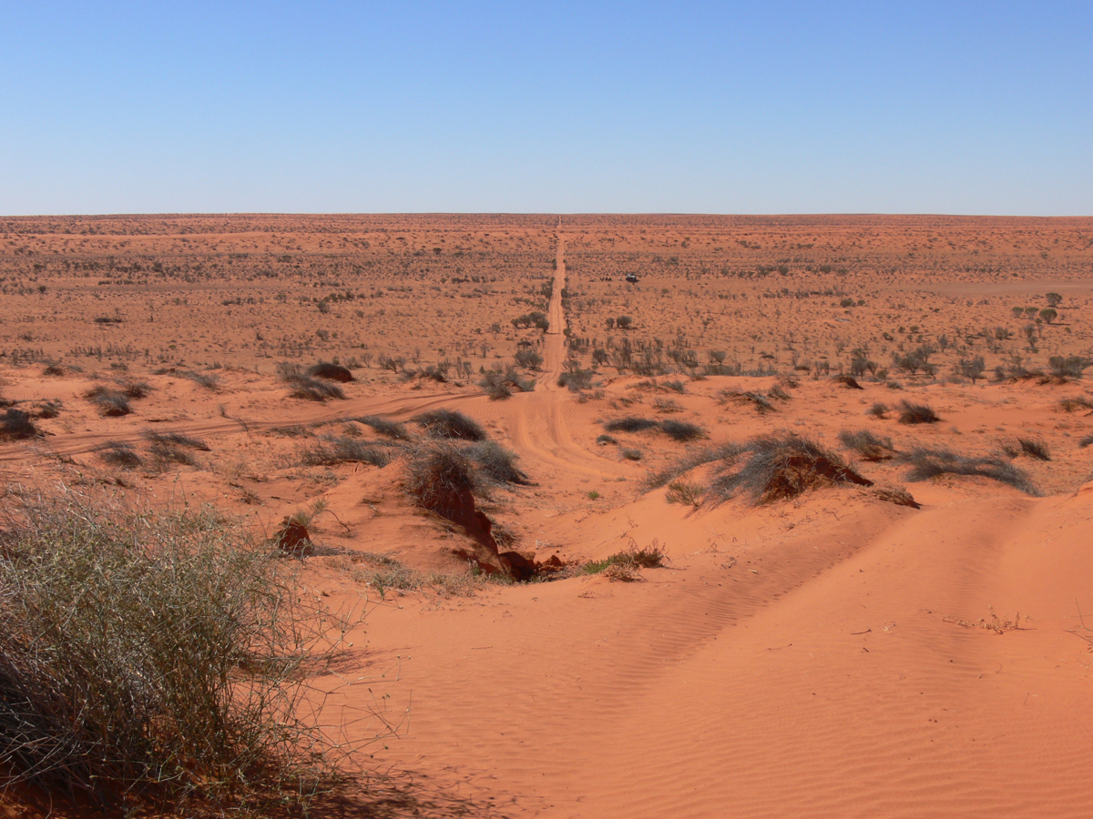

Slide 7
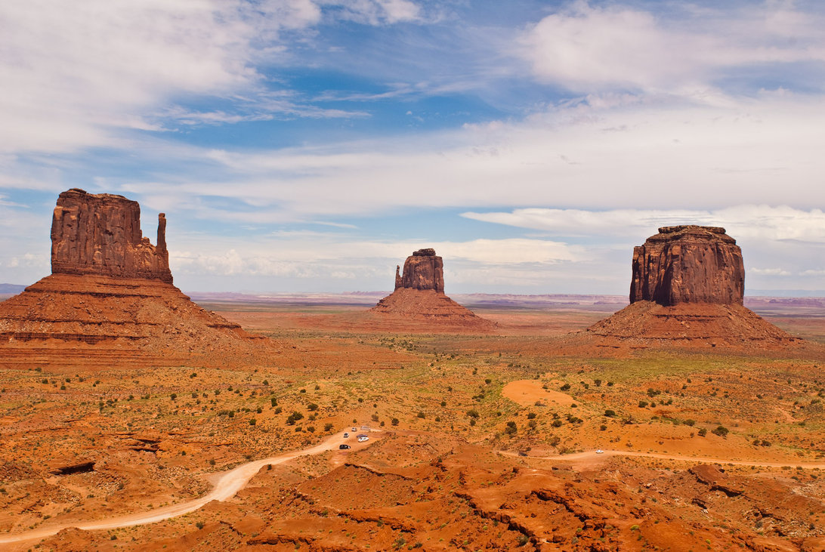

Slide 9
DEUTERONOMY 32:10
10. “He found him in a desert land and in the wasteland, a howling wilderness; He encircled him, He instructed him, He kept him as the apple of His eye.

Slide 10
DEUTERONOMY 32:10 (NLT)
10. He found them in a desert land, in an empty, howling wasteland. He surrounded them and watched over them; he guarded them as he would guard his own eyes.

Slide 11
DEUTERONOMY 32:10 (NLT)
10. He found them in a desert land, in an empty, howling wasteland. He surrounded them and watched over them; he guarded them as he would guard his own eyes.

Slide 12
God SURROUNDS
us while in the desert.

Slide 13
God WATCHES
over us in the desert.

Slide 14
God GUARDS
us in the desert.

Slide 16
God’s School
of the
Wilderness
Part 1
DEUTERONOMY 32:10-12

