Slide 1
GOD’S WILL,
MY WAY
Exodus 2:11-15
Acts 7:20-29

Slide 2
ACTS 7:20-29
20. At this time Moses was born, and was well pleasing to God; and he was brought up in his father’s house for three months.

Slide 3
ACTS 7:20-29
21. But when he was set out, Pharaoh’s daughter took him away and brought him up as her own son.

Slide 4
ACTS 7:20-29
22. And Moses was learned in all the wisdom of the Egyptians, and was mighty in words and deeds.

Slide 5
ACTS 7:20-29
23. “Now when he was forty years old, it came into his heart to visit his brethren, the children of Israel.

Slide 6
ACTS 7:20-29
24. And seeing one of them suffer wrong, he defended and avenged him who was oppressed, and struck down the Egyptian.

Slide 7
ACTS 7:20-29
25. For he supposed that his brethren would have understood that God would deliver them by his hand, but they did not understand.

Slide 8
ACTS 7:20-29
26. And the next day he appeared to two of them as they were fighting, and tried to reconcile them, saying, ‘Men, you are brethren; why do you wrong one another?’

Slide 9
ACTS 7:20-29
27. But he who did his neighbor wrong pushed him away, saying, ‘Who made you a ruler and a judge over us?

Slide 10
ACTS 7:20-29
28. Do you want to kill me as you did the Egyptian yesterday?’

Slide 11
ACTS 7:20-29
29. Then, at this saying, Moses fled and became a dweller in the land of Midian, where he had two sons.

Slide 12
We get in trouble when we HELP God along.

Slide 13
We must be energized by HOLY SPIRIT.

Slide 14
We must be dedicated to GOD and not just
His will.

Slide 15
We must be careful
to do God’s WILL
God’s WAY.

Slide 16
EXODUS 2:15
15. When Pharaoh heard of this matter, he sought to kill Moses. But Moses fled from the face of Pharaoh and dwelt in the land of Midian; and he sat down
by a well.

Slide 17
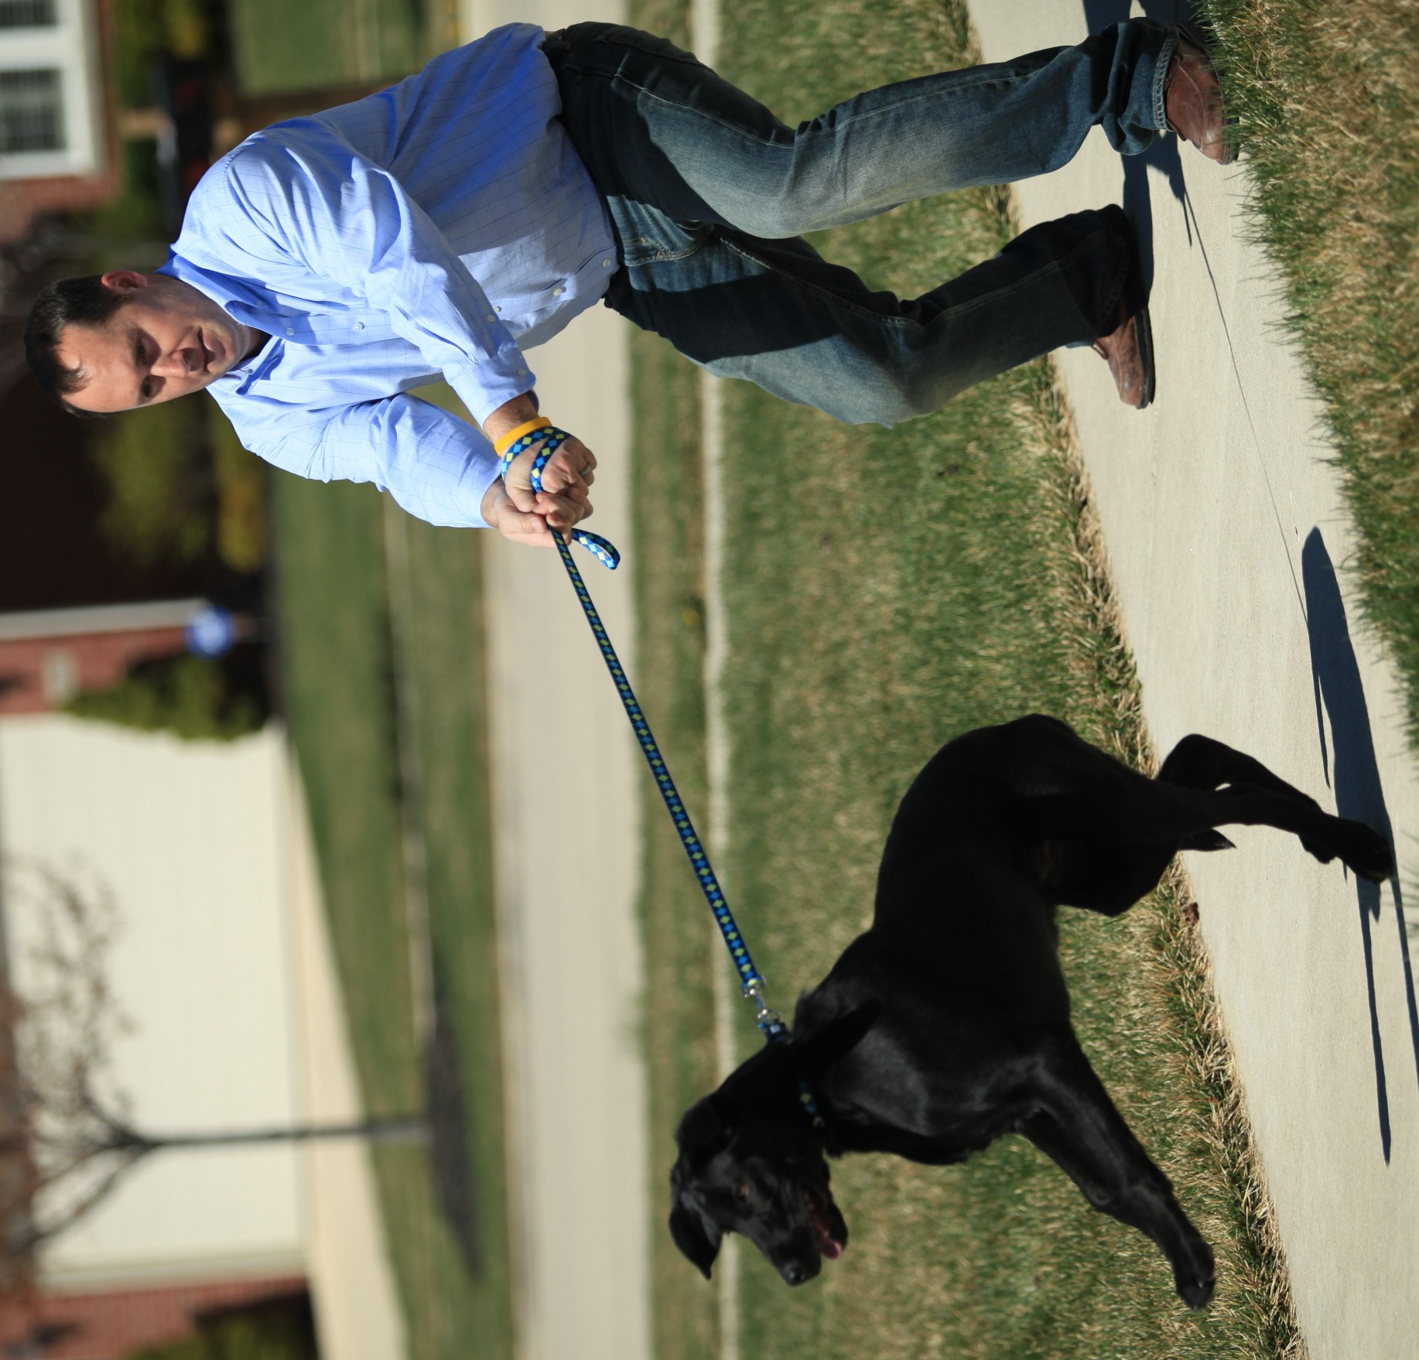

Slide 18
GOD’S WILL,
MY WAY
Exodus 2:11-15
Acts 7:20-29

