Slide 1
WHERE’S YOUR
DEVOTION?
________________________________
MATTHEW 26:10-29

Slide 2
Mary’s devotion
to JESUS.

Slide 3
MATTHEW 26:6-13
6. And when Jesus was in Bethany at the house of Simon the leper,

Slide 4
MATTHEW 26:6-13
7. a woman came to Him having an alabaster flask of very costly fragrant oil, and she poured it on His head as He sat at the table.

Slide 5
MATTHEW 26:6-13
8. But when His disciples saw it, they were indignant, saying, “Why this waste?

Slide 6
MATTHEW 26:6-13
9. For this fragrant oil might have been sold for much and given to the poor.”

Slide 7
MATTHEW 26:6-13
10. But when Jesus was aware of it, He said to them, “Why do you trouble the woman? For she has done a good work for Me.

Slide 8
MATTHEW 26:6-13
11. For you have the poor with you always, but Me you do not have always.

Slide 9
MATTHEW 26:6-13
12. For in pouring this fragrant oil on My body, she did it for My burial.

Slide 10
MATTHEW 26:6-13
13. Assuredly, I say to you, wherever this gospel is preached in the whole world, what this woman has done will also be told as a memorial to her.”

Slide 11
Judas’s devotion
to HIMSELF.

Slide 12
MATTHEW 26:14-16
14. Then one of the twelve, called Judas Iscariot, went to the chief priests

Slide 13
MATTHEW 26:14-16
15. and said, “What are you willing to give me if I deliver Him to you?” And they counted out to him thirty pieces of silver.

Slide 14
MATTHEW 26:14-16
16. So from that time he sought opportunity to betray Him.

Slide 15
MATTHEW 26:17-19
17. Now on the first day of the Feast of Unleavened Bread the disciples came to Jesus, saying to Him, “Where do You want us to prepare for You to eat the Passover?”

Slide 16
MATTHEW 26:17-19
18. And He said, “Go into the city to a certain man, and say to him, ‘The Teacher says, “My time is at hand; I will keep the Passover at your house with My disciples.”’”

Slide 17
MATTHEW 26:17-19
19. So the disciples did as Jesus had directed them; and they prepared the Passover.

Slide 18
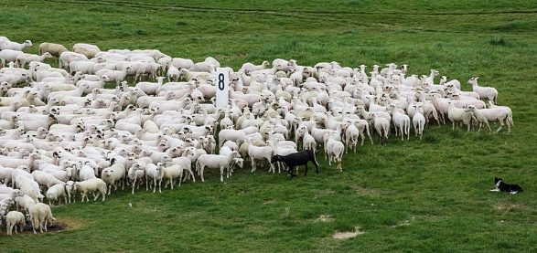

Slide 20
HEBREWS 10:4
4. For it is not possible that the blood of bulls and goats could take away sins.

Slide 21
HEBREWS 10:12
12. But this Man, after He had offered one sacrifice for sins forever, sat down at the right hand of God,

Slide 22
Jesus’ devotion
to the FATHER.

Slide 23
MATTHEW 26:20-25
20. When evening had come, He sat down with the twelve.

Slide 24
MATTHEW 26:20-25
21. Now as they were eating, He said, “Assuredly, I say to you, one of you will betray Me.”

Slide 25
MATTHEW 26:20-25
22. And they were exceedingly sorrowful, and each of them began to say to Him, “Lord, is
it I?”

Slide 26
MATTHEW 26:20-25
23. He answered and said, “He who dipped his hand with Me in the dish will betray Me.

Slide 27
MATTHEW 26:20-25
24. The Son of Man indeed goes just as it is written of Him, but woe to that man by whom the Son of Man is betrayed! It would have been good for that man if he had not been born.”

Slide 28
MATTHEW 26:20-25
25. Then Judas, who was betraying Him, answered and said, “Rabbi, is it I?” He said to him, “You have said it.”

Slide 29
MATTHEW 26:26-29
26. And as they were eating, Jesus took bread, blessed and broke it, and gave it to the disciples and said, “Take, eat; this is My body.”

Slide 30
MATTHEW 26:26-29
27. Then He took the cup, and gave thanks, and gave it to them, saying, “Drink from it, all of you.

Slide 31
MATTHEW 26:26-29
28. For this is My blood of the new covenant, which is shed for many for the remission of sins.

Slide 32
MATTHEW 26:26-29
29. But I say to you, I will not drink of this fruit of the vine from now on until that day when I drink it new with you in My Father’s kingdom.”

Slide 33
WHERE’S YOUR
DEVOTION?
________________________________
MATTHEW 26:10-29

