Slide 1
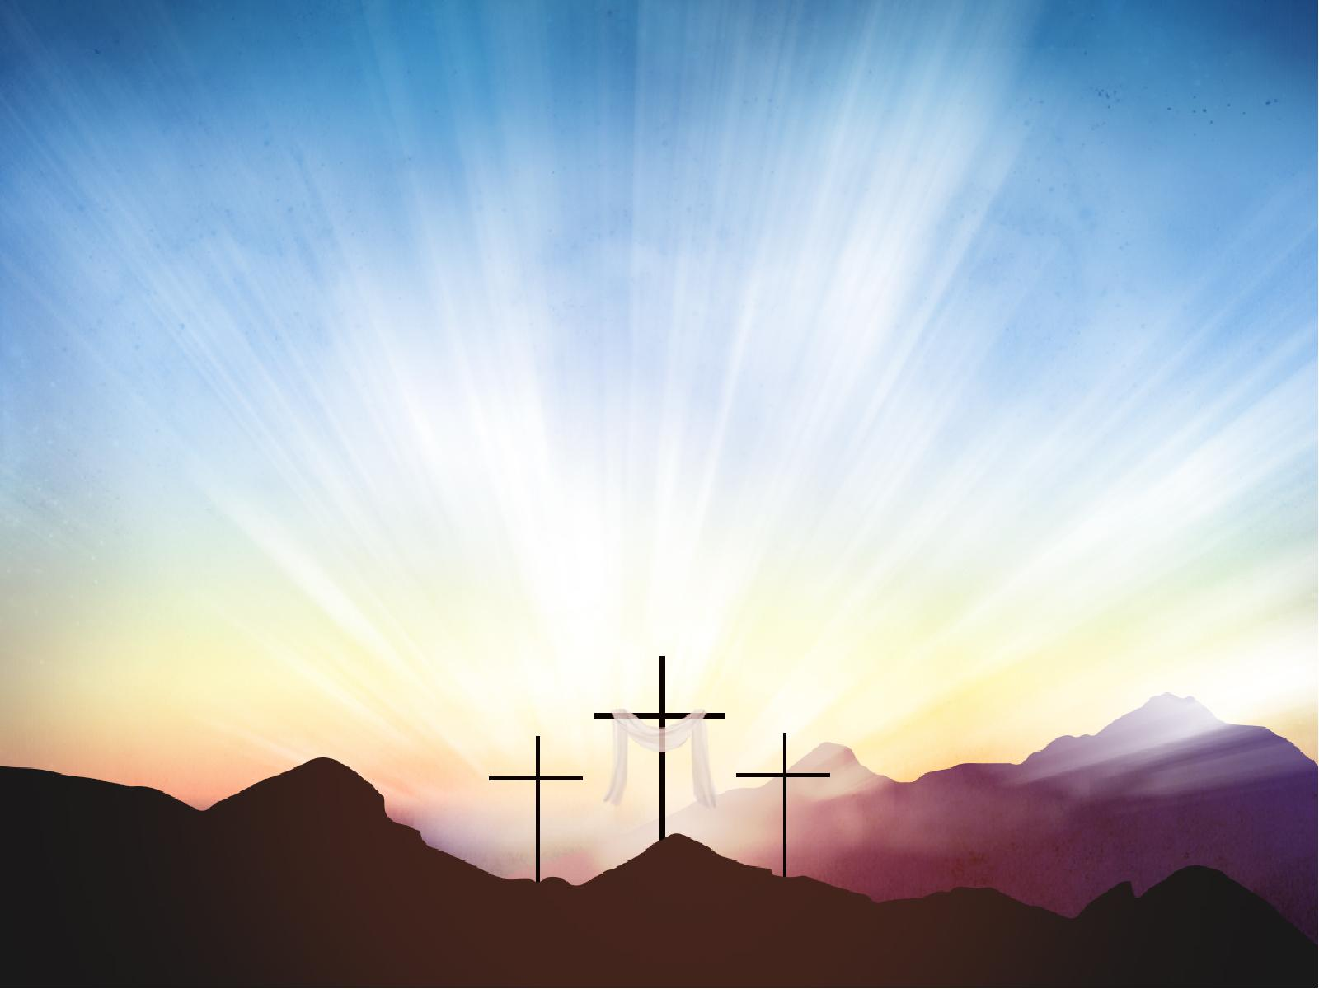
BUILT TO
LAST
1 CORINTHIANS 15

Slide 2
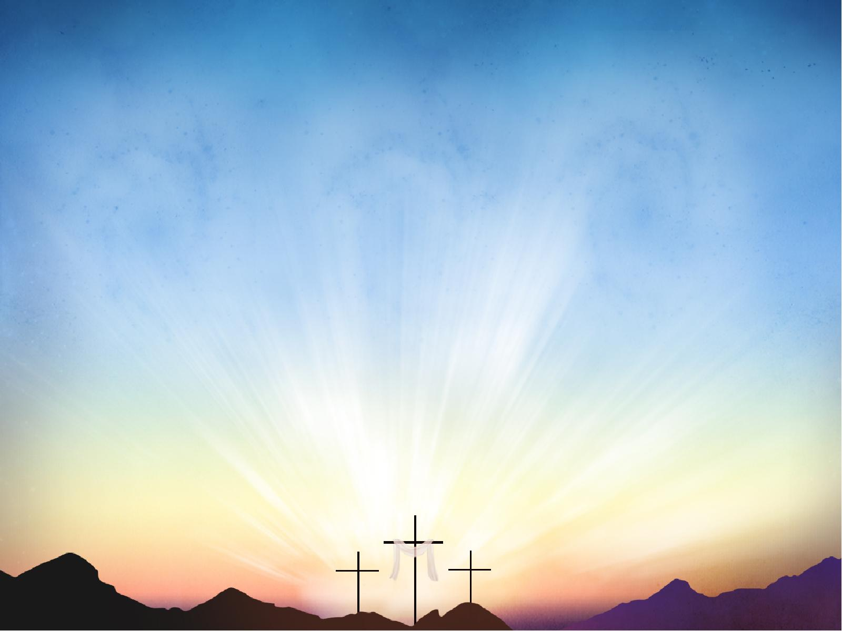
1 CORINTHIANS 15:1-4
1. Moreover, brethren, I declare to you the gospel which I preached to you, which also you received and in which you stand,

Slide 3
1 CORINTHIANS 15:1-4
2. by which also you are saved, if you hold fast that word which I preached to you – unless you believed in vain.

Slide 4
1 CORINTHIANS 15:1-4
3. For I delivered to you first of all that which I also received: that Christ died for our sins according to the Scriptures,

Slide 5
1 CORINTHIANS 15:1-4
4. and that He was buried, and that He rose again the third day according to the Scriptures,

Slide 6
1 CORINTHIANS 15:14
14. And if Christ is not risen, then our preaching is empty and your faith is also empty.

Slide 7
1 CORINTHIANS 15:17-19
17. And if Christ is not risen, your faith is futile; you are still in your sins!

Slide 8
1 CORINTHIANS 15:17-19
18. Then also those who have fallen asleep in Christ have perished.

Slide 9
1 CORINTHIANS 15:17-19
19. If in this life only we have hope in Christ, we are of all men the most pitiable.

Slide 10
1 CORINTHIANS 15:35-49
35. But someone will say, “How are the dead raised up? And with what body do they come?”

Slide 11
1 CORINTHIANS 15:35-49
36. Foolish one, what you sow is not made alive unless it dies.

Slide 12
1 CORINTHIANS 15:35-49
37. And what you sow, you do not sow that body that shall be, but mere grain – perhaps wheat or some other grain.

Slide 13
1 CORINTHIANS 15:35-49
38. But God gives it a body as He pleases, and to each seed its own body.

Slide 14
1 CORINTHIANS 15:35-49
39. All flesh is not the same flesh, but there is one kind of flesh of men, another flesh of animals, another of fish, and another of birds.

Slide 15
1 CORINTHIANS 15:35-49
40. There are also celestial bodies and terrestrial bodies; but the glory of the celestial is one, and the glory of the terrestrial is another.

Slide 16
1 CORINTHIANS 15:35-49
41. There is one glory of the sun, another glory of the moon, and another glory of the stars; for one star differs from another star in glory.

Slide 17
1 CORINTHIANS 15:35-49
42. So also is the resurrection of the dead. The body is sown in corruption, it is raised in incorruption.

Slide 18
1 CORINTHIANS 15:35-49
43. It is sown in dishonor, it is raised in glory. It is sown in weakness, it is raised in power.

Slide 19
1 CORINTHIANS 15:35-49
44. It is sown a natural body, it is raised a spiritual body. There is a natural body, and there is a spiritual body.

Slide 20
1 CORINTHIANS 15:35-49
45. And so it is written, “The first man Adam became a living being.” The last Adam became a life-giving spirit.

Slide 21
1 CORINTHIANS 15:35-49
46. However, the spiritual is not first, but the natural, and afterward the spiritual.

Slide 22
1 CORINTHIANS 15:35-49
47. The first man was of the earth, made of dust; the second Man is the Lord from heaven.

Slide 23
1 CORINTHIANS 15:35-49
48. As was the man of dust, so also are those who are made of dust; and as is the heavenly Man, so also are those who are heavenly.

Slide 24
1 CORINTHIANS 15:35-49
49. And as we have borne the image of the man of dust, we shall also bear the image of the heavenly Man.

Slide 25
BUILT TO
LAST
1 CORINTHIANS 15

