Slide 1
MATTHEW 13:44-46
FINDERS
KEEPERS

Slide 2
MATTHEW 13:44-46
44. “Again, the kingdom of heaven is like treasure hidden in a field, which a man found and hid; and for joy over it he goes and sells all that he has and buys that field.

Slide 3
MATTHEW 13:44-46
45. “Again, the kingdom of heaven is like a merchant seeking beautiful pearls,

Slide 4
MATTHEW 13:44-46
46. who, when he had found one pearl of great price, went and sold all that he had and bought it.

Slide 5
Salvation
requires PERSONAL acceptance.

Slide 6
Romans 9:6-7
6. But it is not that the word of God has taken no effect. For they are not all Israel who are of Israel,

Slide 7
Romans 9:6-7
7. nor are they all children because they are the seed of Abraham; but, “In Isaac your seed shall be called.”

Slide 8
Salvation is
PRICELESS.

Slide 9
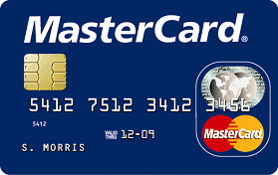

Slide 10
Salvation’s value
is not seen in the
NATURAL.

Slide 11
Luke 17:20-21
20. Now when He was asked by the Pharisees when the kingdom of God would come, He answered them and said, “The kingdom of God does not come with observation;

Slide 12
Luke 17:20-21
21. nor will they say, ‘See here!’ or ‘See there!’ For indeed, the kingdom of God is within you.”

Slide 13
Matthew 16:27-28
27. For the Son of Man will come in the glory of His Father with His angels, and then He will reward each according to his works.

Slide 14
Matthew 16:27-28
28. Assuredly, I say to you, there are some standing here who shall not taste death til they see the Son of Man coming in His kingdom.”

Slide 15
John 18:36
36. Jesus answered, “My kingdom is not of this world. If My kingdom were of this world, My servants would fight, so that I should not be delivered to the Jews; but now My kingdom is not from here.”

Slide 16
1 Corinthians 2:14
14. But the natural man does not receive the things of the Spirit of God, for they are foolishness to him; nor can he know them, because they are spiritually discerned.

Slide 17
2 Corinthians 4:4
4. whose minds the god of this age has blinded, who do not believe, lest the light of the gospel of the glory of Christ, who is the image of God, should shine on them.

Slide 18
Salvation is the
only thing that brings TRUE JOY.

Slide 19
1 John 1:4
4. And these things we write to you that your joy may be full.

Slide 20
Realizing our need of
salvation comes to us
DIFFERENTLY.

Slide 21
Acts 17:10-12
10. Then the brethren immediately sent Paul and Silas away by night to Berea. When they arrived, they went into the synagogue of the Jews.

Slide 22
Acts 17:10-12
11. These were more fair-minded than those in Thessalonica, in that they received the word with all readiness, and searched the Scriptures daily to find out whether these things were so.

Slide 23
Acts 17:10-12
12. Therefore many of them believed, and also not a few of the Greeks, prominent women as well as men.

Slide 24
Salvation requires a
DECISION.

Slide 25
ISAIAH 64:6
6. But we are all like an unclean thing, and all our righteousness are like filthy rags; we all fade as a leaf, and our iniquities, like the wind, have taken us away.

Slide 26
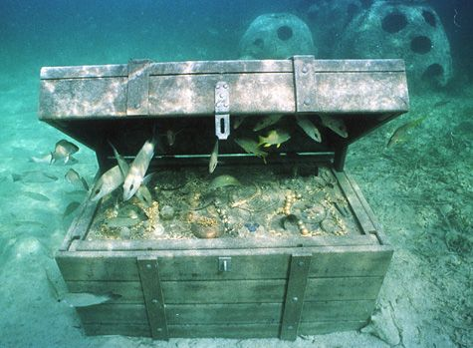

Slide 27
MATTHEW 13:44-46
FINDERS
KEEPERS

