Slide 1

Box of Chocolates
Matthew
14:34-15:20

Slide 2

Exodus 20:7
7. “You shall not take the name of the Lord your God in vain, for the Lord will not hold him guiltless who takes His name in vain.

Slide 3
Isaiah 1:13-15
13. Bring no more futile sacrifices; Incense is an abomination to Me. The New Moons, the Sabbaths, and the calling of assemblies – I cannot endure iniquity and
the sacred meeting.

Slide 4
Isaiah 1:13-15
14. Your New Moons and your appointed feasts My soul hates; they are a trouble to Me, I am weary of bearing them.

Slide 5
Isaiah 1:13-15
15. When you spread out your hands, I will hide My eyes from you; Even though you make many prayers, I will not hear. Your hands are full of blood.

Slide 6
Isaiah 66:2-3
2. For all those things My hand has made, and all those things exist,” says the Lord. “But on this one will I look: on him who is poor and of a contrite spirit, and who
trembles at My word.

Slide 7
Isaiah 66:2-3
3. “He who kills a bull is as if he slays a man; He who sacrifices a lamb, as if he breaks a dog’s neck; He who offers a grain offering, as if he offers swine’s blood; He who burns
incense, as if he blesses

Slide 8
Isaiah 66:2-3
an idol. Just as they have chosen their own ways, and their soul delights in their abominations,

Slide 9
Amos 5:21-24
21. “I hate, I despise your feast days, and I do not savor your sacred assemblies.

Slide 10
Amos 5:21-24
22. Though you offer Me burnt offerings and your grain offerings, I will not accept them, nor will I regard your fattened peace offerings.

Slide 11
Amos 5:21-24
23. Take away from Me the noise of your songs, for I will not hear the melody of your stringed instruments.

Slide 12
Amos 5:21-24
24. But let justice run down like water, and righteousness like a mighty stream.

Slide 13
Unless a person’s heart
is cleansed, he cannot worship God ACCEPTABLY.

Slide 14
Matthew 14:34-36
34. When they had crossed over, they came to the land of Gennesaret.

Slide 15
Matthew 14:34-36
35. And when the men of that place recognized Him, they sent out into all that surrounding region, brought to Him all who were sick,

Slide 16
Matthew 14:34-36
36. and begged Him that they might only touch the hem of His garment. And as many as touched it were made perfectly well.

Slide 17
Matthew 15:1-2
1. Then the scribes and Pharisees who were from Jerusalem came to Jesus, saying,

Slide 18
Matthew 15:1-2
2. “Why do Your disciples transgress the tradition of the elders? For they do not wash their hands when they eat bread.”

Slide 19
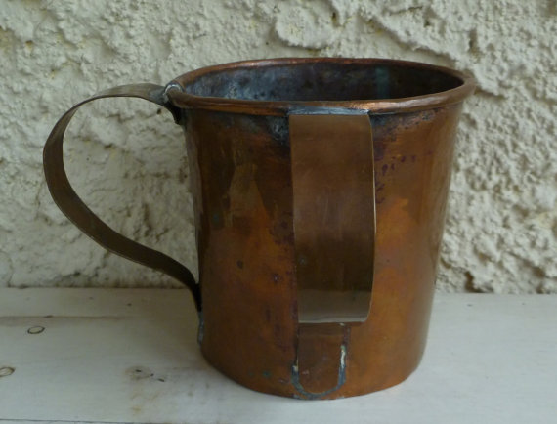

Slide 20
Wanted to APPEAR righteous but not BE righteous .

Slide 21
Matthew 15:3-9
3. He answered and said to them, “Why do you also transgress the commandment of God because of your tradition?

Slide 22
Matthew 15:3-9
4. For God commanded, saying, ‘Honor your father and your mother’; and, ‘He who curses father or mother, let him be put to death.’

Slide 23
Matthew 15:3-9
5. But you say, ‘Whoever says to his father or mother, “Whatever profit you might have received from me is a gift to God” -

Slide 24
Matthew 15:3-9
6. then he need not honor his father or mother.’ Thus you have made the commandment of God of no effect by your tradition.

Slide 25
Matthew 15:3-9
7. Hypocrites! Well did Isaiah prophesy about you, saying:

Slide 26
Matthew 15:3-9
8. ‘These people draw near to Me with their mouth, and honor Me with their lips, but their heart is far from Me.

Slide 27
Matthew 15:3-9
9. And in vain they worship Me, teaching as doctrines the commandments of men.’”

Slide 28
Traditions require no conviction, TRUST, or dependence on God.

Slide 29
Traditions can take a person FURTHER
from God.

Slide 30
Matthew 15:10-11
10. When He had called the multitude to Himself, He said to them, “Hear and understand:

Slide 31
Matthew 15:10-11
11. Not what goes into the mouth defiles a man; but what comes out of the mouth, this defiles a man.”

Slide 32
Man’s spiritual problem is on the INSIDE
not the OUTSIDE.

Slide 33
Matthew 15:12-14
12. Then His disciples came and said to Him, “Do You know that the Pharisees were offended when they heard this saying?”

Slide 34
Matthew 15:12-14
13. But He answered and said, “Every plant which My heavenly Father has not planted will be uprooted.

Slide 35
Matthew 15:12-14
14. Let them alone. They are blind leaders of the blind. And if the blind leads the blind, both will fall into a ditch.”

Slide 36
Religious hypocrites
are easily OFFENDED
and fall into JUDGMENT.

Slide 37
Matthew 15:15-20
15. Then Peter answered and said to Him, “Explain this parable to us.”

Slide 38
Matthew 15:15-20
16. So Jesus said, “Are you also still without understanding?

Slide 39
Matthew 15:15-20
17. Do you not yet understand that whatever enters the mouth goes into the stomach and is eliminated?

Slide 40
Matthew 15:15-20
18. But those things which proceed out of the mouth come from the heart, and they defile a man.

Slide 41
Matthew 15:15-20
19. For out of the heart proceed evil thoughts, murders, adulteries, fornications, thefts, false witness, blasphemies.

Slide 42
Matthew 15:15-20
20. These are the things which defile a man, but to eat with unwashed hands does not defile a man.”

Slide 43
Man must not be more concerned with outside RITUALS than inside RIGHTEOUSNESS.

Slide 44
God’s righteousness comes from WITHIN
with real heart change.

Slide 45
Box of Chocolates
Matthew
14:34-15:20

